Slide 1


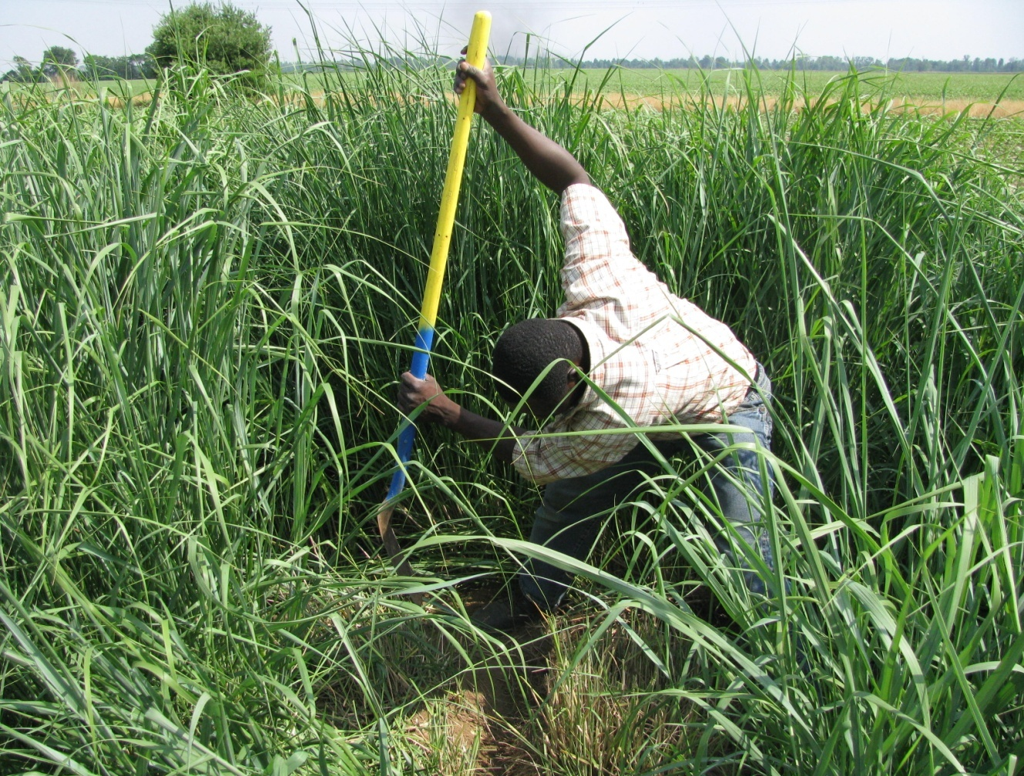
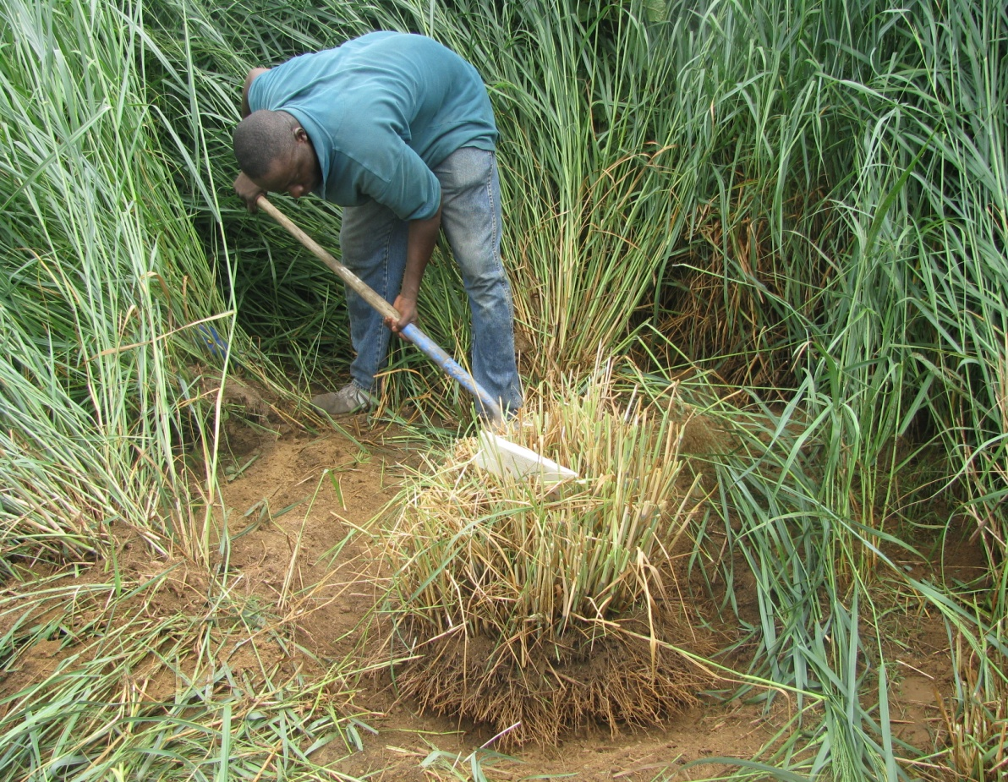
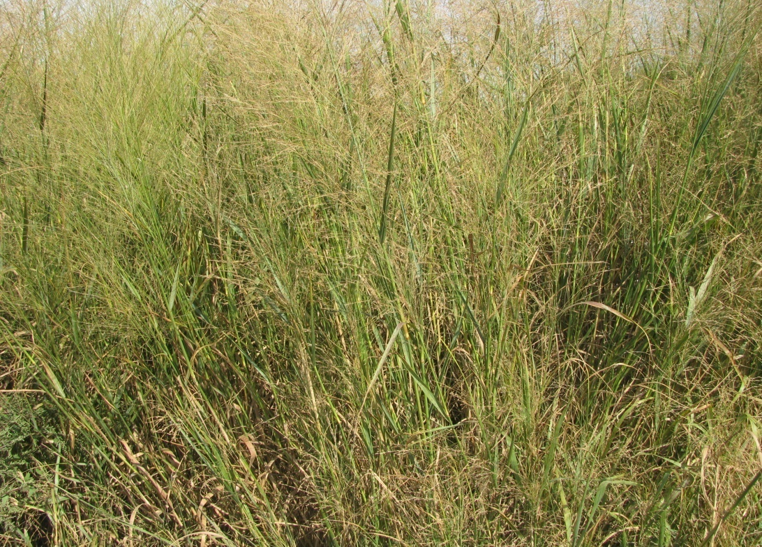
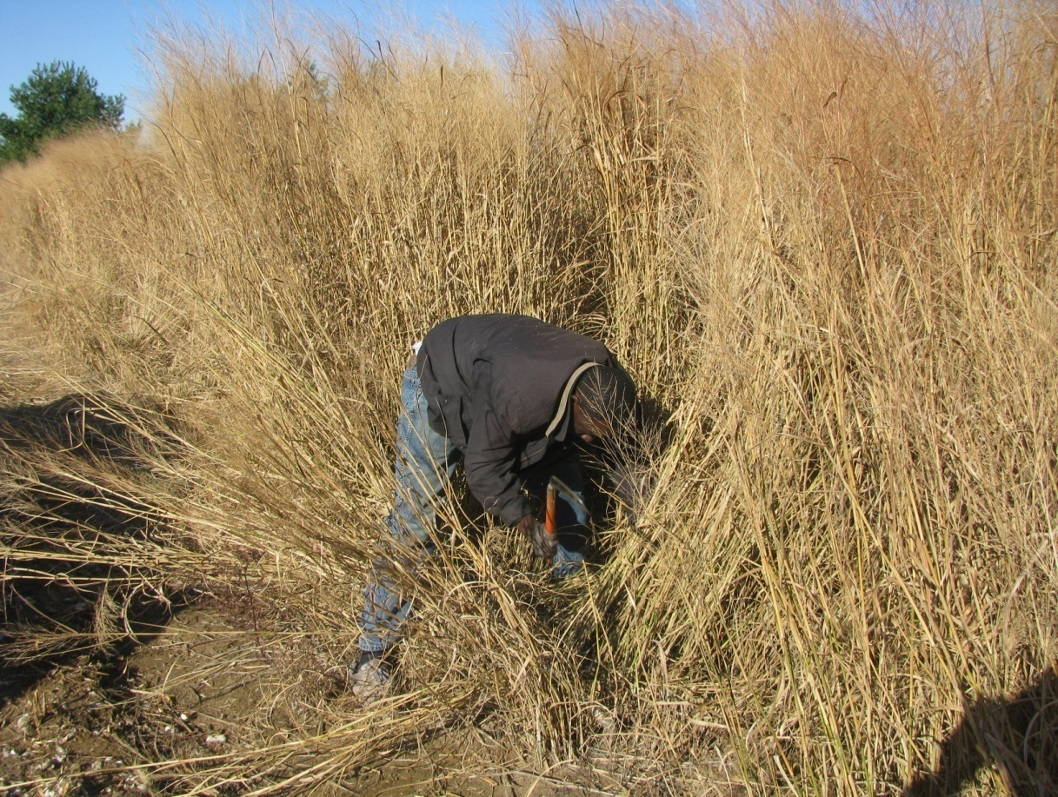
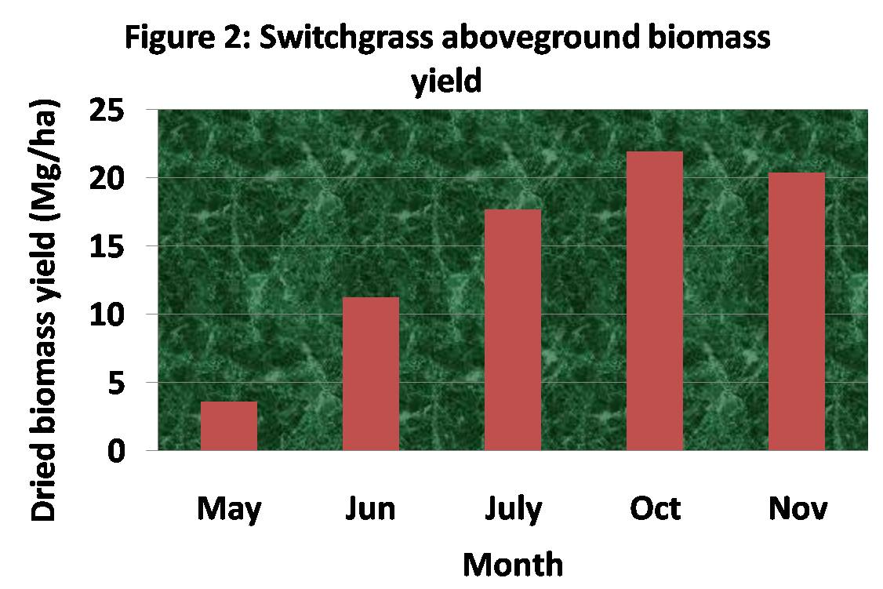
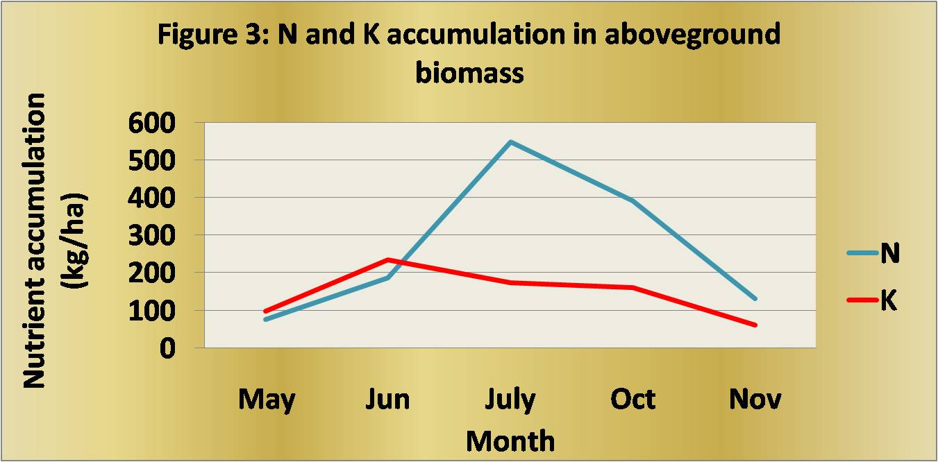
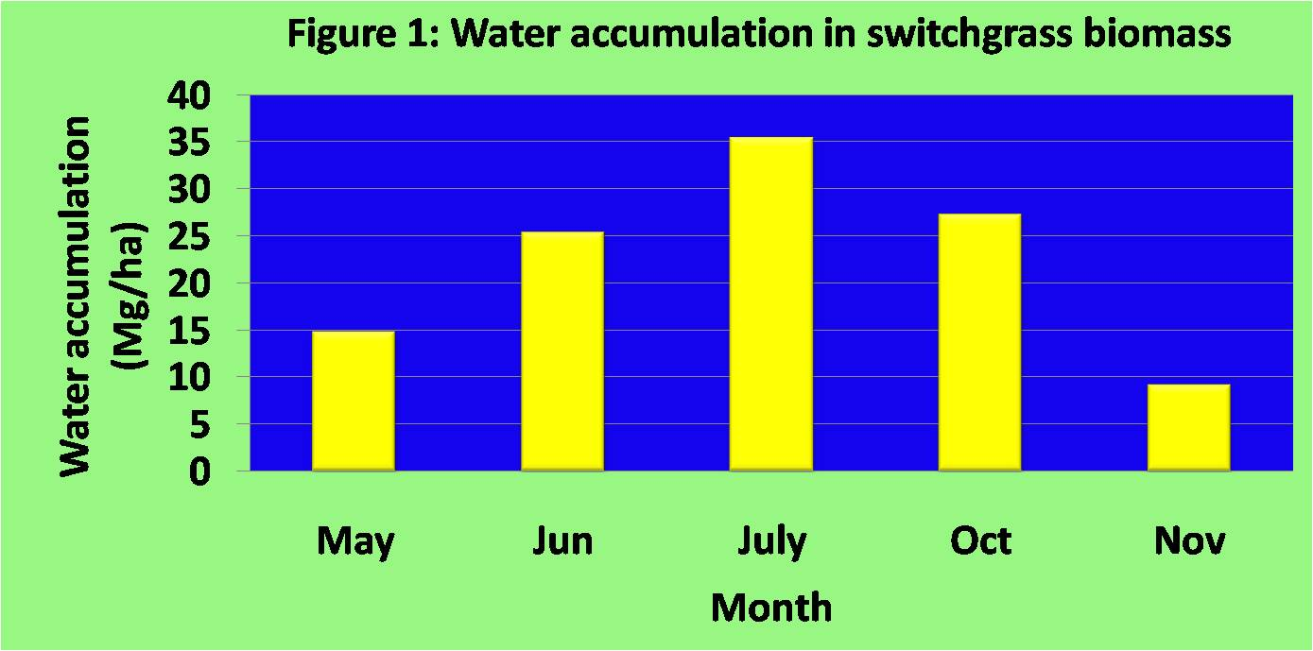
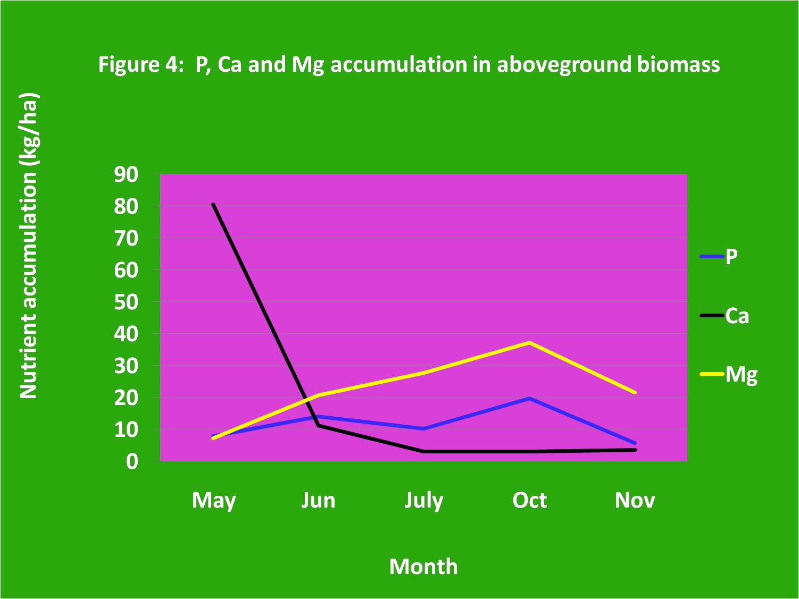
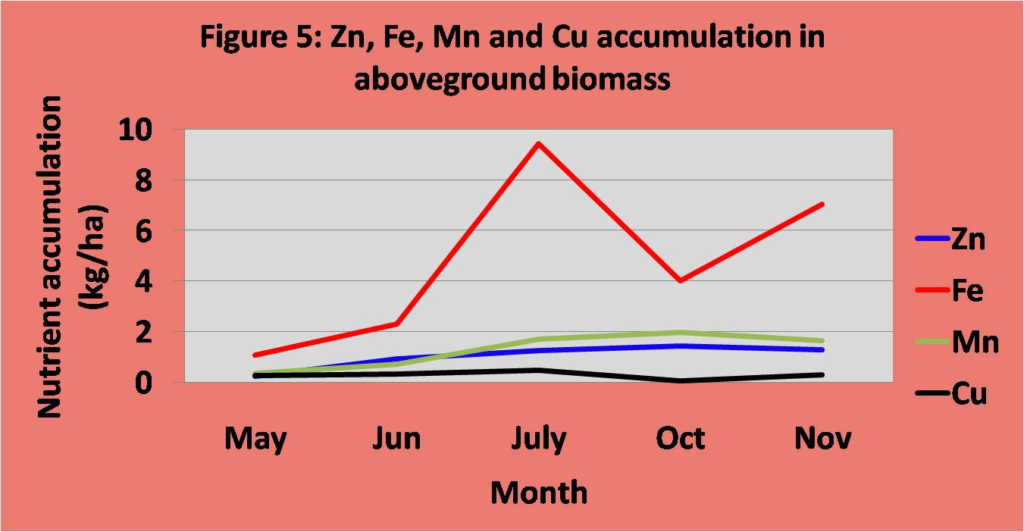
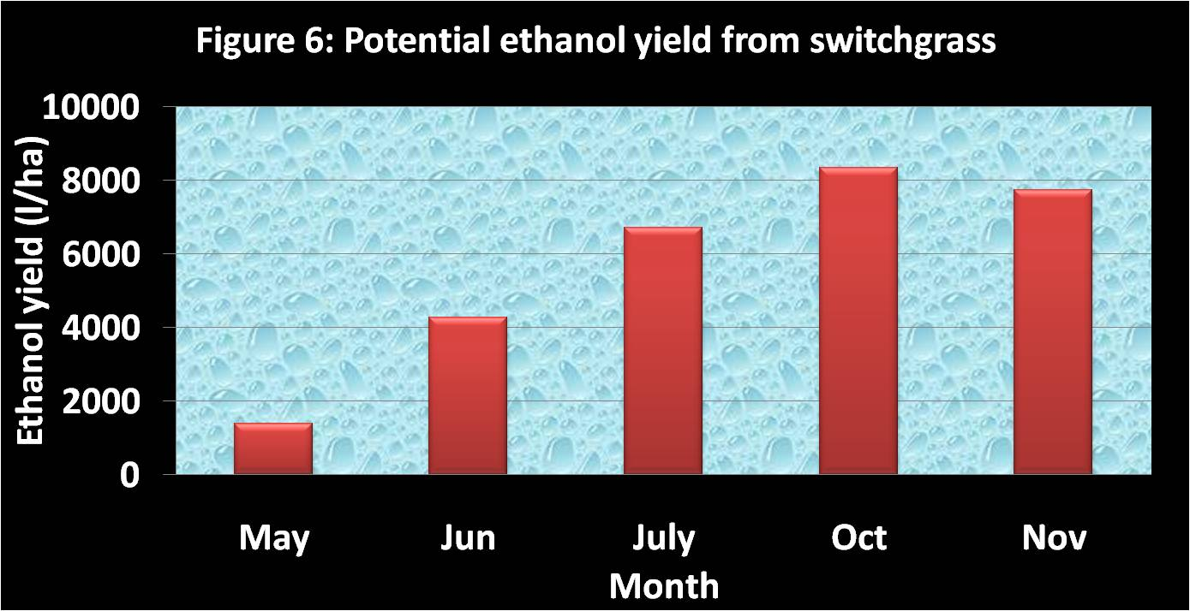
Nutrient Management as a Way to Sustain Biofuel Production From Switchgrass
Roland Holou & Gene Stevens
Plant Science Division, University of Missouri – Columbia
ABSTRACT
Material and Methods
With the rise of the energy crisis, much attention is being paid to biofuel crop. Switchgrass (Panicum virgatum) is one of the prospective plants for cellulosic ethanol production. One of the challenges is to lower the production costs and improve the biomass yield in a sustainable way. This can be done by managing nutrient removal during harvest. The overall objective of the current research is to study nutrient partitioning in switchgrass during the year and therefore determine the best time to harvest the biomass in order to minimize nutrient removal and sustain the biofuel production system. The maximum feedstock yield was obtained in October (21.9 Mg/ha); while a slight loss of biomass was encountered from October to November due to the fall of seed and the wind that cut some dried leaves off the plants. A dramatic change in nutrient accumulation was observed with time. For instance, N accumulation in the aboveground biomass decreased more than 4 times from July to November. The least decrease was observed with the micronutrients. We are actually analyzing why some nutrients content decreased and where they went in order to determine the best harvest time. More than 7500 liters/ha of ethanol can be produced from switchgrass biomass in a sustainable way.
The experiment was conducted on a 10 years old switchgrass stand in Portageville (South Missouri). Four plots were delimited and at different time of the year, the biomass was harvested within these plots (see pictures). The aboveground biomass was separated into leaf, stem, and head. Biomass samples were dried in an oven. Using an atomic mass spectrometer, nutrient content was determined in the biomass. Nutrient accumulation was determined by multiplying the biomass by the nutrient content.
Switchgrass in May
Switchgrass in July
Switchgrass in October
Switchgrass in November
Results
Water accumulation
The water accumulation in switchgrass biomass by the end of the fall is about one-fourth that of the active vegetation stage (Fig 1). The harvest date will affect the biomass drying cost and storage.
Biomass yield
The maximum feedstock yield was obtained in October; while a slight loss of biomass was encountered in November due to the fall of seeds and the effect of the wind that cut some dried leaves off the plants (Fig 2).
Nutrient accumulation
As far as the nutrient accumulation is concerned, a dramatic change is observed with time. For instance, N accumulation in the biomass in July was more than 4 times that of November (Fig 3). In general, the accumulation of most micronutrients was almost constant after July (Fig 4 and 5). One possible explanation is that the N in the aboveground biomass translocated to the soil as switchgrass matures. Another possibility is that N went into the air when switchgrass was senescing or it may have leached out of the leaves by rain. Depending on the place where the N went, the proper date of harvest that will be assigned to maximize biomass yield and reduce nutrients removal will differ. I am still working on the data that will allow me to determine that date. For instance, if the bulk of the N returned to the soil, November seems to be the best time to harvest in order to maximize the yield and minimize nutrient removal. By doing so, farmers can save on fertilizer application. Also, in November, the water accumulation in the biomass is lower and therefore can reduce the cost of biomass drying. In addition, the low N content of the biomass at that time can have a positive impact on the industrial biomass processing. However, if the bulk of the N went into the air, it would be better to harvest the biomass sooner in order to reduce a possible negative impact of nitrous oxide that can be formed.
Biofuel yield
Based on the 2007 estimate of the Renewable and Applicable Energy Laboratory (RAEL, 2007), switchgrass can yield 0.38 liter ethanol/kg biomass. Considering this ratio and the biomass yield obtained in the present study, more than 7500 liters/ha of ethanol can be produced from switchgrass biomass (Fig 6) in a sustainable way.
Conclusion
References
Acknowledgement
A significant decrease of N accumulation in the biomass was found toward the end of the season. It is clear that the harvest date of switchgrass can really have a significant impact on the sustainable management and production of biofuel from that plant.
RAEL (2007) Renewable and Applicable Energy Laboratory. Energy and Resources Group Biofuel Analysis Meta-Model (Univ. of California, Berkeley, CA).
Thanks to the Missouri Life Science Research Board and to the Missouri Fertilizer and Ag Lime Board for funding this research.

