Slide 1


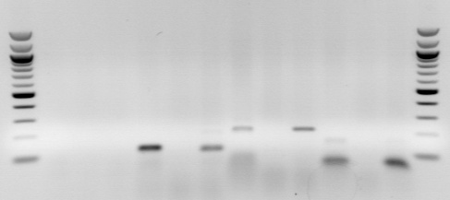
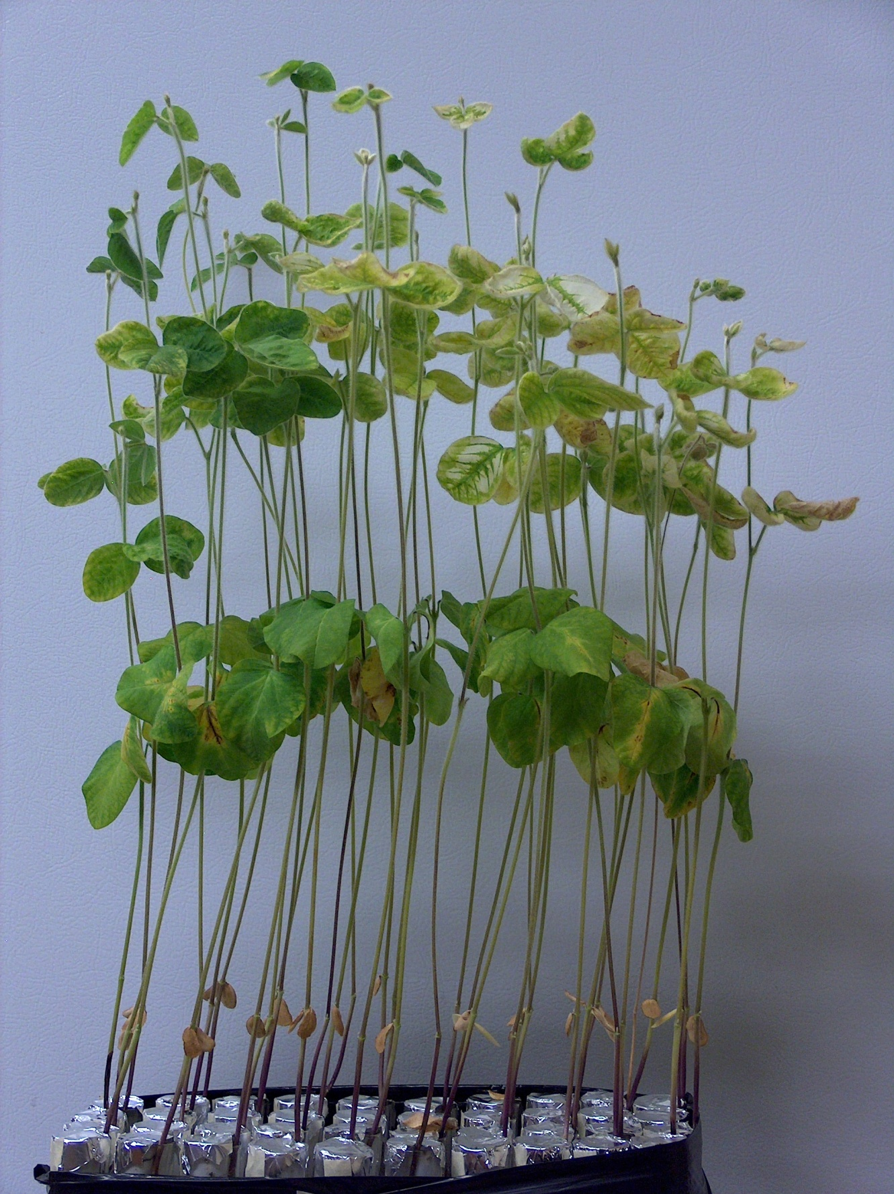
QUANTIFICATION OF SOYBEAN-ASSOCIATED SOIL RHIZOBIA WITH QUANTITATIVE POLYMERASE CHAIN REACTION
Branden Furseth, Shawn Conley, Jean-Michel Ané
Dept. of Agronomy, University of Wisconsin-Madison
Introduction
Soybean (Glycine max L. Merr) producers often apply rhizobia inoculants to their seed to promote nitrogen fixation and plant health. However, previous studies suggest that if soybean is frequently grown in a crop rotation, soil rhizobia populations can be sustained without inoculation. Traditional methods for determining the need for inoculation involve counting the incidence of nodulation on test plants. This method has limited practical use due to time constraints. The ultimate goal of this research is to develop a timely method for quantifying soil rhizobia from which inoculant recommendations can be made to soybean growers.
400bp
400bp
300bp
300bp
200bp
200bp
100bp
100bp
noeI-A
noeI-B
nodZ-A
nodZ-B
Figure 2. Primer test with Bradyrhizobium japonicum USDA110 and a soybean plot soil sample. 58°C annealing temperature.
Materials and Methods
Primers for PCR were developed based upon the nodZ and noeI specificity genes in the group of rhizobia most commonly associated with Midwestern soybean production. Bradyrhizobium japonicum, B. elkanii, Sinorhizobium fredii and Rhizobium etli nucleotide sequences were obtained from the National Center for Biotechnology and Information database and aligned with BioEdit software. Soil samples were collected from the long-term corn and soybean rotation study at the agriculture research station in Arlington, WI. Preliminary soil DNA samples were processed by qPCR using the nodZ-A and noeI-B primer sets. Final qPCR results will be correlated to (1) the most probable number of rhizobia (Figure1.) and (2) colony forming units as determined by plate counts.
Results
  Primer sets noeI-B and nodZ-A perform well with standard PCR, at an annealing temperature of 58°C (Figure 2). The length of the amplified DNA is as expected for each primer set.
  qPCR primer optimization indicated efficiencies of 88.9% and 98.5% for the nodZ-A and noeI-B primer sets respectively (Figure 3).
  qPCR indicates that, relative to the other plots, soil from the continuous corn plots contained the least amount of soybean-associated rhizobia. Though similar to third year corn, the continuous soybean plots contained the most rhizobia (Figure 4).
  Based upon the MPN method for counting rhizobia (Figure 5), a continuous soybean system holds the most rhizobia (57,675 g⁻¹ soil) and continuous corn contains the least (25 g⁻¹ soil). A crop rotation of 5 yrs of soybean followed by 3 yrs of corn was found to have 4,100 g⁻¹ soil.
Figure 1. Most probable number (MPN) of rhizobia in the soil is determined by the infection rate of a set of plants which have been inoculated with a serial dilution of the soil.
Figure 5. Most probable number of soil rhizobia
Conclusions
Both the noeI-B and nodZ-A primer sets show promise for the use of quantifying Bradyrhizobium in the soil.
Both the MPN and qPCR methods indicate that soybean- specific soil rhizobia populations will decline over time if soybean is not incorporated into the rotation.
Further conclusions can be made upon completion of the plate count quantification method.
Figure 4. Relative number of soil rhizobia quantified by qPCR with the noeI-B primer set.
Figure 3. qPCR primer efficiency. Top: nodZ-A , Bottom: noeI-B

