Slide 1
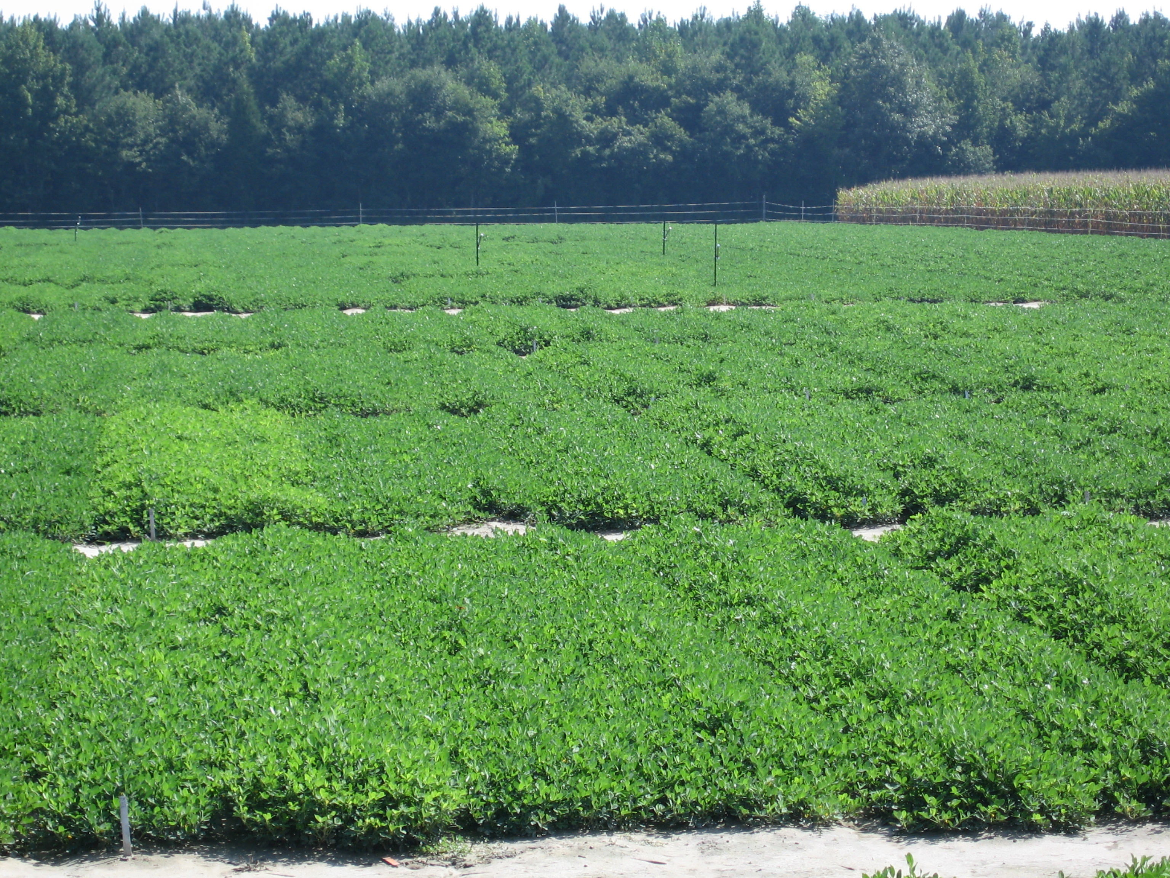


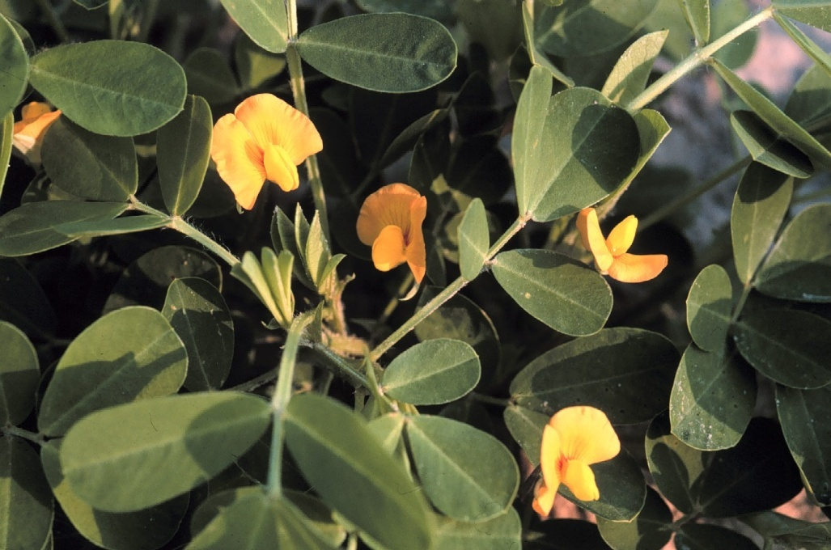
Agronomic and Grade Characteristics of the Virginia Market Type Peanut Grown in Virginia and Carolina Region
Maria Balota and Thomas Isleib
Results:
Location, genotype, and location × genotype interaction had a significant effect on yield, crop value and the grade characteristics of the peanut genotypes (Table 1).
Genotypes with less content of grade characteristics had less crop value although yields were high. For example, Wilson had high yield but less content of ELK and VA 98-R had less yield and high ELK content; they had similar crop value (Figs. 1&2).
Virginia market type peanut is an important cash crop for VA, NC, and SC. It annually brings over $90 million to the economies of this region from approximately 160,000 acres planted every year. For over 35 years, cultivars from VT and NCSU breeding programs are released based upon a multi- year and location selection test as part of a joint research project entitled Peanut Variety and Quality Evaluation (PVQE)¹. Every year, PVQE replicated field plots are conducted at various locations in VA, NC, and SC to determine the potential for yield and grade characteristics of the Virginia market type peanut genotypes. Yield and grade factors are equally important for this crop’s profitability.
Table 1. ANOVA results and averages by location for 47 peanut genotypes. Within each column, values with the same letter are not significantly different based on Tukey’s HSD test.
 | df | Extra large kernels | Sound mature kernels | Meat content | Fancy pods | Pod Yield | Crop value
 |  | P value
Location (L) | 4 | 0.0001 | 0.0001 | 0.0001 | 0.0001 | 0.0001 | 0.0001
Genotype (G) | 46 | 0.0001 | 0.0001 | 0.0001 | 0.0001 | 0.0001 | 0.0001
L × G | 184 | 0.05 | 0.0001 | 0.0001 | 0.0001 | 0.0001 | 0.005
Error | 368
 |  | % | % | % | % | Kg ha⁻¹ | $/ha
Bladen, NC |  | 44 a | 67 b | 74 c | 91 c | 6099 c | 2471 c
Florence, SC |  | 44 a | 57 a | 73 ab | 89 b | 5802 b | 2004 a
Martin, NC |  | 48 b | 67 b | 72 a | 87 a | 5518 a | 2114 b
Southampton, VA |  | 51 c | 68 c | 73 ab | 95 d | 6706 d | 2661 d
Suffolk, VA |  | 48 b | 69 c | 73 ab | 93 e | 6634 d | 2622 d
Figure 2. Average crop value of 12 commercial Virginia peanut cultivars in 2008.
Objectives were to 1) examine the genotype × location interaction for pod yield, value, and grade characteristics, and 2) compare commercial cultivars with advanced breeding lines for value, yield and grade factors.
For some cultivars and advanced lines, genotype × location interaction was not significant for yield (Fig. 3) and grade characteristics, showing that some genotypes may grow with good net returns in all three states.
Materials & Methods:
47 genotypes: 12 commercial varieties 26 NCSU advanced breeding lines 9 VT advanced breeding lines
5 locations: VA (2), NC (2), and SC (1) 3 replications in a RCB design
Pod yield and crop value
Grade characteristics: fancy pods, extra large kernels (ELK), sound mature kernels, and total meat¹.
Figure 3. Pod yield of three Virginia type peanut genotypes at 5 locations in 2008.
References:
1. http://www.ext.vt.edu/pubs/np/2812-1030.pdf
Figure 1. Average pod yield and extra large kernel content of 47 Virginia market type peanut grown at 5 locations in 2008.

