Slide 1


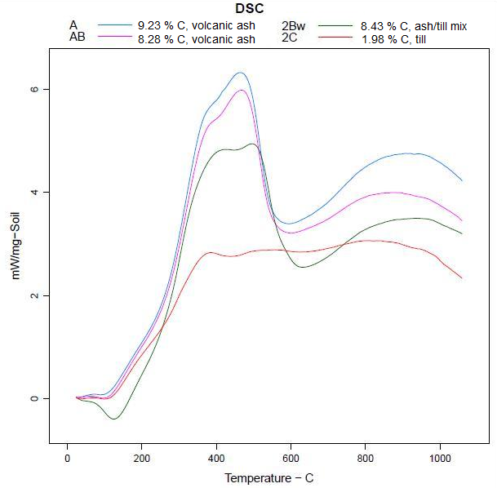
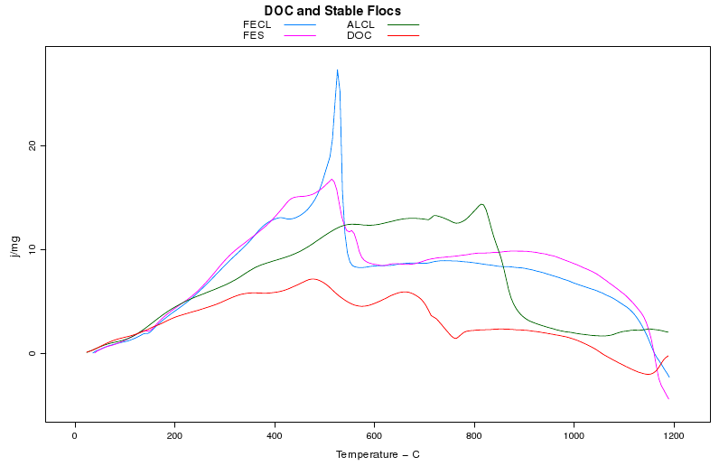
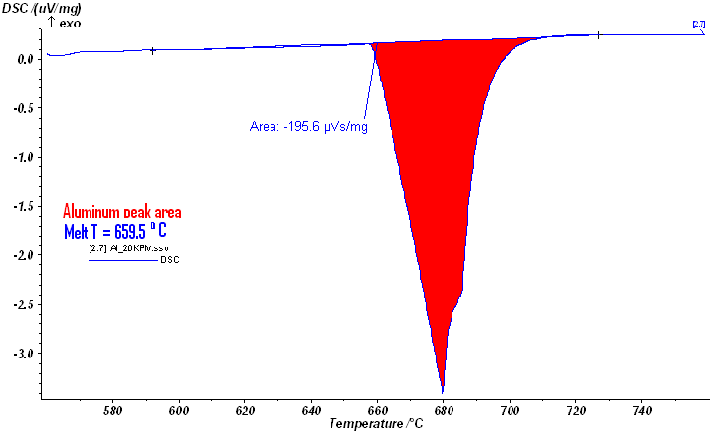
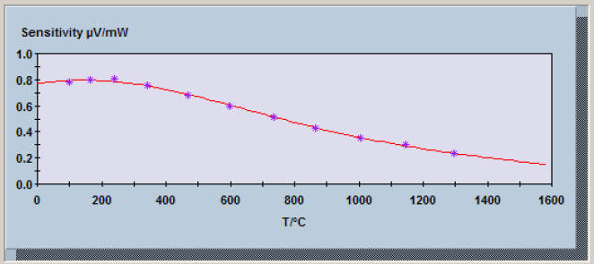
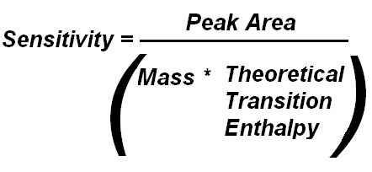
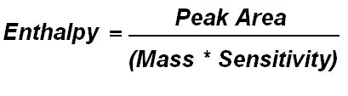
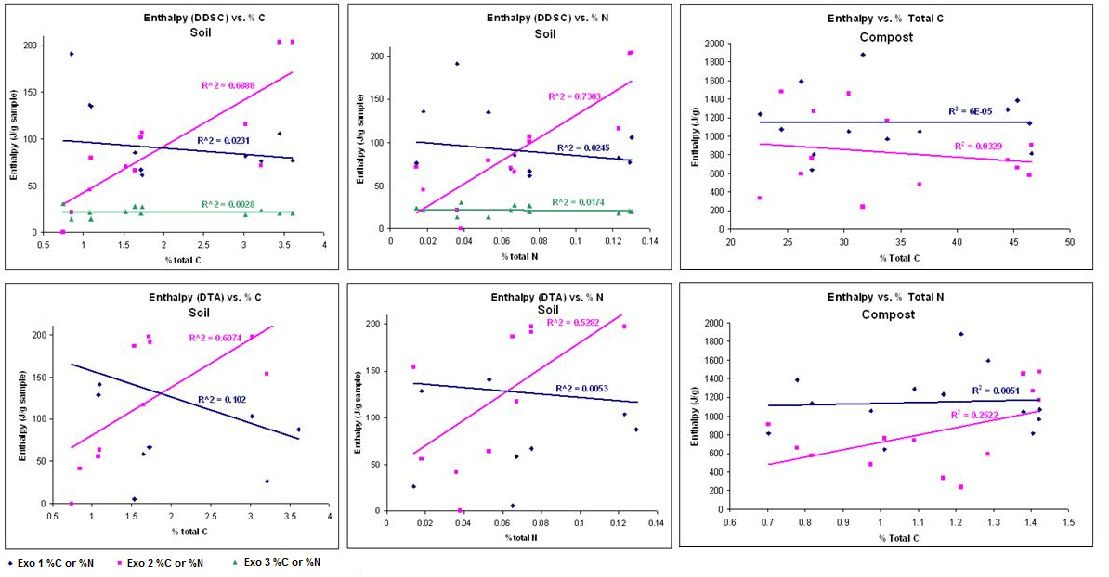
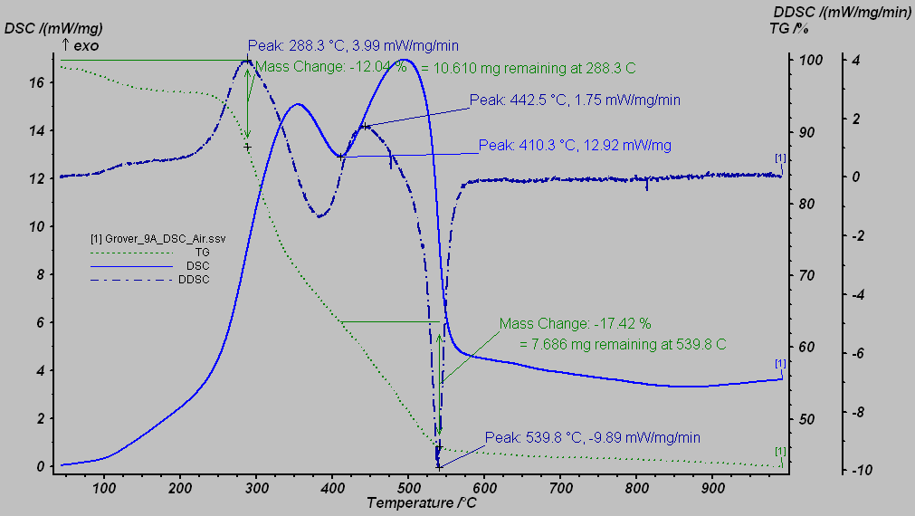
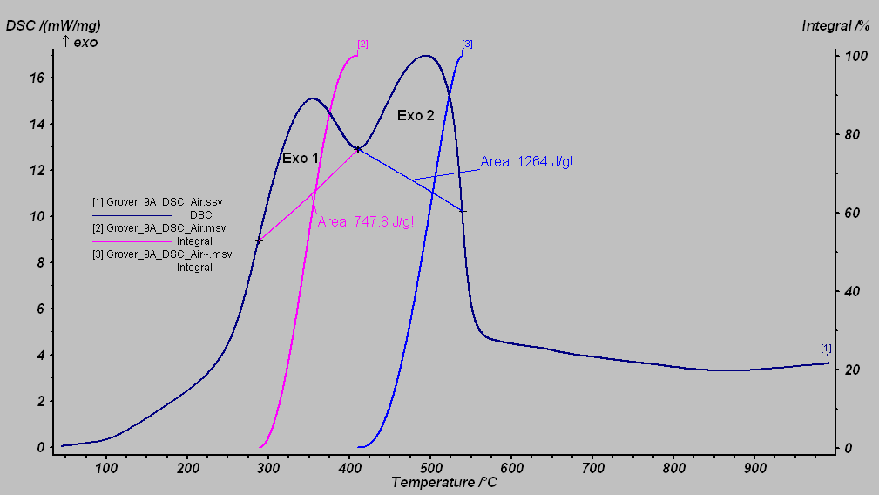
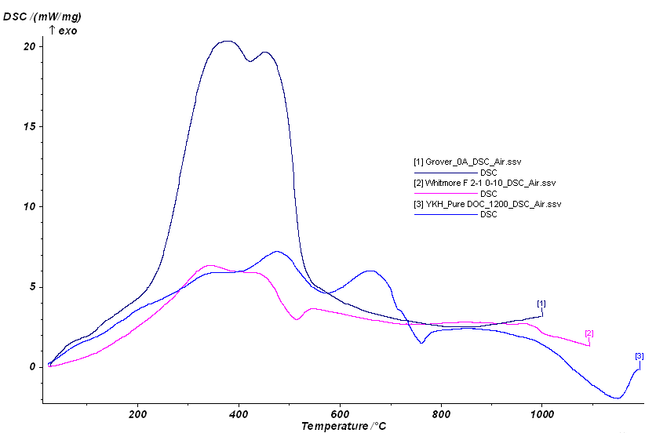
Application of Differential Scanning Calorimetry to Determine Enthaplic Character of
Composts, Dissolved Organic Carbon (DOC) and Soils
Julie Bower, Garrett Liles, Yumiko Henneberry, Victor Claassen, William Horwath
Department of Land, Air and Water Resources, University of California, Davis
Background
Methods
Results and Discussion
Analysis of polymeric materials with differential scanning calorimetry (DSC) provides quantitative resolution to determine:
Energies of phase transformations (mineral dehydrations, oxidation of SOM)
energy status of those transformations (endo- or exothermic)
enthalpy value of these thermal reactions,
And to compare entire thermal profiles of natural polymers.
To determine enthalpic values for thermal reactions and develop relationships with other chemical properties (organic C content, C/N values, δ¹³C values, etc.) across a variety of natural organic materials:
yard waste composts
whole soils
flocs of metal coagulants with wetland-derived DOC.
Thermal characteristics were determined with an STA 409 PC Luxx, furnace type S (temperature range of 25ºC-1500ºC) with a TG-DSC carrier. Materials were run in zero air at a heating rate of 20ºC/min without pre-treatment or fractionation. Soils were unfractionated/untreated and compost was fractionated by size and age.
Enthalpy values were calculated in the instrument software. Two integral limit parameters were used for comparison: key temperatures identified by the first derivative of mass loss trace (DTG) and second derivative of the heat flow trace (DDSC).
Software is calibrated using a series of pure metals with known enthalpies and known melting temperatures that cover the instrument’s temperature range:
Enthalpy (ΔH) is the heat of transformation of any reaction and is a component in of Gibb’s free energy (ΔG = ΔH – TΔS). It allows for quantitative characterization of reactions in these complex systems.
DDSC can characterize differences between treatments. Stacked thermograms below (figures 4 and 5) show differences in stability of the materials while Table 1 and Figure 6 analyses correlations between enthalpy and C and N.
Figure 4: DSC traces of various whole soils. Relative intensity differences of Exo 1 & 2 between each soil and between OM and mineral peaks indicate differences in stability of bonds within OM molecules and bonds in OM-mineral complexes.
Figure 5: DSC traces of flocced wetland-derived DOC and of pure DOC. Different metal centers of each coagulant in the floc affects the floc’s thermal character, indicating differences in bonding. Pure DOC has additional exothermic peaks than other soil-free OM materials tested (composts, see Figure 1), suggesting that types of OM differ in thermal stability.
Objective
 |  |  | Exo 1 |  | Exo 2 |  | Exo 3
Sample Type | Treatment | Depth (cm) or age | ΔH (J/g, DDSC) | ΔH (J/g, DTG) | ΔH (J/g, DDSC) | ΔH (J/g, DTG) | ΔH (J/g, DDSC) | %C | %N
Soil | Control 0-10 | 0-10 | 77 | 88 | 203 | 219 | 21 | 3.612 | 0.129
Soil | Control 10-20 | 10-20 | 70 | 6 | 70 | 187 | 22 | 1.531 | 0.065
Soil | Control 20-30 | 20- 30 | n/a | 284 | n/a | n/a | 31 | 0.744 | 0.038
Soil | Fertilizer 0-10 | 0-10 | 106 | 235 | 204 | 214 | 20 | 3.445 | 0.13
Soil | Fertilizer 10-20 | 10-20 | 61 | 67 | 107 | 191 | 27 | 1.732 | 0.075
Soil | Fertilizer 20-30 | 20- 30 | 191 | 324 | 21 | 41 | 14 | 0.847 | 0.036
Soil | Herbicide 0-10 | 0-10 | 76 | 27 | 71 | 154 | 23 | 3.214 | 0.014
Soil | Herbicide 10-20 | 10-20 | 85 | 58 | 66 | 117 | 27 | 1.65 | 0.07
Soil | Herbicide 20-30 | 20- 30 | 136 | 129 | 45 | 55 | 22 | 1.08 | 0.02
Soil | Herbicide & Fertilizer 0-10 | 0-10 | 82 | 104 | 116 | 197 | 19 | 3.02 | 0.12
Soil | Herbicide & Fertilizer 10-20 | 10-20 | 66 | 67 | 101 | 197 | 20 | 1.72 | 0.08
Soil | Herbicide & Fertilizer 20-30 | 20- 30 | 135 | 141 | 79 | 64 | 14 | 1.10 | 0.05
Compost | Grover 0 A | 0 | 1292 |  | 741 |  |  | 44.45 | 1.09
Compost | Grover 0 C | 0 | 1593 |  | 590 |  |  | 26.22 | 1.29
Compost | Grover 4A | 4 | 968 |  | 1171 |  |  | 33.85 | 1.42
Compost | Grover 9A | 9 | 810 |  | 1269 |  |  | 27.36 | 1.41
Compost | Allied Waste 0A | 0 | 1139 |  | 577 |  |  | 46.40 | 0.82
Compost | Allied Waste 0B | 0 | 1054 |  | 482 |  |  | 36.70 | 0.97
Compost | Allied Waste 0C | 0 | 640 |  | 761 |  |  | 27.20 | 1.01
Compost | Allied Waste 33A | 33 | 1384 |  | 659 |  |  | 45.31 | 0.78
Compost | Allied Waste 33B | 33 | 1879 |  | 233 |  |  | 31.68 | 1.21
Compost | Allied Waste 33C | 33 | 1235 |  | 331 |  |  | 22.55 | 1.17
Compost | Allied Waste 120A | 120 | 815 |  | 906 |  |  | 46.58 | 0.70
Compost | Allied Waste 120B | 120 | 1049 |  | 1457 |  |  | 30.30 | 1.38
Compost | Allied Waste 120C | 120 | 1071 |  | 1478 |  |  | 24.47 | 1.42
*Exo 3 is a mineral transformation (~960C) so it cannot be determined using DTG limits because no mass loss occurred
Enthalpy is calculated as the integral of the DSC trace. Values differ depending on the integral limits (DDSC or DTG). Preliminary review shows that DDSC limits work best for these complex, natural polymers.
*
*
Table 1: Enthalpy values of forest soil and compost calculated using DDSC and/or DTA peaks to determine integral limits.
DTA could not be used for compost because mass loss changes did not occur in unison with heat flow.
Figure 6: Enthalpy values correlate strongest with % total C, especially when defined by DDSC peaks. Correlating enthalpy with testable soil material parameters will give insight into C and N cycling, bonding and molecular structure of OM, and OM-mineral or OM-metal interactions on the molecular level.
*
*
*
*
Further Studies
Figure 2: DDSC peaks were used to determine integral limits in this representative compost sample. Mass is calculated for each peak.
Figure 3: Enthalpy values (area) and integral limits based on DDSC are shown for the compost sample.
Coupling DSC with an isotope ratio mass spectrometer for evolved gas analysis in real time will let us correlate OM stability and mineral-OM interactions:
δ¹³C for C pool dynamics
¹⁵N release for N turnover
¹⁸O release for mineral changes (interlayer water)
Figure 1: Thermogram of compost material, pure DOC, and a forest soil. Stars show organic matter pools of similar stability in each sample type.
Currently two key exothermic reactions due to organic matter have been repeatedly measured in soil materials:
Exo 1:~350°C, nominally ‘labile’ aliphatic compounds & lower molecular weight fragments
Exo 2:~550°C, nominally ‘recalcitrant’ aromatic compounds & mineral stabilized C
Similar calculations can be repeated using DTG peaks.
DDSC peaks allow for enthalpy determination for transformations that do not result in a mass loss (mineral changes).
Acknowledgments
This work was partly funded by California Department of Transportation and Kearney Foundation of Soil Soil Science.

