Slide 1

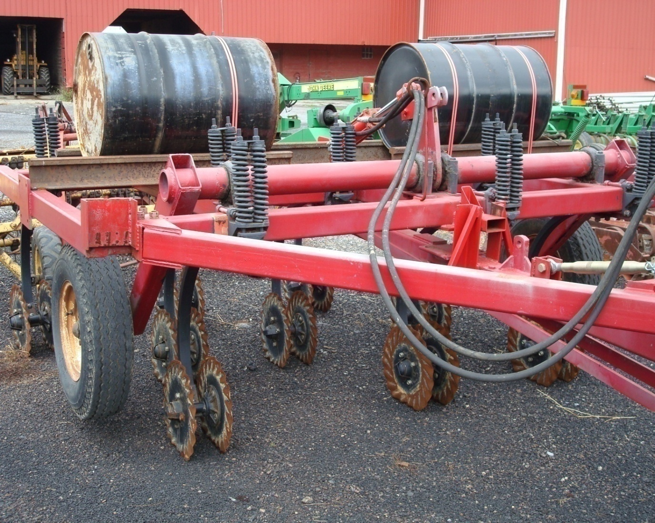
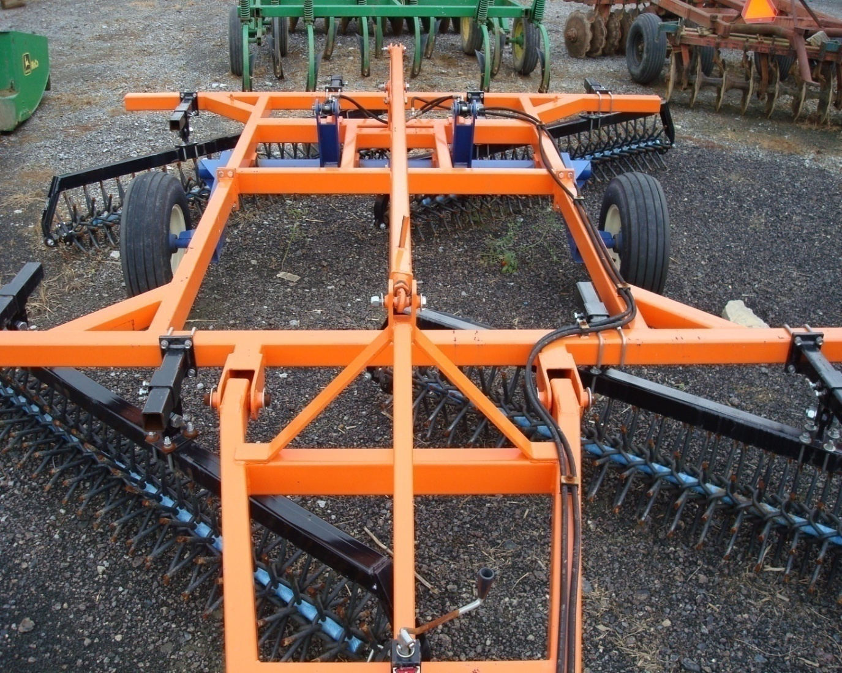
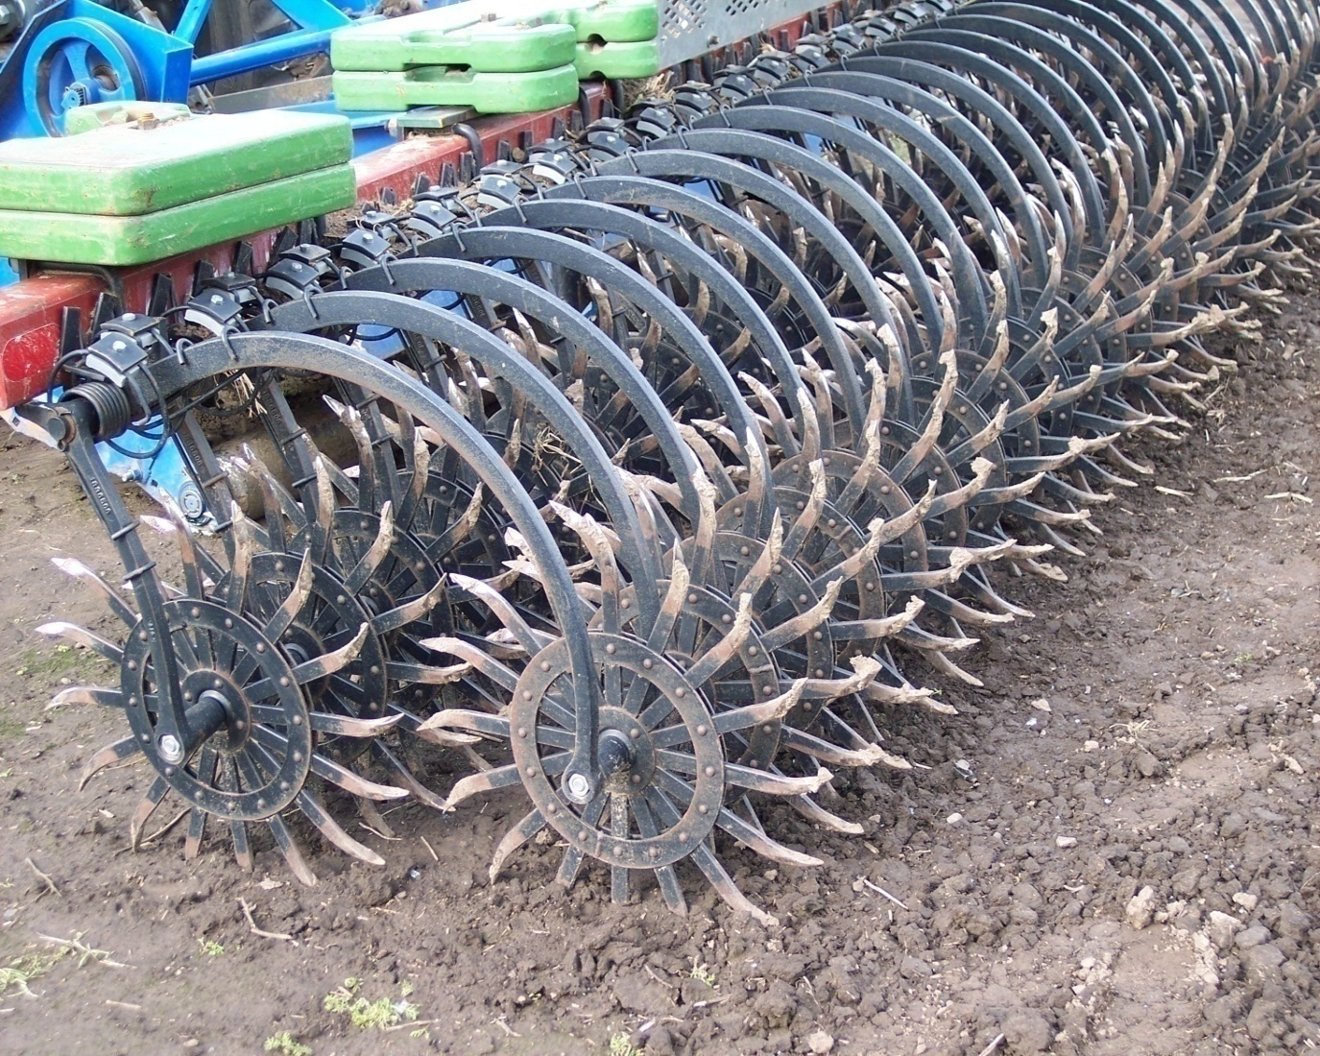
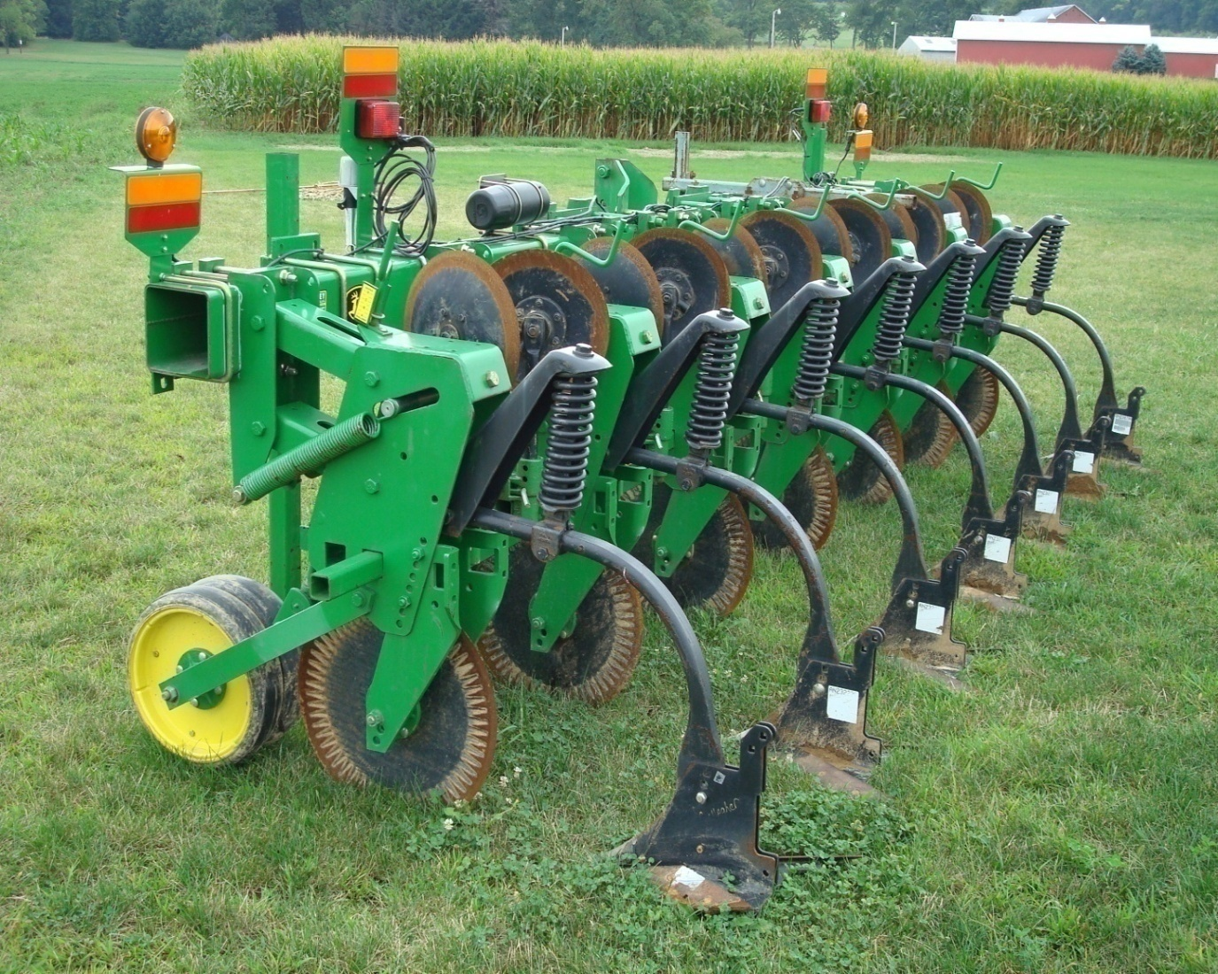
Integrating Mechanical Weed Management to Avert Herbicide Resistance in Conservation Tillage Systems
Ryan T. Bates, Robert S. Gallagher, William S. Curran
Department of Crop and Soil Sciences
The Pennsylvania State University, University Park, PA 16802
Background
Corn and soybean systems in the US occupy 67 million hectares using various weed management strategies with over 97% of the hectares using herbicides.
Heavy reliance on few herbicides for weed management will continue to increase the abundance of herbicide resistant weeds.
Herbicide resistant weeds need to be managed with additional herbicides or other management practices.
Increased concerns about preventing and controlling herbicide resistant weeds has created the need to integrate nonchemical management tactics, while maintaining key soil conservation practices in corn and soybean.
Results
Treatments that did not differ at time of data collection were combined.
Tukey comparisons at α = 0.05.
Conclusions
Substituting mechanical tools for herbicides in high residue systems may be as effective as herbicides while reducing the potential for evolution of herbicide resistant weeds.
Mechanical tools can be effective in corn and soybean.
The vertical coulter/rotary harrow controlled early season weeds under 5 cm, but was less effective on larger weeds.
The rotary hoe was most inconsistent at reducing weed density and weed biomass.
The cultivator was most effective at reducing weed biomass.
Herbicides in a 30 cm band over the row plus the cultivator reduced weed biomass compared to no-band, and controlled weeds similar to a post emergence broadcast herbicide.
The cultivator was effective at removing weed escapes from pre emergence broadcast herbicides, reducing the potential for herbicide resistant weeds.
Combinations of herbicides and mechanical tools have the potential to control weeds and reduce the potential for evolution of herbicide resistant weeds, preserving herbicides for future use.
Corn Results
Objective
To evaluate surface tillage implements for their inclusion into an integrated weed management system for preventing, delaying, and controlling herbicide resistant weeds in high residue corn and soybean systems.
Figure 5. 2008 Weed density 40 days after planting.
Figure 6. 2008 End of season weed biomass.
Materials and Methods
In 2008 and 2009, a complete randomized block design was set up at Rock Springs, PA
Corn and Soybean
Ten treatments using surface tillage implements and/or herbicides and a weedy check
Herbicides
Broadcast herbicides
II. Herbicide in a 30 cm band over the row at planting (Band)
Herbicide use reduced 60% per hectare compared to broadcast
Mechanical Tools
  Vertical coulter implement (Fig. 1) and rotary harrow (Fig. 2) (VC/RH)
    Used in combination to control weeds and aerate the soil prior to planting
    Disrupts only the top 5 cm of soil
    Could replace burn down herbicides
  High residue rotary hoe (Fig. 3) (Hoe)
    Performed 2-3 times shortly after planting
    Disrupts weed seedlings in the white thread stage
    Penetrates soil up to 2.5 cm
    Could replace pre emergence herbicides
  High residue row cultivator (Fig. 4) (Cult)
    Performed 3-4 weeks after crop emergence
    Controls weeds between crop rows
    Penetrates 5 cm deep; designed to uproot, slice, or bury weeds
    Could replace post herbicides
Parameters evaluated:
  Weed density
  Weed biomass
Fig. 1
Figure 7. 2009 Weed density 30 days after planting.
Figure 8. 2009 End of season weed biomass.
Soybean Results
Fig. 2
Figure 9. 2008 Weed density 40 days after planting.
Figure 10. 2008 End of season weed biomass.
Fig. 3
Fig. 4
Figure 11. 2009 Weed density 30 days after planting.
Figure 12. 2009 End of season weed biomass.

