Slide 1


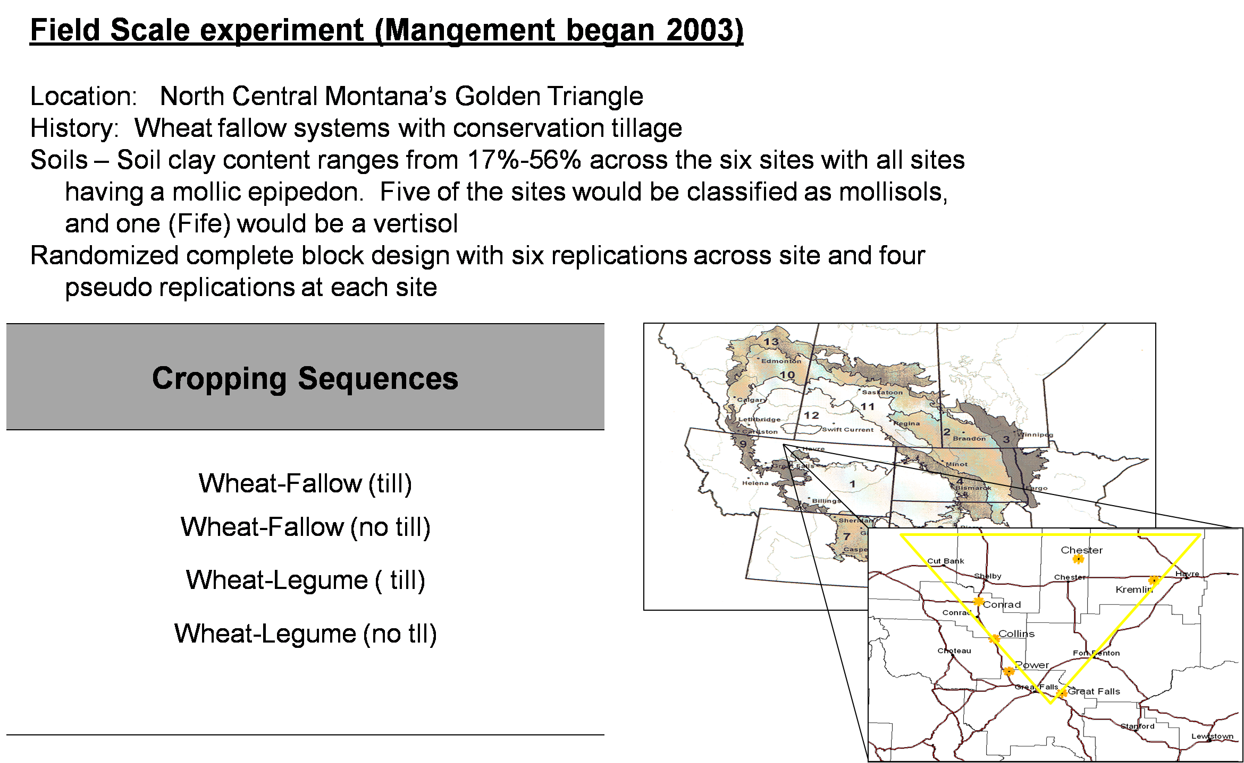
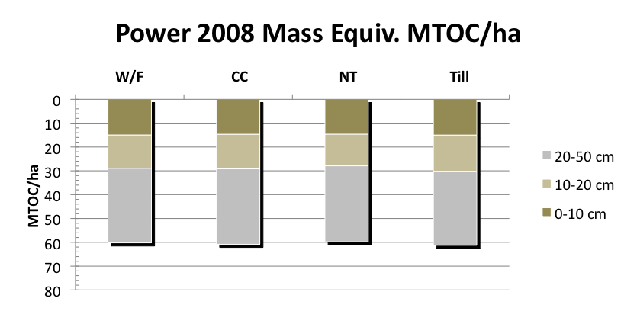
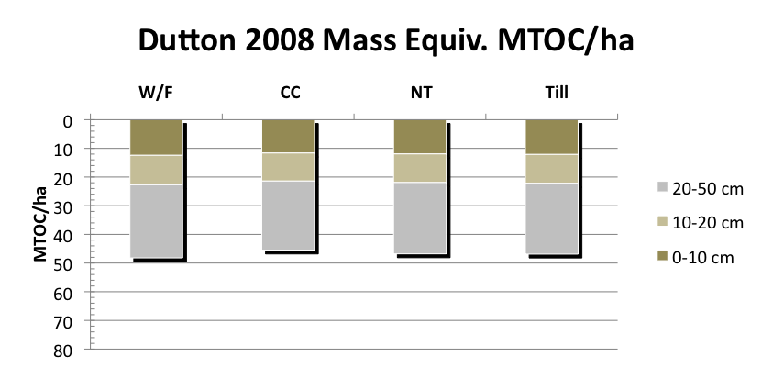
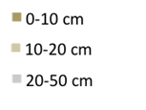
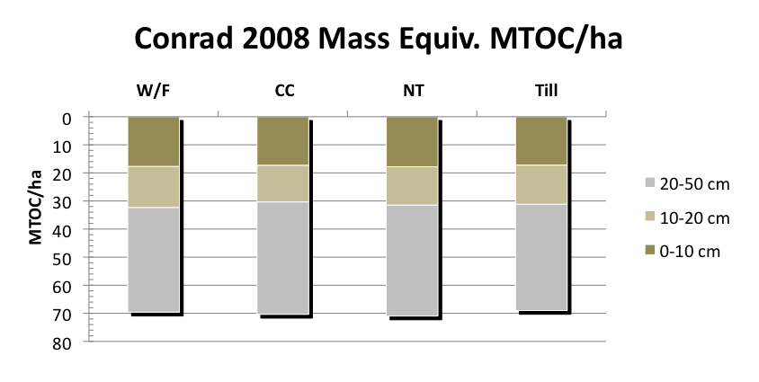
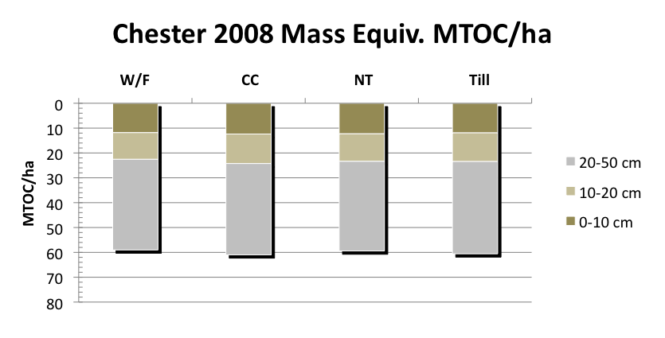
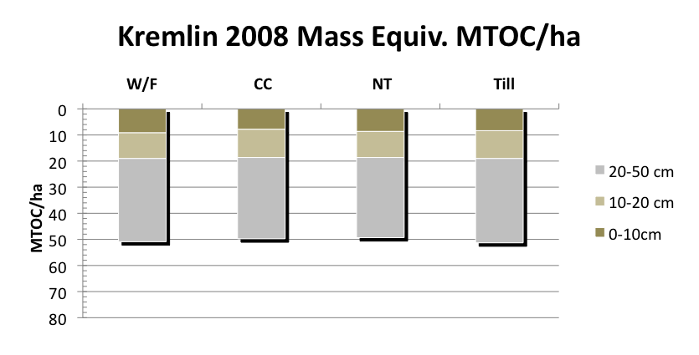
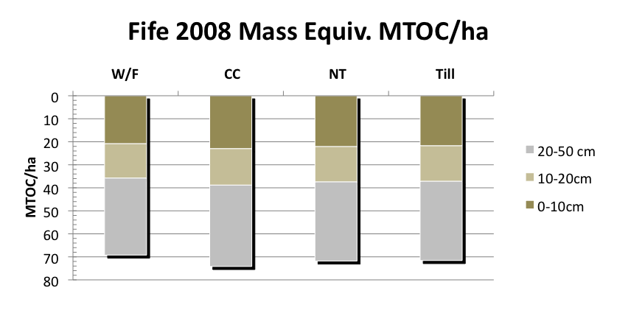
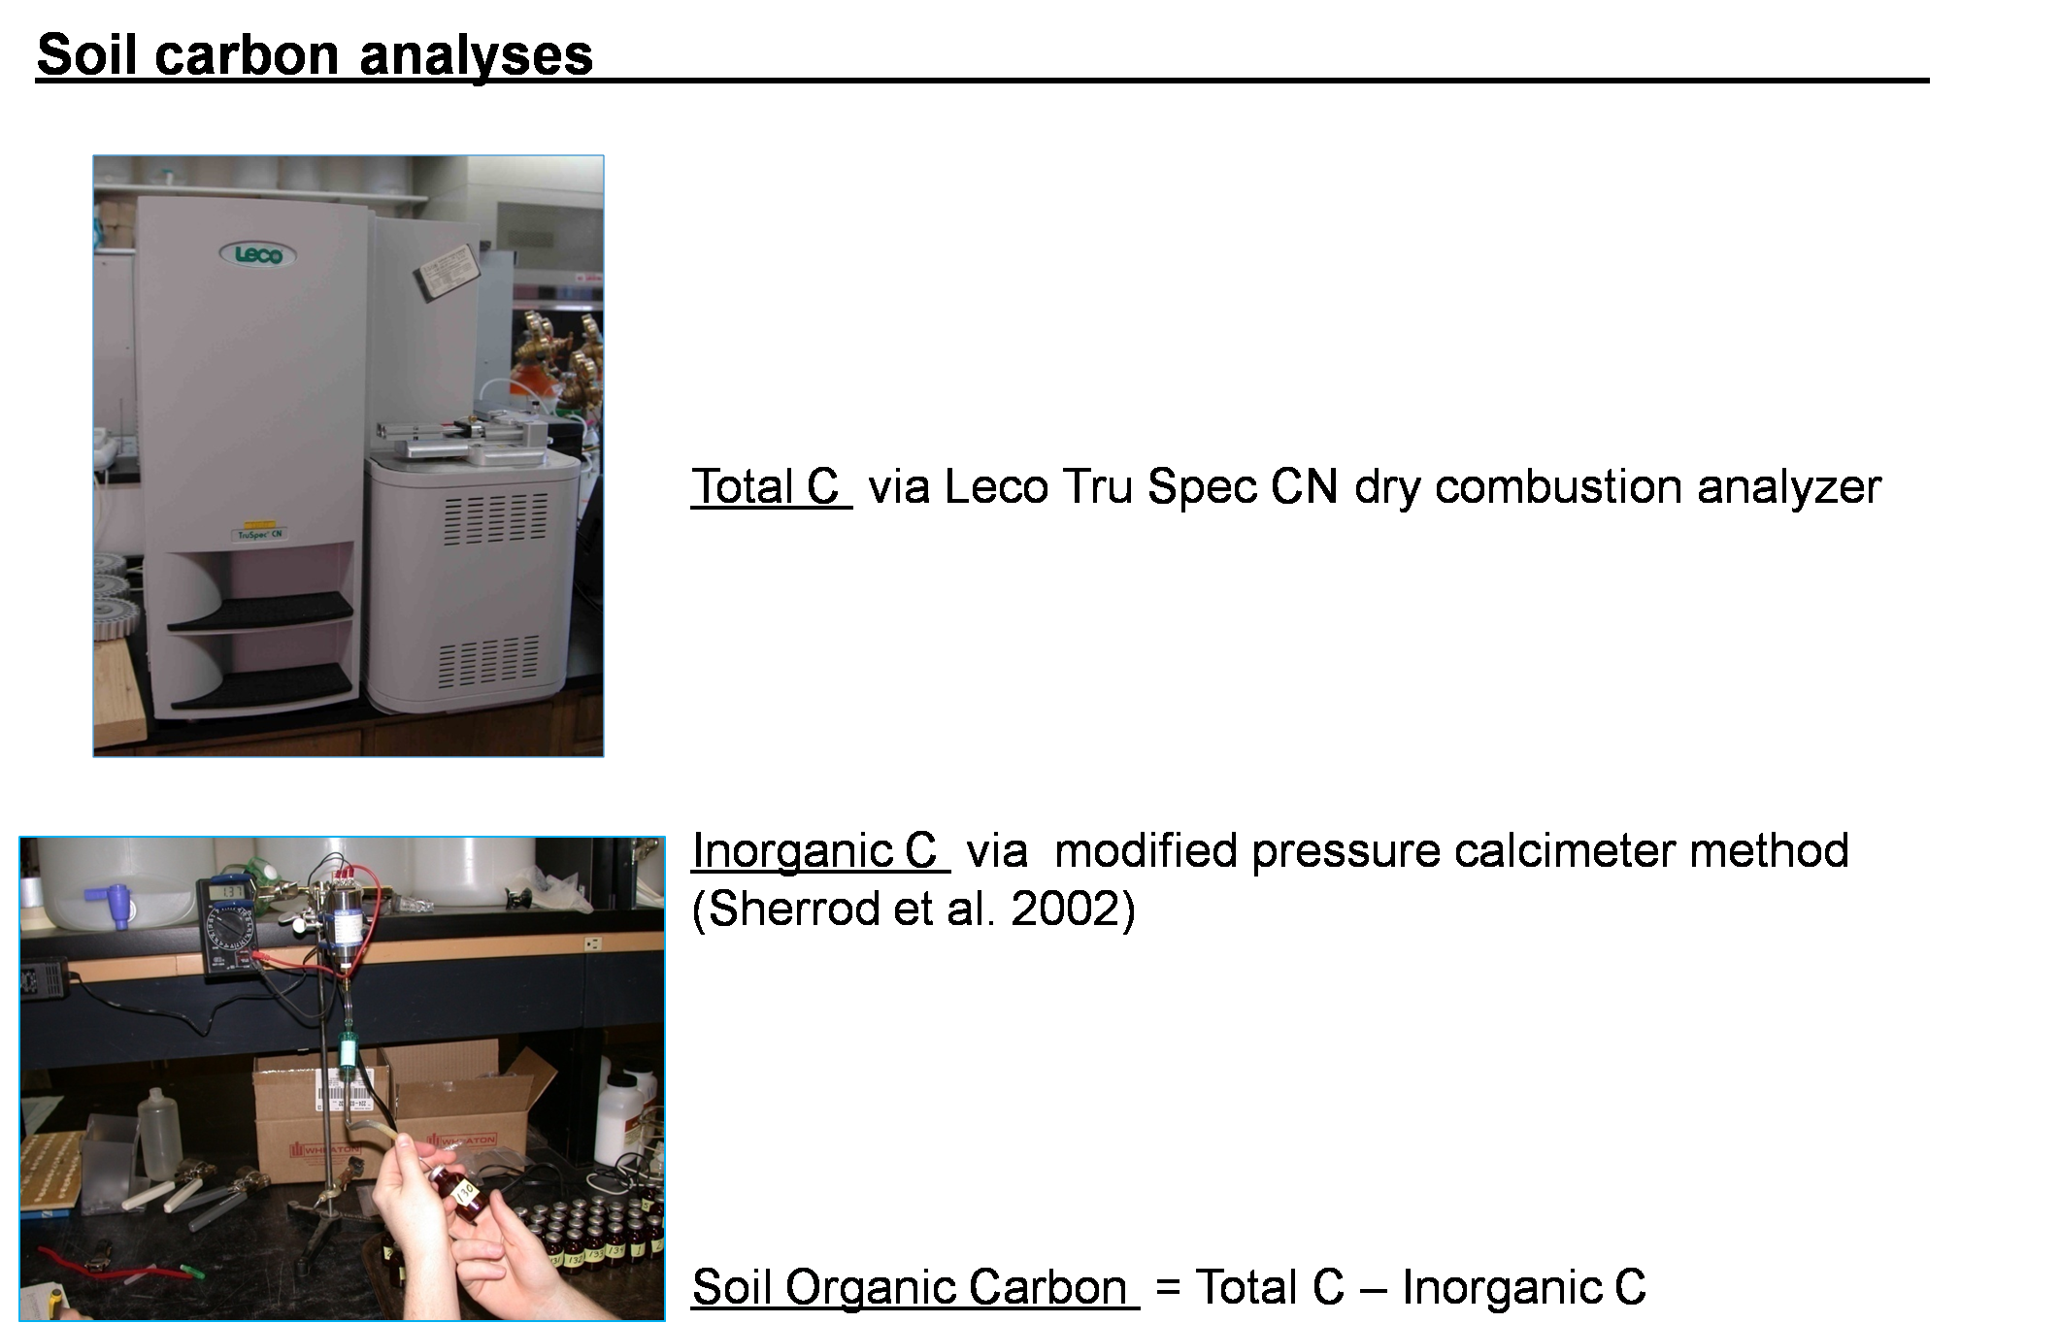
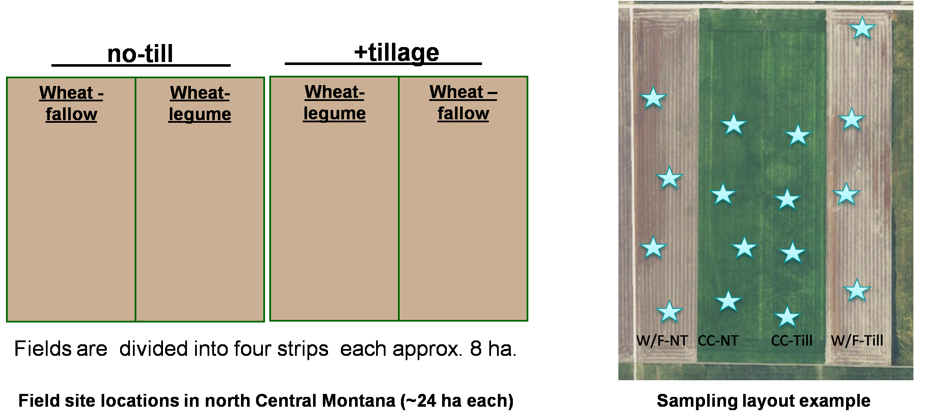
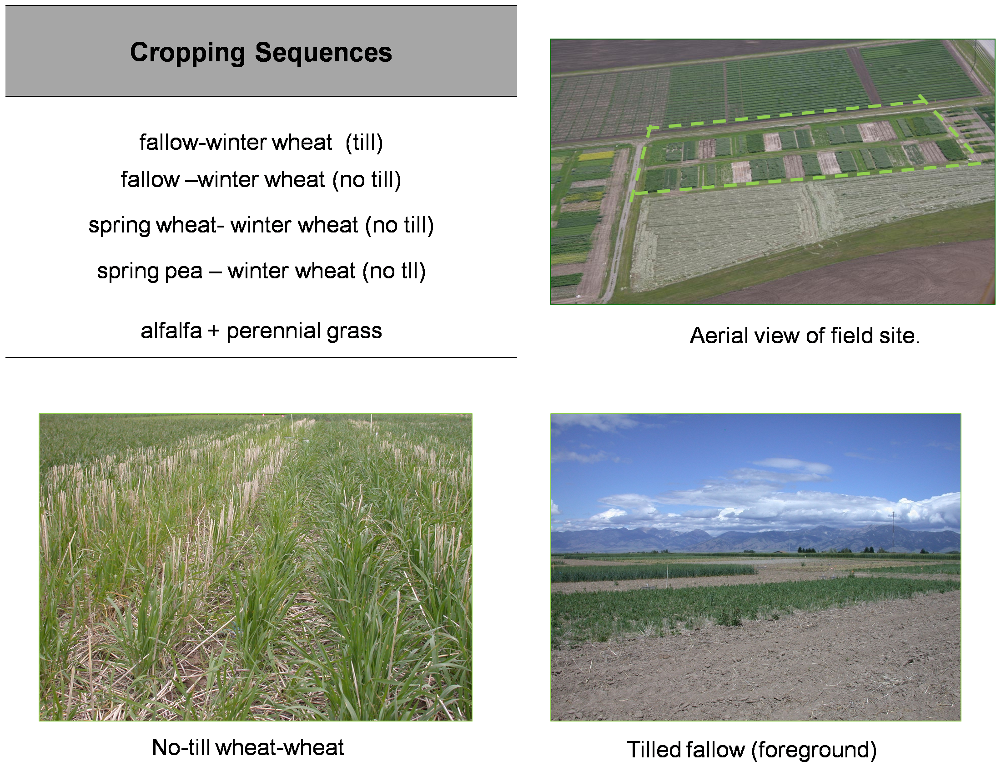
No-till and continuous cropping system studies in semiarid Montana to measure soil C sequestration
Ryan Feddema¹, Rick Engel¹, Perry Miller¹, Ross Bricklemyer², Rosie Wallander¹
1(Department of Land Resources and Environmental Sciences, Montana State University, Bozeman, Montana, 59717-3120), (2)Washington State Univ., Pullman, WA
Introduction
.
Field scale experiments
Figure 1. 2008 mass equivalent adjusted SOC by site
Rationale:
Minimizing soil disturbance (e.g. no-till farming methods) and/or increasing the cropping intensity (e.g. decreasing fallow periods, utilizing cover-crops, etc) have been reported to sequester soil C (Lal et al., 1998; Peterson et al., 1998).
Quantification of C sequestration in low rainfall, summerfallow-reliant regions such as North Central Montana is required to estimate potential for atmospheric CO2 mitigation.
Objectives:
Quantify changes in soil carbon storage that result from adopting annual cropping practices to replace summer-fallow.
Quantify changes in soil carbon storage that result from adopting no-till management
Better understand the processes and mechanisms associated with soil C sequestration in this region..
*
*
*
*
*
*
*
*
*
*
*
*
*
*
*
*
*
*
*
*
*
*
*
*
*
*
*
*
b
a
*
*
*
*
*
*
*
*
*
*
*
*
*
*
*
*
*
*
Methods
*
*
*
*
b
a
*
*
*
*
*
*
*
*
*
*
*
*
*
*
*
*
*
*
Both the Fife and Chester field sites show a statistically significant difference (p<0.05) between the wheat fallow treatment (W/F) and the continuous crop treatment (CC) as indicated by the letter assignment. Statistically significant differences could not be detected at the other four sites after six years and indicated by the asterisk. Estimated residue carbon (potential carbon inputs) for each of the sites can be seen in Figure 2. Significance at P<0.10 is indicated by the letter assignment.
Figure 2. Residue carbon by cropping intensity and site
b
a
Small plot field experiment (initiated in 2002)
Location: Bozeman - Montana State University – Post Farm
History: field site was cropped continuously with no-till practices from 1999 to 2002; previously it was intensively tilled in a fallow – crop system
Soil - Amsterdam silt loam, pH 7.8
Randomized complete block design with four replications
a
a
a
a
a
b
a
b
b
Results and Discussion
b
Small plot field experiments
Conclusions
Cropping system | Soil organic C (MT/ha)
 | 2002 | 2008
till wheat-fallow | 35.8 | 33.2
no-till wheat-fallow | 36.2 | 33.6
no-till wheat-wheat | 35.7 | 36.8
no-till pea-wheat | 36.0 | 36.5
alfalfa-perennial grass | 35.0 | 36.3
Detecting rates of change in SOC from field studies for Montana's dryland wheat production requires continued long term studies.
Significant (P<0.05) effects from management to date have only observed from increasing crop intensity (i.e. annual cropping) in the plot-scale and field-scale (two of six sites only) studies. No differences have been noted from tillage reduction. Additionally, the effects in the field- scale study are limited to the upper 10 cm of soil.
Great efforts need to be made when sampling and analyzing soil carbon in effort to maximize the signal to noise ratio. Secondly, natural soil variability and micro climates can result in increased noise in the eventual SOC on data set making changes in SOC difficult to detect
References
Lal, R., J.M. Kimble, R.F. Follett, and C.V. Cole. 1998. The potential of U.S. cropland to sequester carbon and mitigate the greenhouse effect. Ann Arbor Press, Chelesa, Mi
Peterson, G.A., A.D. Halvorson, J.L. Havlin, O.R. Jones, D.G. Lyon, and D.L. Tanaka. 1998. Reduced tillage and increasing cropping intensity in the Great Plains conserve soil carbon. Soil Tillage Res. 47:207–218.
Sherrod, L.A., G. Dunn, G.A. Peterson, and R.L. Kolberg. 2002. Inorganic carbon analysis by modified pressure-calcimeter method. Soil Sci. Soc. Am. J. 66:299-305.
Results from the field experiment at MSU-Bozeman’s Post Farm indicate SOC is being lost from both tilled and no-till wheat fallow systems. Step-wise contrasts show that no-till fallow – wheat has accumulated less soil C than no-till continuous wheat (P < 0.05). The fallow – containing systems lost SOC at a rate of 0.55 MT C/ha/yr compared with no-till continuous crop systems. Gains in SOC were greatest in a perennial alfalfa/ grass system .
Acknowledgements
This project has been or is currently being supported by CASMGS, NRCS-Conservation Innovation Grants Program, DOE Big Sky Regional Carbon Sequestration Partnership, and Montana Wheat and Barley Committee.

