Slide 1


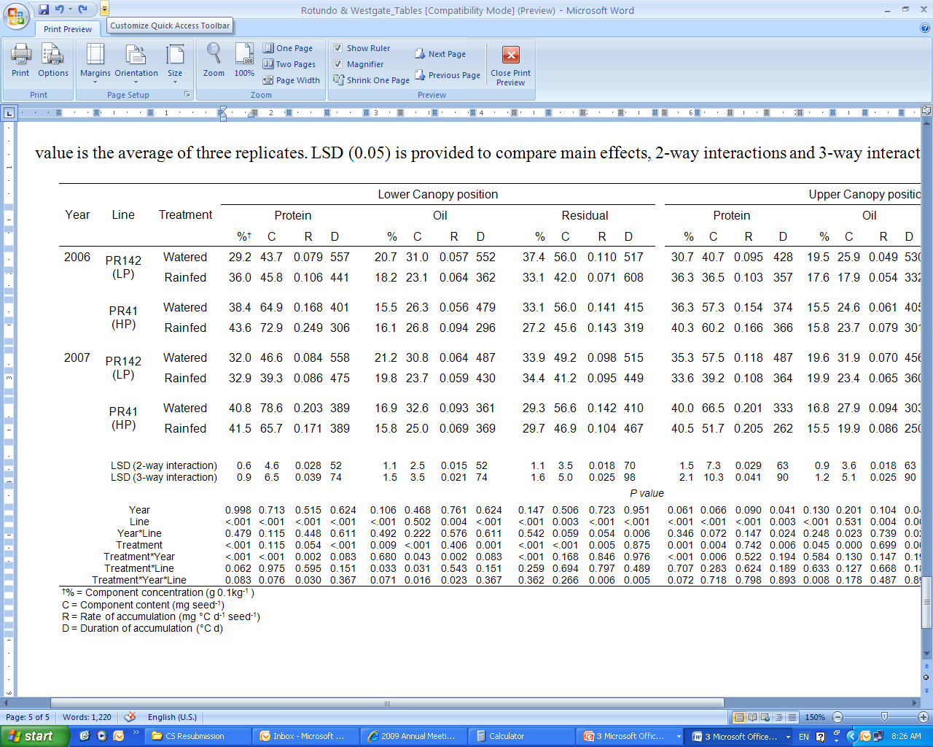
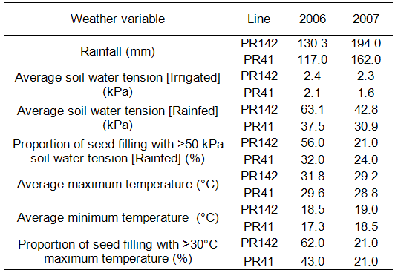
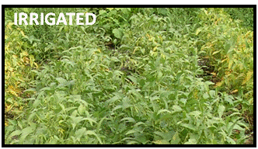
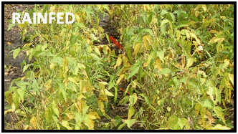
Rate and Duration of Seed Component Accumulation in Water Stressed Soybeans
José L. Rotundo & Mark Westgate
Iowa State University, 1301 Agronomy Hall, Ames, IA; rotundo@iastate.edu
Abstract:
Lack of adequate soil moisture during seed filling limits seed size in soybean (Glycine max L.) generally by shortening duration of seed fill. Seed protein concentration often increases despite stable rates of seed filling. This change in composition suggests compensation among rates of seed component accumulation or a differential impact water stress on duration of component accumulation. We examined these possibilities at upper and lower canopy positions in two closely related soybean lines differing in final protein concentration. The results indicate both responses to water deficit can occur. The rates of protein, oil and carbohydrate accumulation often compensated resulting in a constant seed growth rate. This compensation typically favored protein accumulation. The relative stability of protein accumulation likely reflects availability of remobilized amino-N late in seed filling and the dependence of oil accumulation on current assimilate supply. To our knowledge, this is the first demonstration of a differential response among rates and durations of seed component accumulation to water stress.
Materials and Methods:
Randomized complete block design (n=3); 4 row plots, 6 m long [2006 & 2007]
Two closely related soybean genotypes
Rainfed vs. Drip Irrigation treatment after R5.5 (linear phase of seed filling)
Seeds sampled throughout seed development (weight, moisture, protein and oil)
Seed collected from two canopy positions (upper third and lower third)
Environmental variables monitored during seed filling (temperature, rainfall, soil moisture tension).
Results
In 2006, an increase in seed protein concentration under rainfed conditions resulted from stability (or slight increases) of protein accumulation (mg seed⁻¹) and reductions in oil and/or residual accumulation (Table 2). Reductions in oil content at both canopy positions of PR142, the low protein (LP) genotype, resulted entirely from a shorter duration of accumulation. In PR41, the high protein (HP) genotype, an increased rate of oil accumulation compensated for a shortened duration of accumulation. Reductions in residual content resulted from shorter duration of accumulation in both canopy positions of PR142 and in the lower canopy of PR41.
In 2007, final seed protein concentration was increased significantly only in the lower canopy of PR142 under rainfed conditions despite measureable decreases in all seed component contents (Table 2). In the lower canopy, water stress shortened the duration of protein, oil, and residual accumulation in the low protein line PR142, but slowed the rate of accumulation of these components in the high protein line PR41.
Introduction:
A recent meta-analysis by Rotundo and Westgate (2009) revealed that protein accumulation usually was less negatively affected when water stress during seed filling decreased the content (mg seed⁻¹) of protein, oil and residual seed components. This difference in the response of the individual component contents resulted in an increase in seed protein concentration (Rotundo and Westgate, 2009). Evidently, not all seed components are affected to the same extent by stresses that occur during seed development. We are considering two complementary hypotheses to reconcile the apparent stability of seed growth rate with the modification of seed component contents when plants are exposed to a water deficit during seed filling.
Hypothesis 1: Rates of component accumulation vary under water stress; duration of accumulation is not affected. Amino-N remobilization from leaves and pod walls may enhance nitrogen availability increasing the rate of seed protein accumulation relative to other seed components. This increase compensates for slower rates of oil and residual accumulation to maintain a fairly constant seed growth rate, and an increase final protein content.
Hypothesis 2: Water stress does not affect rates of seed component accumulation; durations of component accumulation are affected differentially. Seed components continue to accumulate at control rates until concurrent and re-mobilized assimilates required for protein, oil, and carbohydrate synthesis are depleted.
Both hypotheses tacitly assume that accumulation patterns of different seed components are largely independent processes, as proposed for wheat (Triticum aestivum L.) by Jenner et al. (1991).
Table 2. Seed component concentrations, contents, rates and durations of accumulation. LSD_{(0.05)} is provided to compare main effects, 2-way interactions and 3-way interactions within each column.
Results:
The level of moisture stress imposed during seed filling was estimated as the proportion of seed fill duration that occurred at a soil moisture tension > 50 kPa. This varied by year and genotype. 2006 was less favorable for soybean yield with less rainfall and higher maximum temperatures during seed filling (Table 1). The low protein genotype, PR142, was exposed to soil moisture tension >50 kPa during 56% of the seed filling duration in 2006, but only 21 % of seed filling in 2007. For the high protein genotype, PR41, 32% of seed filling duration occurred at soil tension >50 kPa in 2006, with 24 % of seed filling at this or greater soil tension in 2007. Irrigation maintained soil water tension <10 kPa throughout seed filling.
Figure 1 shows the typical developmental pattern of seed component accumulation during the seed filling period. Note that each major seed component responded differently to drier soil conditions.
Table 1. Environmental conditions during the seed filling period of PR142 and PR41 in 2006 and 2007
Figure 1. Example of accumulation curves of seed protein, oil, and residual in the lower canopy of the low protein genotype PR142 (2006). A bilinear model was adjusted to estimate treatment effects on rate and duration of seed filling. Data are the mean ± se (n=3). In some cases error bars are smaller than the symbols.
Conclusions:
These results indicate that rate of accumulation and duration of accumulation of the major seed components respond independently to water stress during seed filling.
Our results confirm that rate of seed growth (dry matter) is indeed conserved under stressful conditions. This occurs primarily via compensation among seed component accumulation rates, which ultimately leads to the observed change in final composition.
References:
Rotundo, J.L., and M.E. Westgate. 2009. Meta-analysis of environmental effects on soybean seed composition. Field Crops Res. 110: 147-156.
Jenner, C.F., T.D. Ugalde, and D. Aspinall. 1991. The physiology of starch and protein deposition in the endosperm of wheat. Aust. J. Plant Phys. 18: 211-226.

