Slide 1
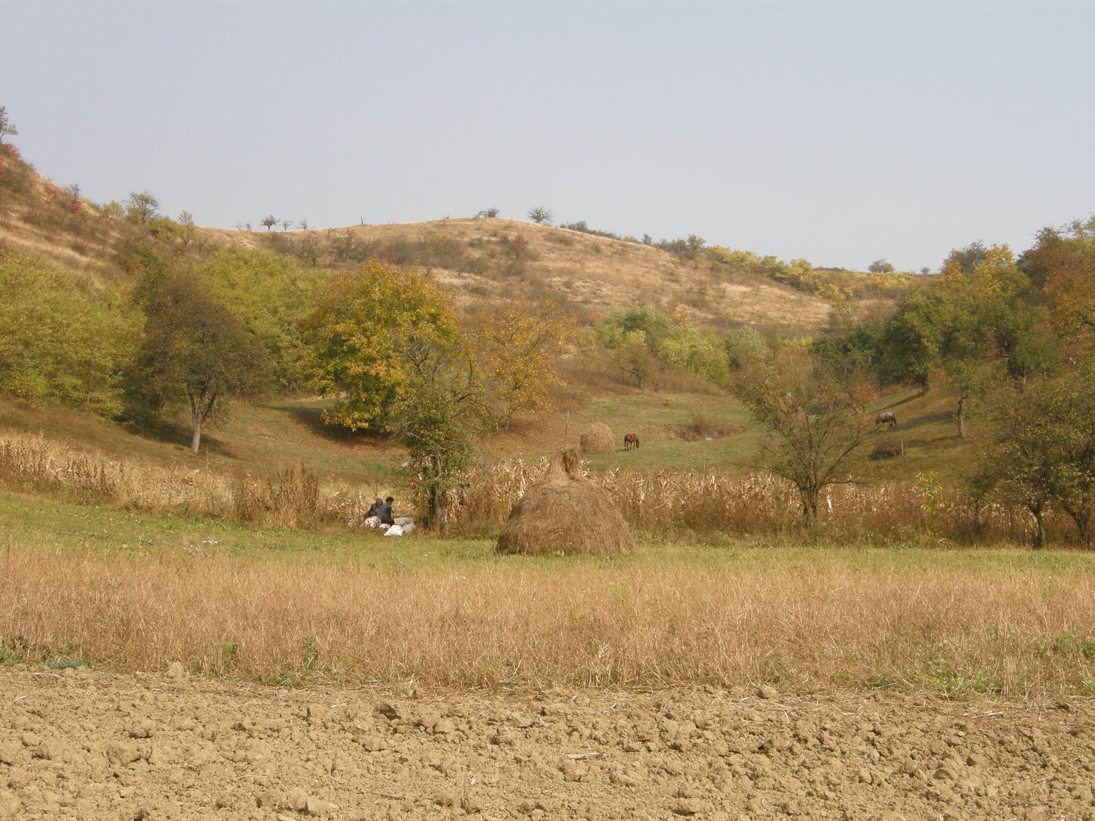

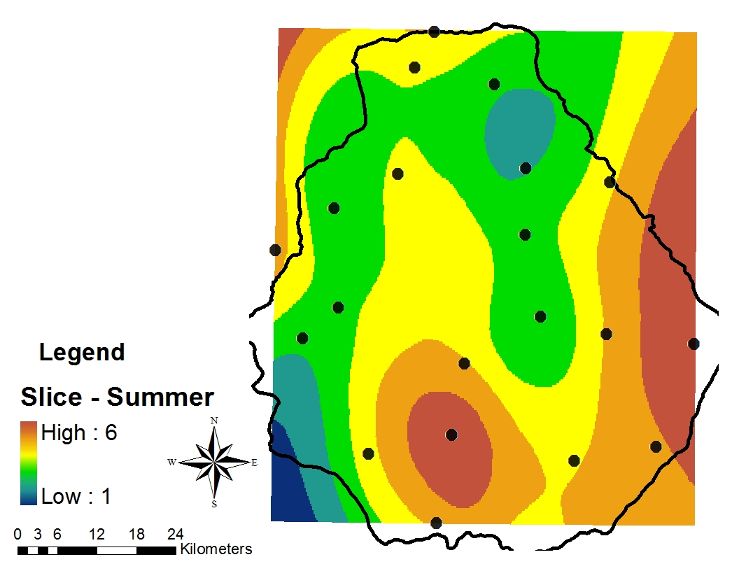
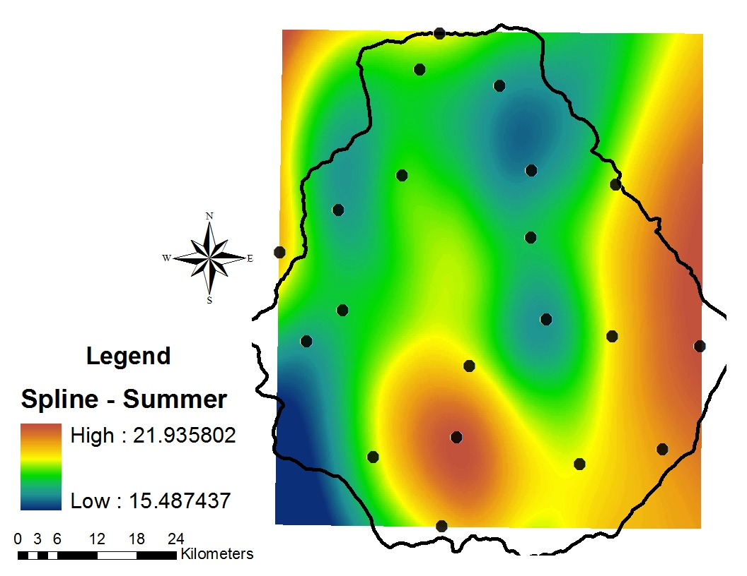
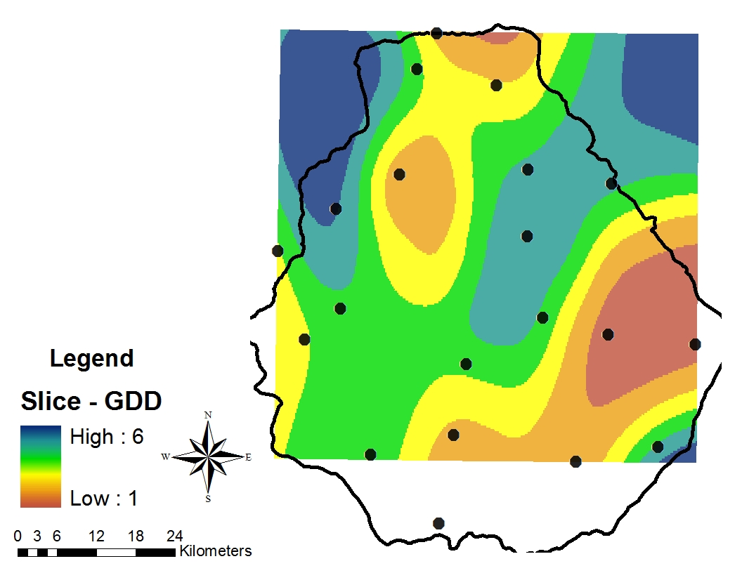
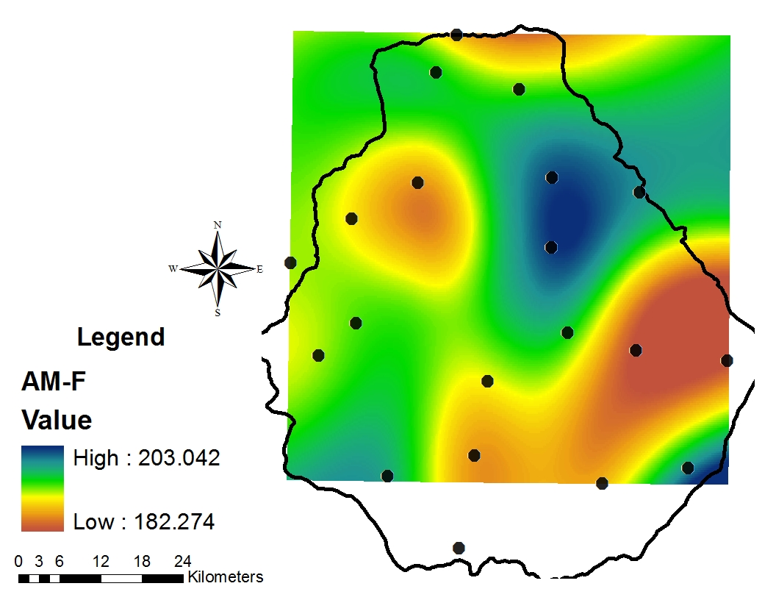
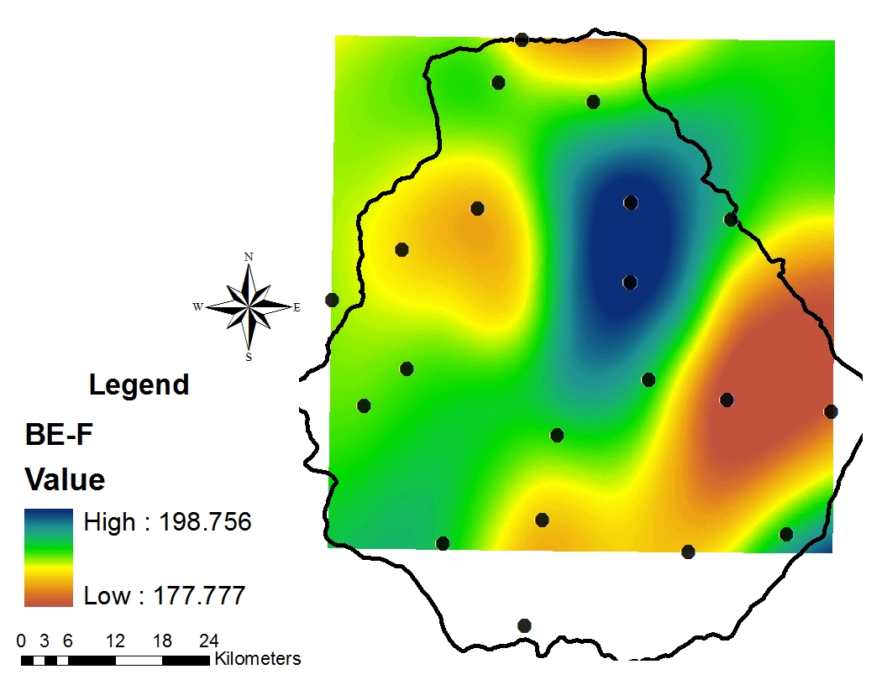
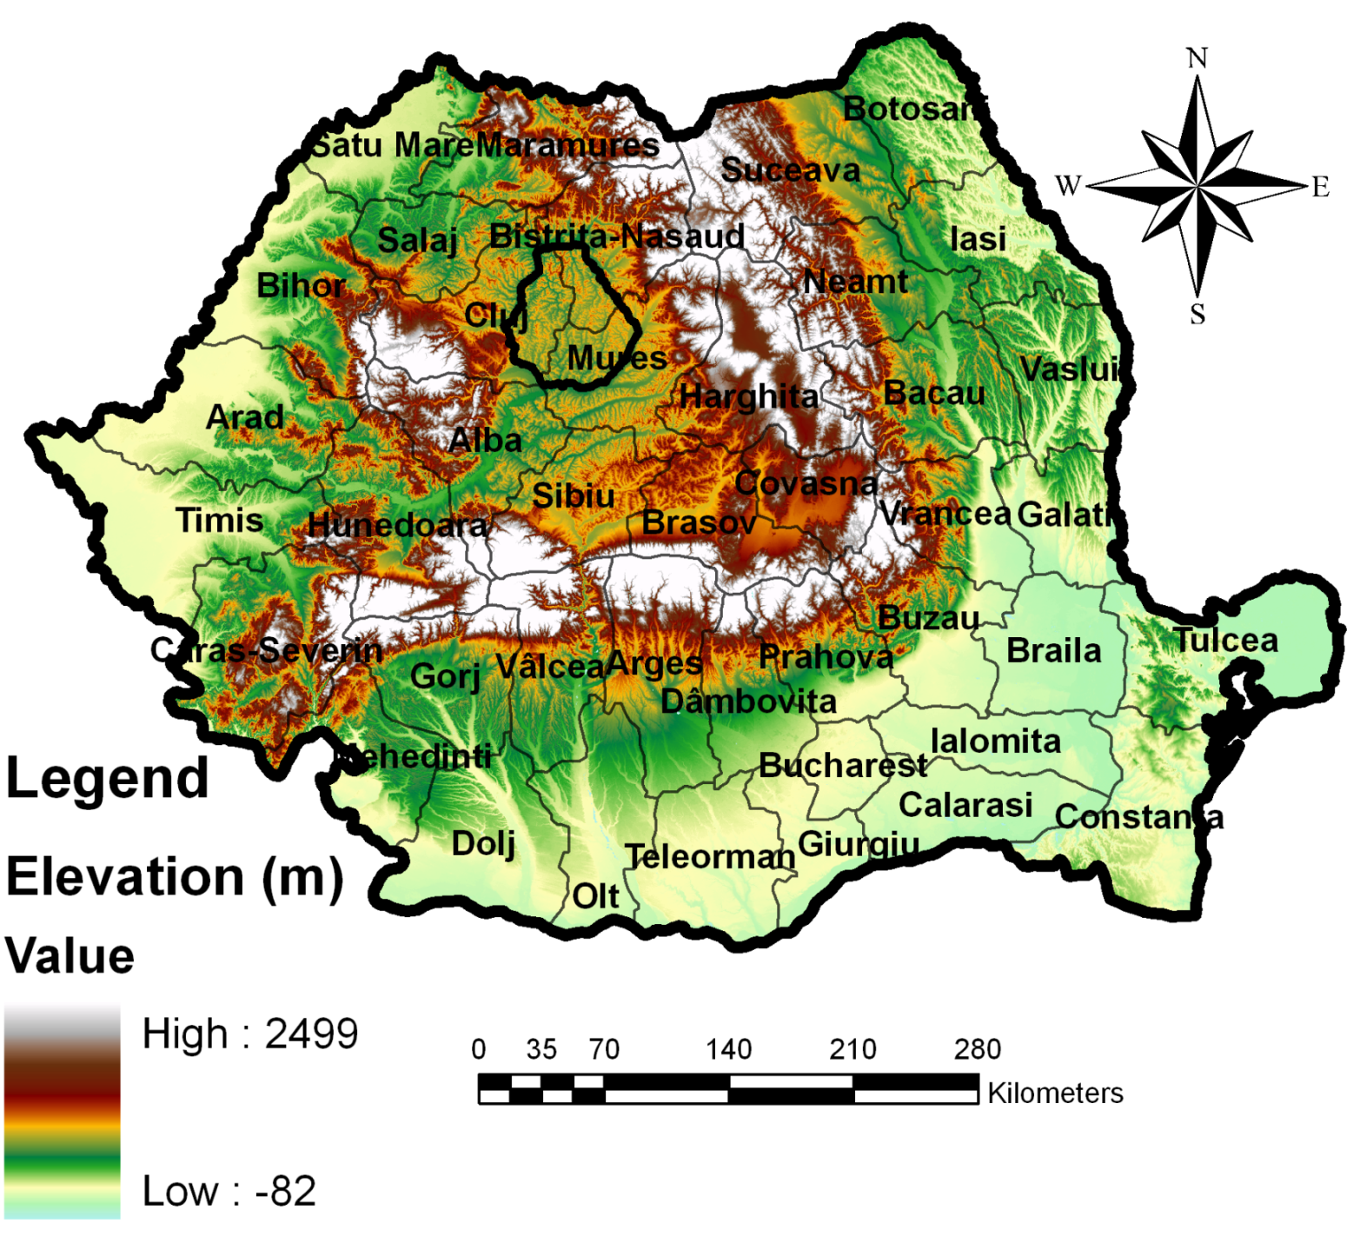
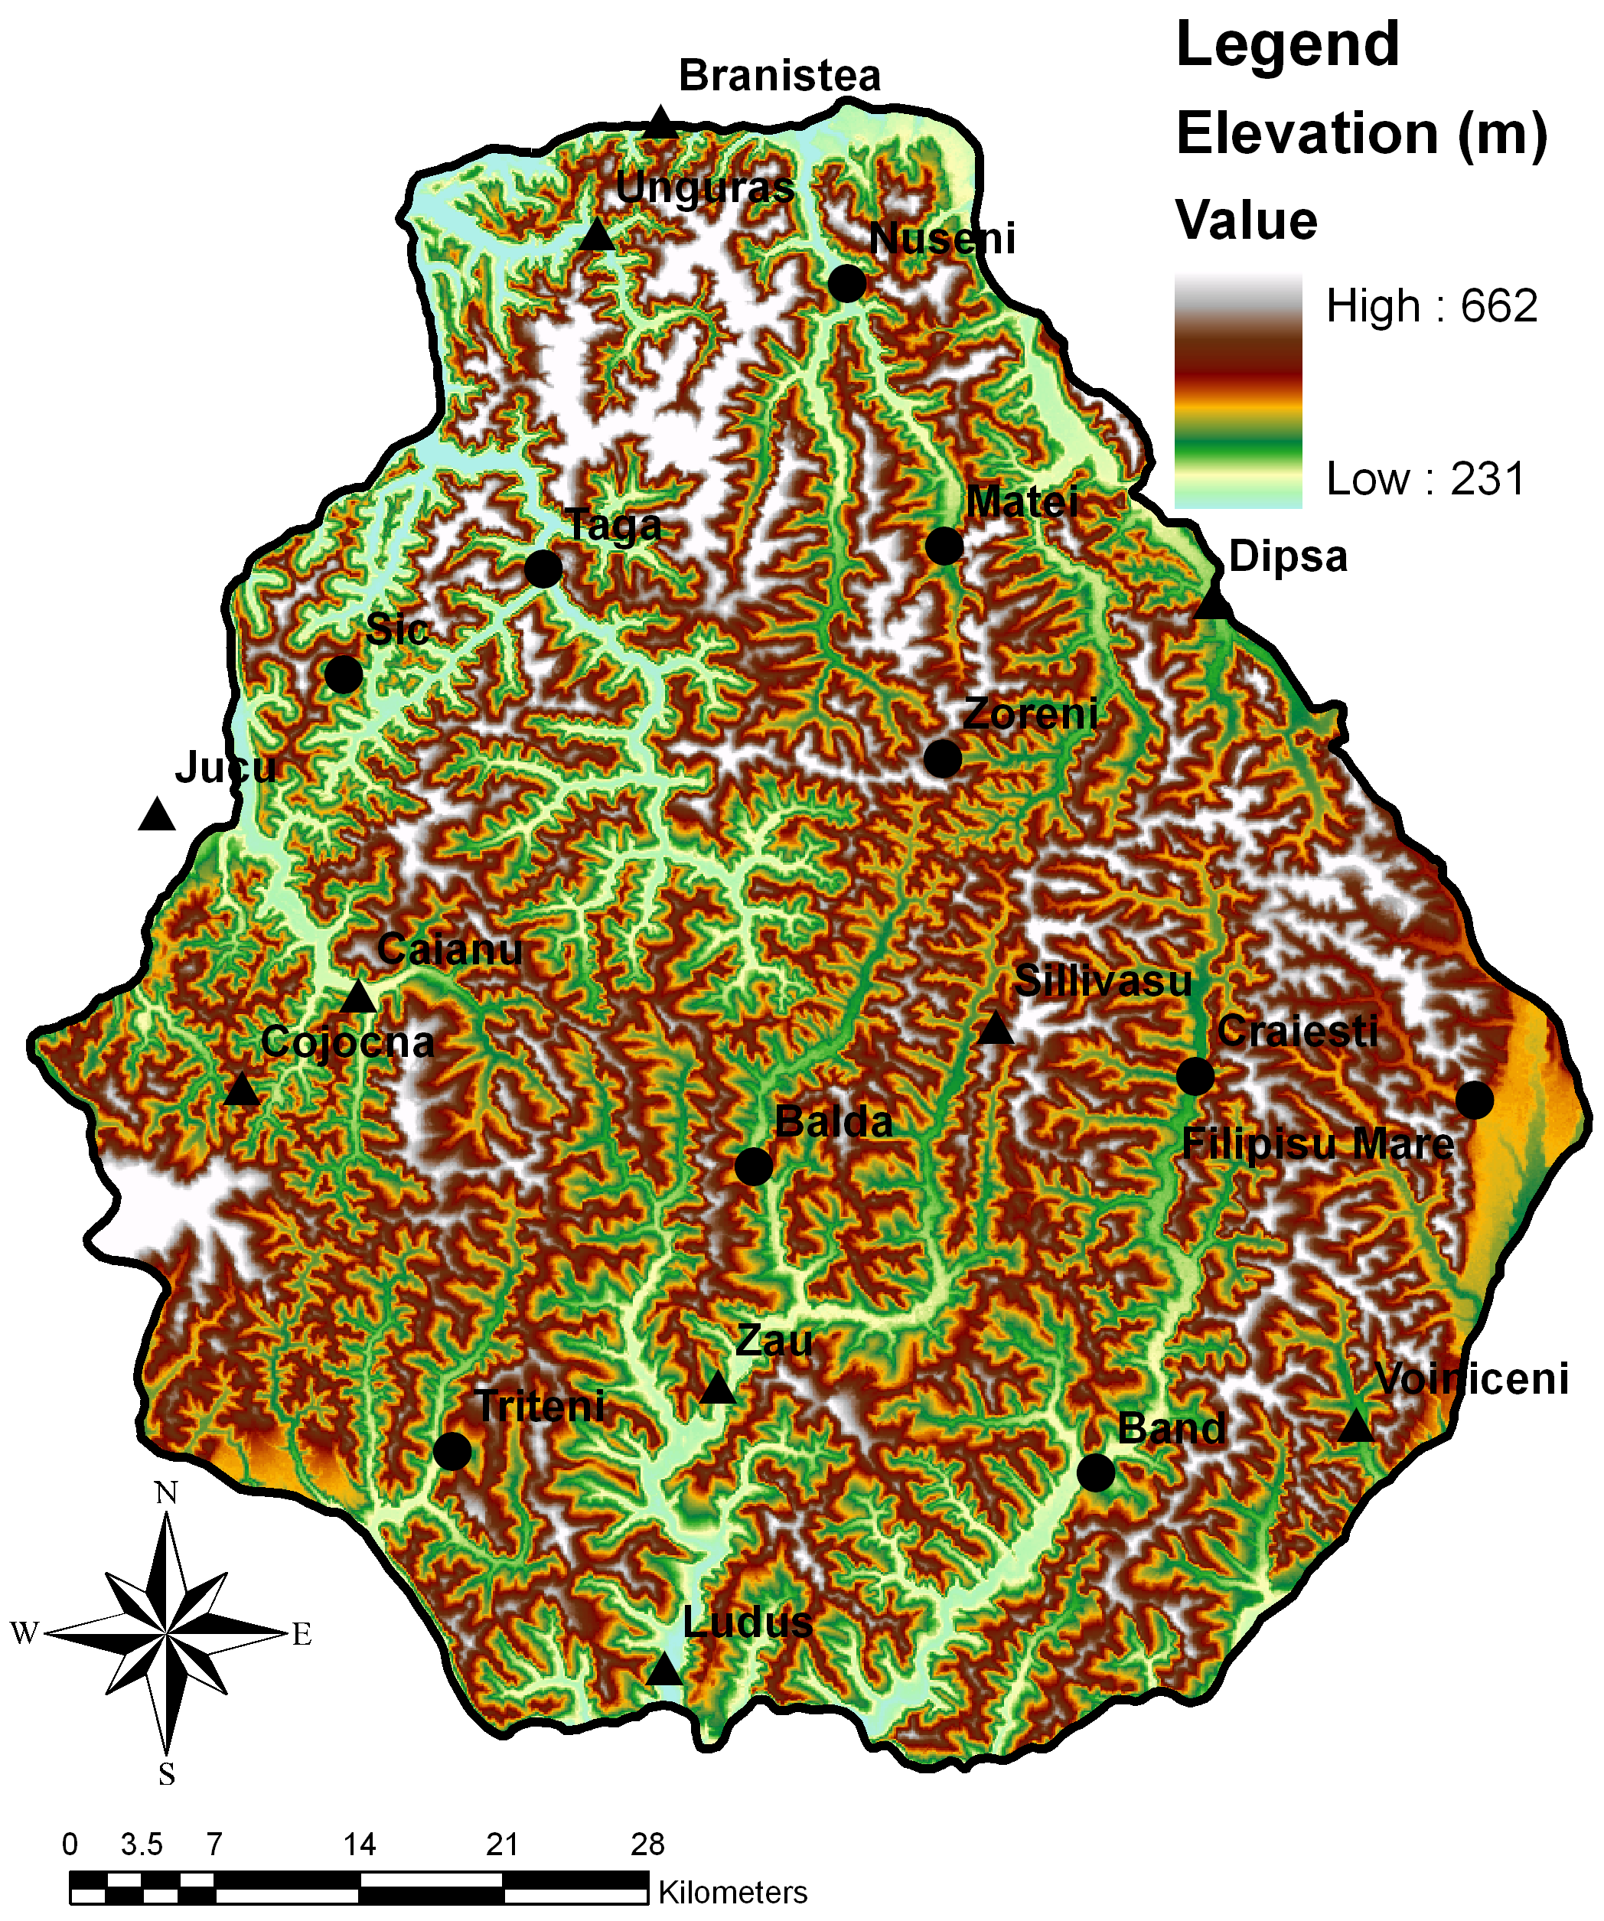
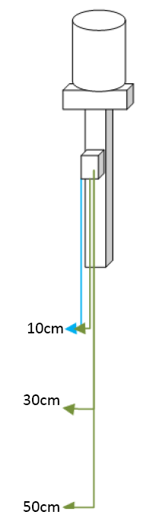
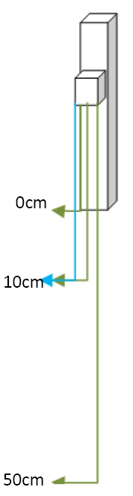
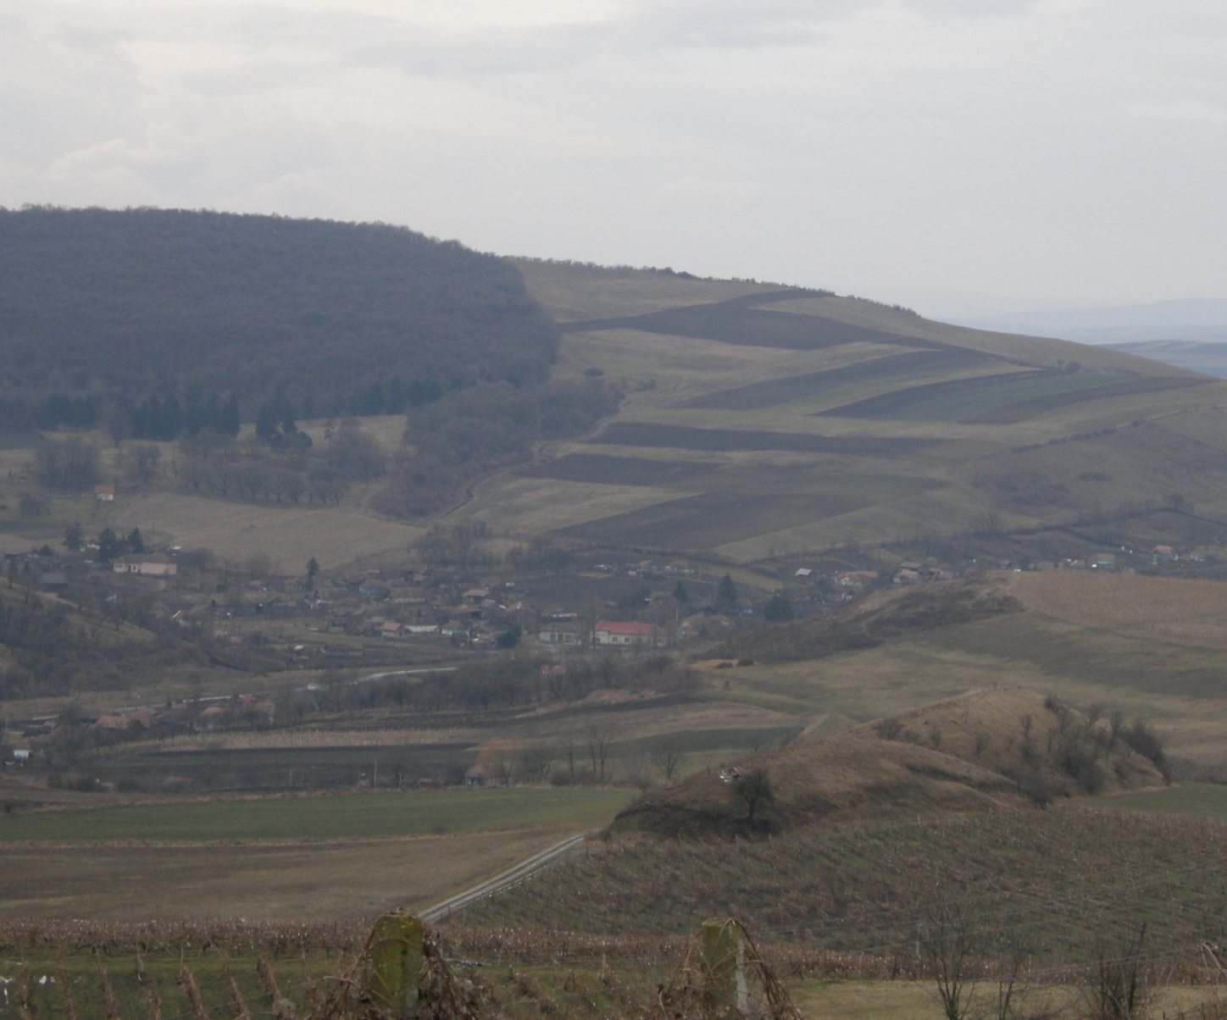
A Course Evaluation of Soil Temperature Regimes in the Transylvanian Plain, Romania
Haggard, B.¹, D. Weindorf¹, H. M. Selim¹, J. Wang¹, T. Rusu², and H. Cacovean²
¹LSU AgCenter, 307 M.B. Sturgis Hall, Baton Rouge, LA 70803, USA
²USAMV, Cluj-Napoca, Romania
ABSTRACT
The Transylvanian Plain (TP) is an agronomic area of importance in Romania for corn, sugar beet, potato, sunflower, and soybean production. The agricultural production could be improved with increased knowledge of the soil temperature characteristics of the region. Soil temperature at multiple depths (0, 10, 30, 50 cm) for 10 sites was recorded for one year as part of a four year study. Soil temperature regimes are being evaluated at the 10 sites based on a year of 50 cm temperature data. Initial findings show a mean annual temperature of 10.98°C with summer and winter temperatures of 19.23°C and 2.73°C, respectively at 50 cm. As such, the soil temperature regimes are mesic. New stations were deployed in March 2009, making the new station total 20. From May-July 2009 growing degree days (GDD) were analyzed for corn using a base temperature of 10°C. Baskerville-Emin (1969) and averaging (Arnold, 1960) were the two methods used to calculate the GDDs. Pedon descriptions have been made at each site location with subsequent taxonomic classification in both U.S. Soil Taxonomy and Romanian Soil Taxonomy. Soils have mostly been Mollisols (Cernosoluri), and to a lesser extent, Alfisols (Luvisoluri), Inceptisols (Cambisoluri), and Entisols (Protisoluri). Future work will evaluate: (1) slope aspect and its influence on soil temperature, (2) soil cover influence on soil temperature, and (3) determination of a planting calendar for local farming operations.
Slice reclass using 6 natural breaks of 2009 50 cm soil temperature summer means, Transylvanian Plain, Romania.
Spline interpolation of 2009 50 cm soil temperature summer means, Transylvanian Plain, Romania.
Accumulated GDD for days of year 100-199 Transylvanian Plain, Romania.
Slice reclass of averaged GDD Transylvanian Plain, Romania.
Site | Mean†
1 | 19.8867
2 | 19.3858
3 | 20.1387
4 | 19.7120
5 | 20.3390
6 | 19.8907
7 | 17.7497
8 | 19.6057
9 | 18.9420
10 | 18.5247
11 | 17.9323
12 | 18.9650
13 | 19.7650
14 | 20.7500
15 | 21.6030
16 | 17.9203
17 | 17.8690
18 | 17.5680
19 | 18.3607
20 | 21.7087
†LSD = 0.8667
Soil Temperature and Growing Degree Days
Soil temperature regimes affect crop production. Since it has long been the practice of famers in the TP to plant on the same day every year, it seemed necessary to evaluate soil and air temperature across the TP. Soil temperature regimes can be calculated by using equally spaced readings from 50 cm or deeper throughout a year. Growing degree days are a way to rate the maturity of crops using air temperature. The GDDs are considered more accurate than calendar days, because they can account for air temperature anomalies throughout the current growing season. Depending on the corn hybrid used, the GDDs needed for maturity range from 1,100 to 1,600. For the GDD interpolation maps shown, days of year 100-199 were evaluated.
LSD test for summer means of 50 cm soil temperature, Transylvanian Plain, Romania.
Day of year that corn reaches 694 accumulated GDD, the needed number of GDD to tassel, assuming a 100 day relative maturity.
MATERIALS AND METHODS
CONCLUSIONS
Station Configuration
10 with Rain-gauges
  Soil Temperature:
    10 cm
    30 cm
    50 cm
    Soil Moisture:
      10 cm
      Air Temperature
10 without Rain-gauges
  Soil Temperature:
    10 cm
    50 cm
    Soil Moisture:
      10 cm
      Air Temperature
Growing Degree Days
Baskerville-Emin
  Single-Sine
BE= {[W * Cos(A)] – [(BT – AVG) * ((3.14/2) – A)]}/3.14
Averaging Method
Rectangular
AM = (MT – BT)/2
Rain-gauge stations have a 1 h sampling interval
Stations without rain-gauges are sampled every 2 min and recorded every 10 min
Evaluated with a base temperature of 10ºC and a maximum of 30ºC
Soil Temperature Regimes
50 cm temperature data was used to evaluate soil temperature regimes (Soil Survey Staff, 1999)
Summer mean
  June, July, and August
  Winter mean
  December, January, and February
Different planting schedules are needed across the TP to maximize agronomic productivity
At some locations, corn could tassel an entire month sooner according to the GDD calculations
According to the summer means
  Warmest
  Filpisu Mare, Voinceni and Zau
  Coolest
  Matei, Sillivasu and Zoreni
Soil temperature regimes are mesic throughout the entire TP
The newest of the 20 stations will have calculated soil temperature regime values after January, 2010
There are some uncertainties when looking at the air and 50 cm temperature values with regards to the origin of weather events
  Weather systems typically originate from the NW portion of the TP
Future work will examine the causes of cooler temperatures for the central portion of the TP
Location of Transylvanian Plain, Apuseni Mountains to the west and Carpathians to the east, Romania.
BACKGROUND
The TP is a geographical region located in north-central Romania and is bordered by large rivers to the north and south, the Somesul Mare and the Mures, respectively. The TP is ~395,000 ha and ranges from 200-600 m in elevation, with some of the highest elevations occurring in the NW region. Contrary to the name, the TP consists of rolling hills with patches of forests located on tops of hills. The region is an agricultural zone with major crops of corn, sugar beet, wheat, sunflower, and forages.
Station number | Station name | Latitude | Elevation | Rain-gauge
 |  |  | m
1 | Balda | 46.717002 | 360 | No
2 | Triteni | 46.59116 | 342 | No
3 | Ludus | 46.497812 | 293 | Yes
4 | Band | 46.584881 | 318 | No
5 | Jucu | 46.868676 | 325 | Yes
6 | Craiesti | 46.758798 | 375 | No
7 | Sillivasu | 46.781705 | 463 | Yes
8 | Dipsa | 46.966299 | 356 | Yes
9 | Taga | 46.975769 | 316 | No
10 | Caianu | 46.790873 | 469 | Yes
11 | Cojocna | 46.748059 | 604 | Yes
12 | Unguras | 47.120853 | 318 | Yes
13 | Branistea | 47.17046 | 291 | Yes
14 | Voiniceni | 46.60518 | 377 | Yes
15 | Zau | 46.61924 | 350 | Yes
16 | Sic | 46.92737 | 397 | No
17 | Nuseni | 47.09947 | 324 | No
18 | Matei | 46.984869 | 352 | No
19 | Zoreni | 46.893457 | 487 | No
20 | Filpisu Mare | 46.746178 | 410 | No
REFERENCES
Arnold, C.Y. 1960. Maximum-minimum temperatures as a basis for computing heat units. Am. Soc. Hort. Sci. 76:682-692.
Baskerville, G.L., and P. Emin. 1969. Rapid estimation of heat accumulation from maximum and minimum temperatures. Ecology. 50:514-517.
Soil Survey Staff. 1999. Soil Taxonomy-A basic system of soil classification for making and interpreting soil surveys, 2nd ed. USDA-NRCS. Washington, D.C.
Stations located in the Transylvanian Plain, Romania.
Station configuration with and without a rain-gauge.
Typical landscape of the Transylvanian Plain, Romania.

