Slide 1




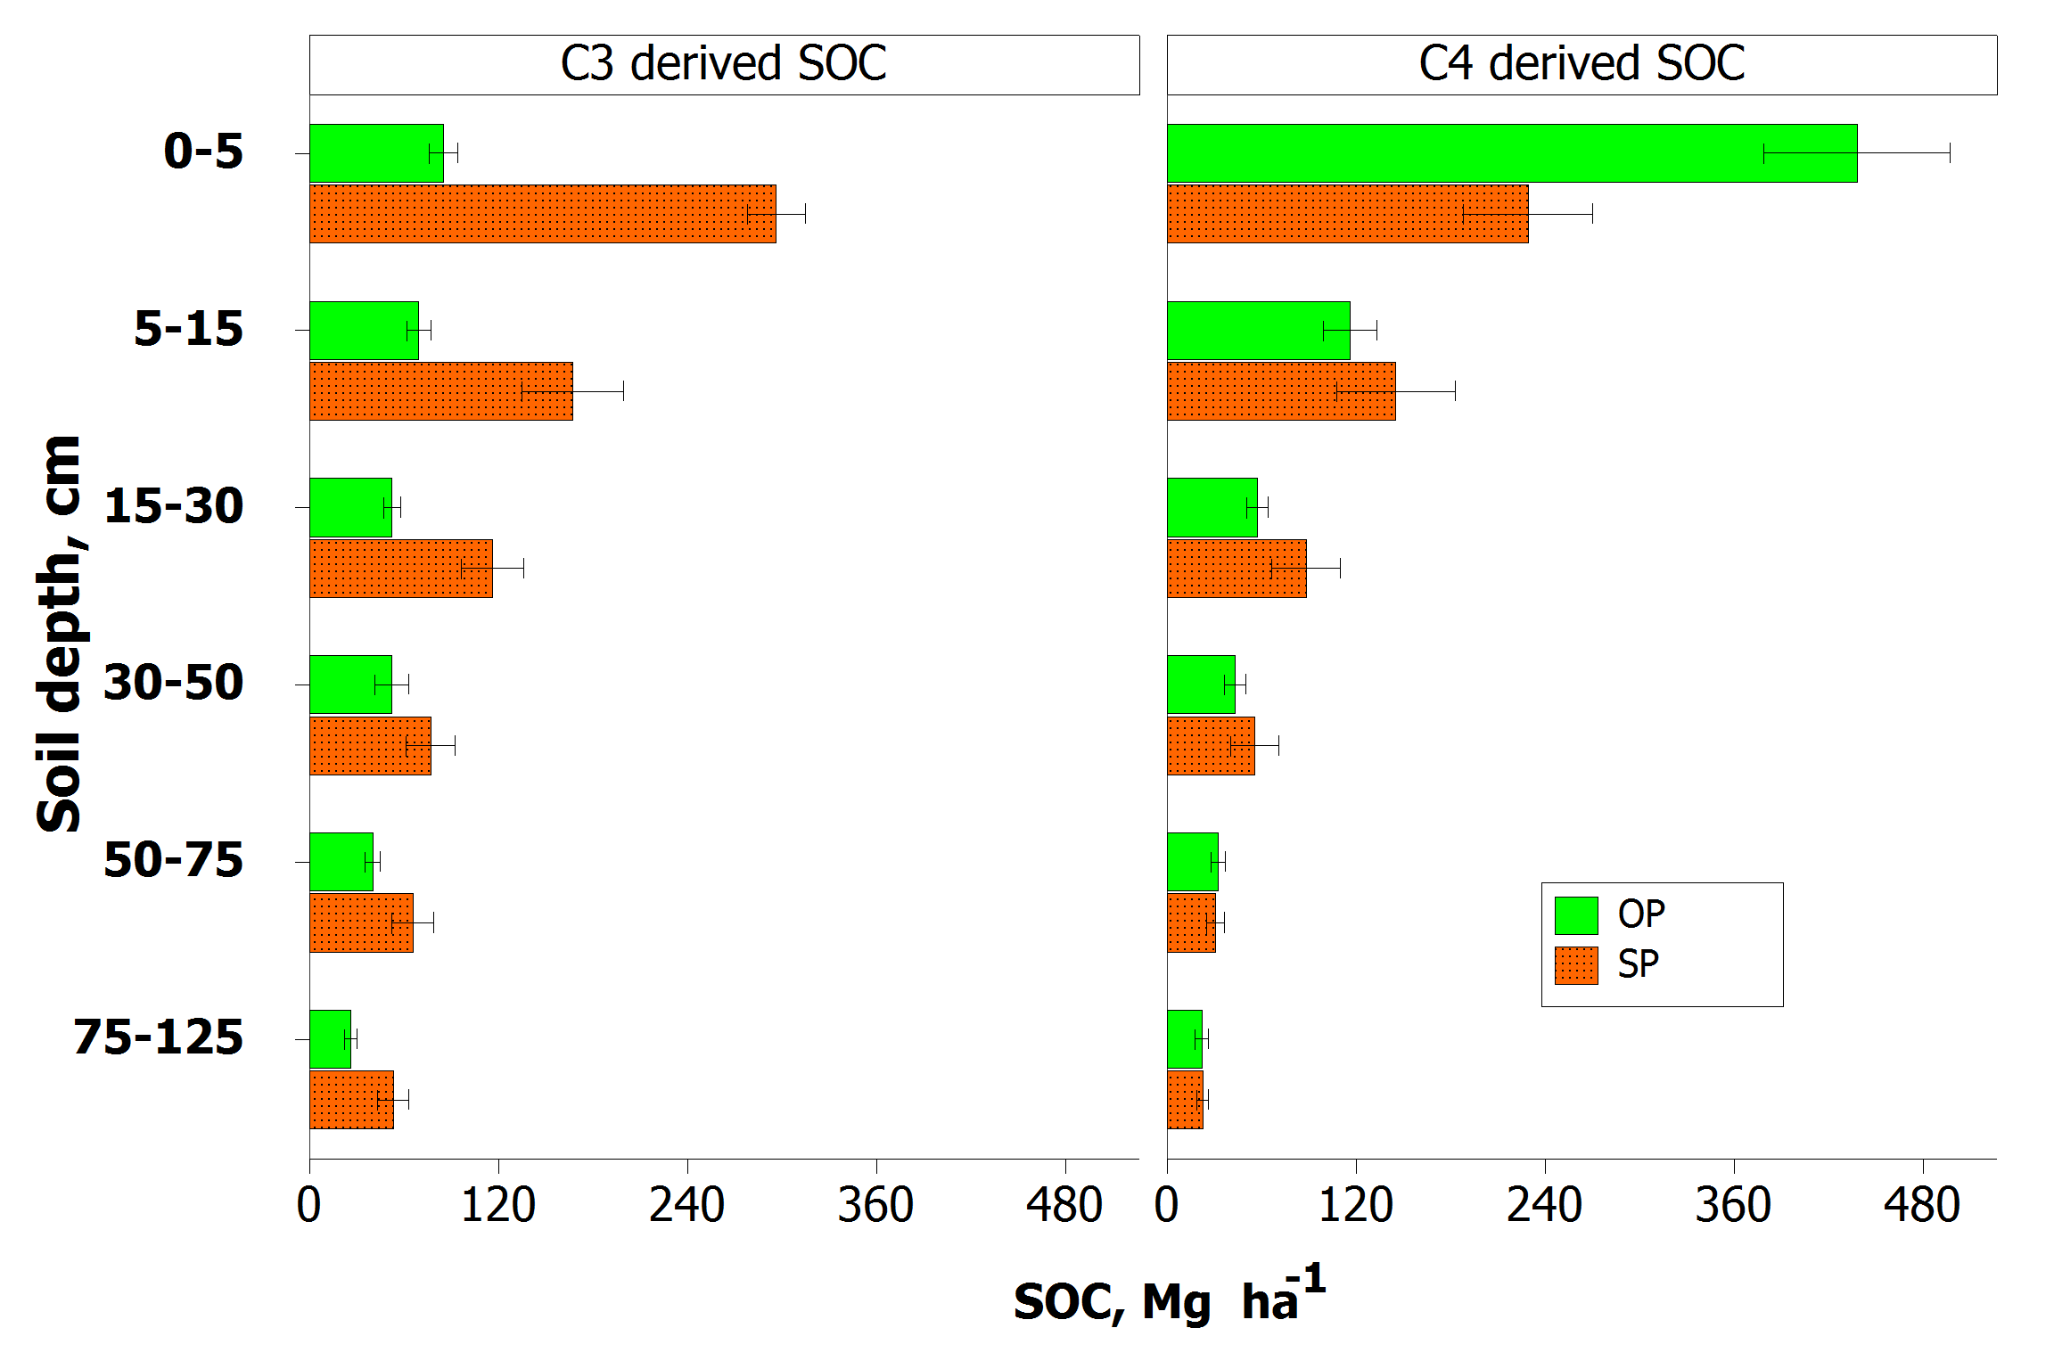
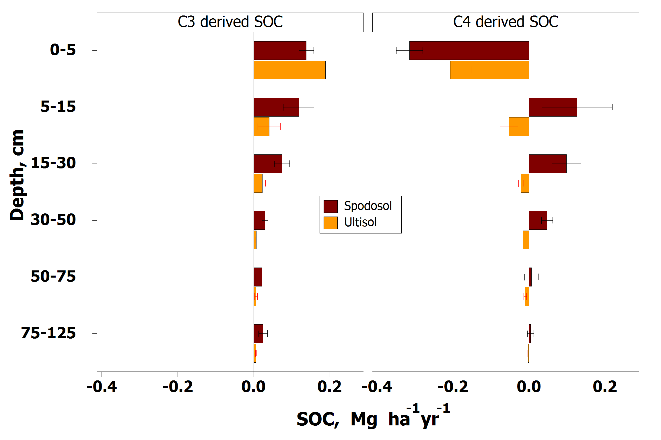
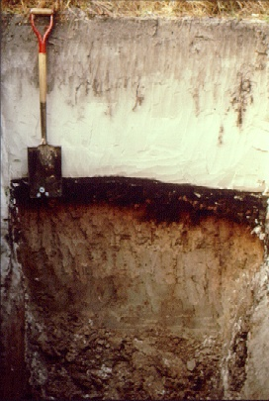
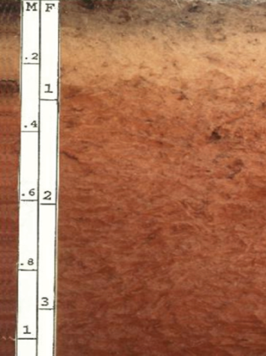
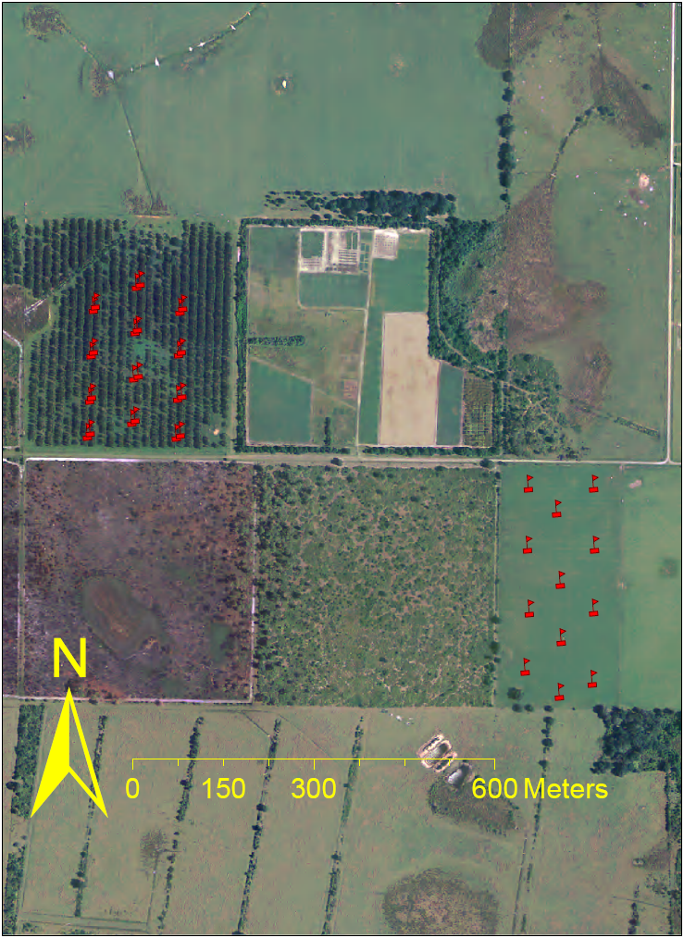
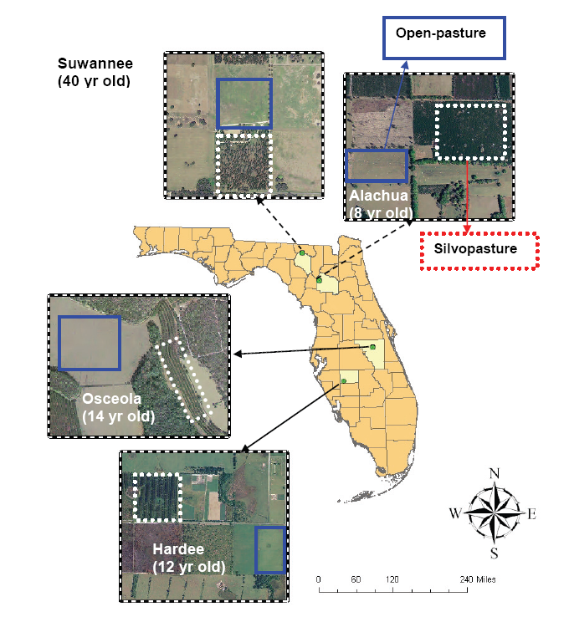
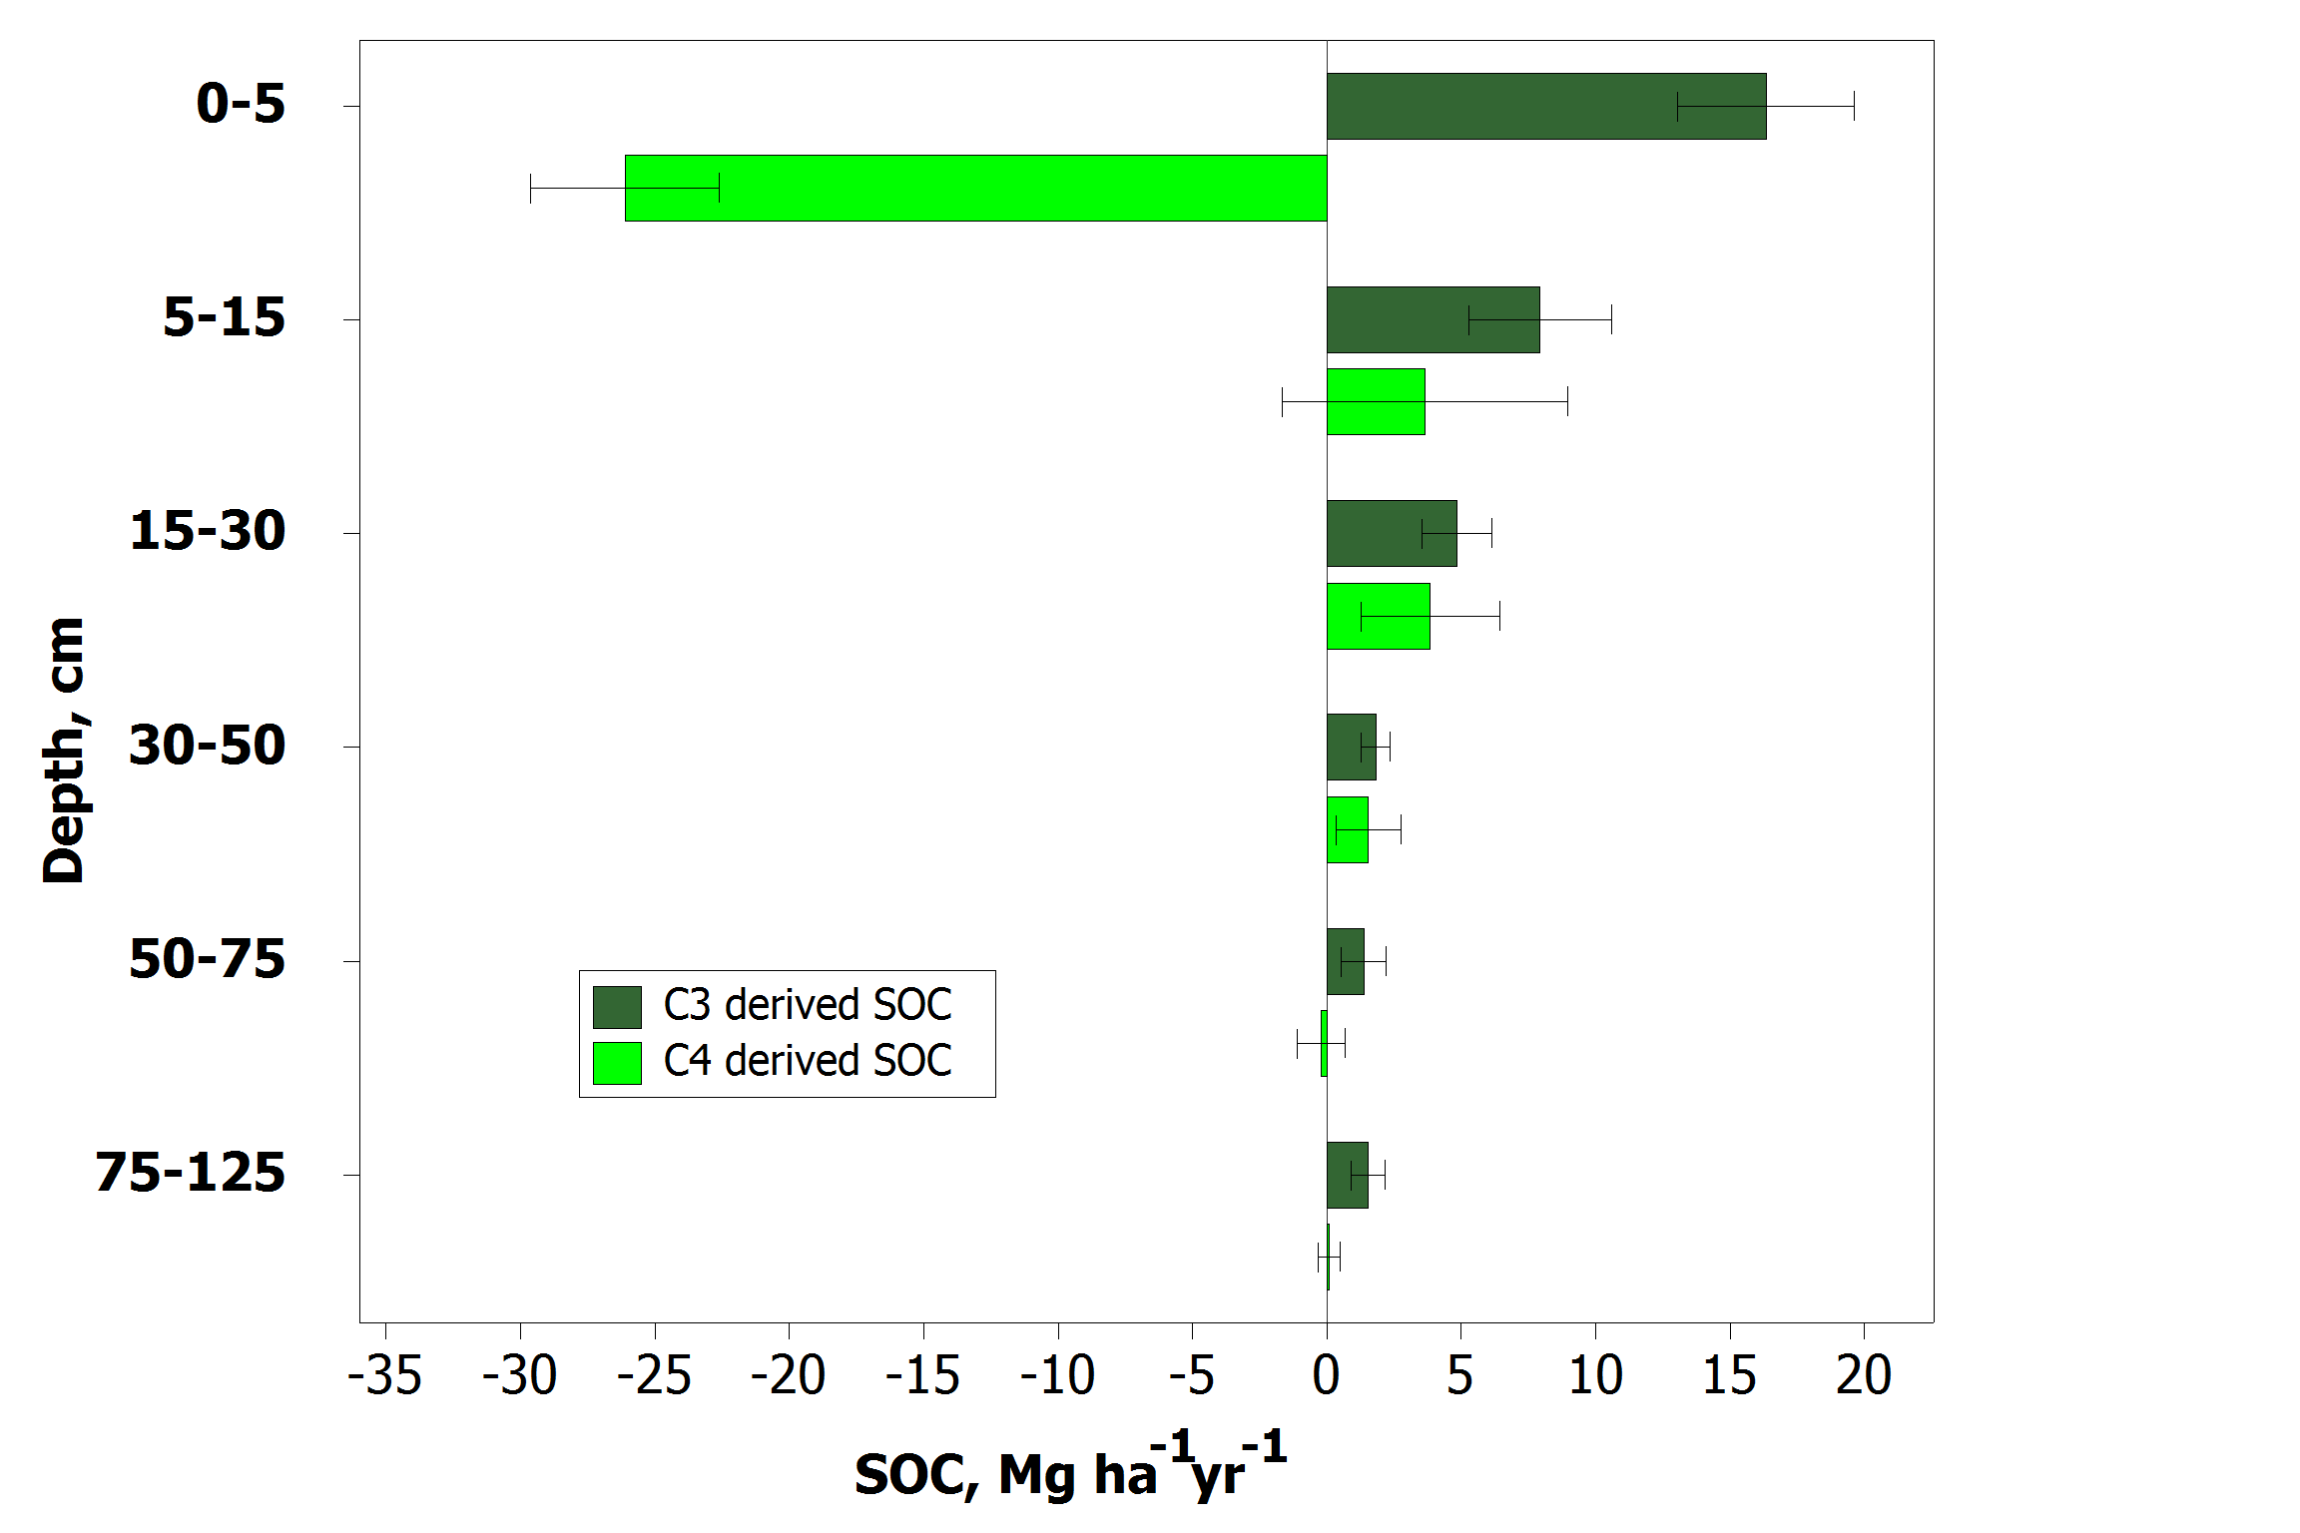


Tree integration into land-use systems as a strategy for soil carbon sequestration
S. G. Haile^{1, 2}, V. D. Nair² and P. K. R. Nair¹
¹Center for Subtropical Agroforestry, School of Forest Resources and Conservation, P.O. Box 110410;
²Soil and Water Science Department, P.O. Box 110510; Institute of Food and Agricultural Sciences, University of Florida, Gainesville, FL 32611.
Introduction
Results and Discussion
Land-use change or intensification can influence the dynamics and storage of soil organic matter (SOM) and the extent of carbon (C) sequestration in soils because of changes in ecosystem dynamics such as plant productivity and plant-litter inputs. In this study, we compared silvopastures (pastures into which trees had been integrated) and adjacent treeless pastures for their C3- and C4-derived soil organic C (SOC) content.
Hypothesis: Silvopasture (SP) has the potential for maximizing soil carbon (C) sequestration compared to adjacent treeless (open) pasture (OP)
Objectives: To determine (i) total soil C stored in soils, and (ii) trace the plant sources of C using stable isotope signatures in paired plots of slash pine-based SP and on adjacent OP located on Spodosols and Ultisols in Florida.
The C3-derived SOC in silvopasture was significantly higher than adjacent treeless pastures across all the depths except at 30-50 cm depth (Fig. 2). The average SOC across four sites and all depths increased 30% in silvopastures compared to the adjacent treeless pastures during the period after tree incorporation.
Materials and Methods
A
Ap
E
Bt
Study Area: Four sites were selected; two on a Spodosol and the other two on an Ultisol. Each site consisted of a pair of plots: a SP of slash pine (Pinus elliottii) + bahiagrass (Paspalum notatum), and an adjacent OP of bahiagrass (Fig. 1).
Bh
Bw
Spodosol profile
Ultisol profile
With a knowledge of the times of tree establishment in the pastures (8, 12, 14 or 40 years at the 4 sites), the C3-derived SOC in soils under the silvopasture was shown to increase by 6−31.8 and 0−5 Mg ha⁻¹ yr⁻¹ at the top (0−5 cm) and deep (75−125 cm) soil layers, respectively, compared to corresponding soil layers under treeless pasture (Fig.3 ).
Figure 2. Mean C3- and C4-derived soil organic carbon (SOC), Mg ha⁻¹, in the soil of open pasture (OP) and silvopasture (SP) across six soil depths.
Figure 4. Mean increase or decrease in C3- and C4-derived soil organic carbon (SOC), Mg ha⁻¹ yr⁻¹, in the soil of silvopasture (SP) across six soil depths for Spodosol and Ultisol sites.
The C4-derived SOC values in silvopasture were 0.9−3.5 Mg ha⁻¹ yr⁻¹ lower at the top soil layer than in the corresponding treeless pasture, whereas, in the deep (75−125 cm) soil layer, the values (Mg ha⁻¹ yr⁻¹) varied within a narrow range of - 0.1 (decrease) to 0.2 (increase) (Fig. 3).
The average increase of C3-derived SOC in each year of the silvopasture was greater in Spodosols than Ultisols in all the soil layers, except at the surface (0-5 cm) (Fig. 4). Higher increases were also observed for the C4-derived SOC, Mg ha⁻¹ yr⁻¹, in the silvopasture at the same depths.
Figure 1. Location of soil sampling sites
Soil Sampling
Sampling points: between trees in a row (SP-T) and at center of an alley (SP-A) in a SP system, and on OP
Six soil depths: 0 – 5, 5 – 15, 15 – 30, 30 – 50, 50 – 75, and 75 – 125 cm
Three sets of composite soils per depth per treatment, each prepared by mixing soil profiles from four sampling spots.
Conclusion
Elemental Analyses: Total soil C was determined by dry combustion on an automated FLASH EA 1112 N C elemental analyzer and stable C isotope ratio was measured in VG602 micromass spectrometer.
During the period after tree incorporation, the average SOC across four sites and all depths increased in silvopastures compared to the adjacent open pastures. Most of these increases, however, are contributed by the increase of C3-derived SOC in each year of the silvopasture establishment. This possibly represents the input to SOC from decomposition of dead tree-roots. Spodosol sites appear to have added more C3 and C4-derived SOC (per year of silvopasture establishment) at all depths except at the surface compared to the Ultisol sites. Results suggest that Spodosols would likely sequester more SOC (particularly at and below the Spodic horizon) than Ultisols during tree incorporation in pasture systems. Additional studies are needed to verify this observation.
Statistical Analyses: ANOVA GLM SAS procedure was used to determine differences in soil characteristics attributable to the landuse systems. Where ANOVA indicated significant effects due to land use systems Waller-Duncan K-Ratio t test was used for mean separation. Significance level was p<0.05.
Calculations:
Based on δ¹³C values for composite of plant-part samples (-28.5‰ for slash pine and -12.9‰ for bahiagrass; Haile et al., 2009), the SOC contribution of bahiagrass, a C4 plant, (F_{C}) vs. the slash pine, a C3 plant, was estimated by mass balance (Balesdent and Mariotti, 1996) :
F_{C} = (δ - δ_{WL}) / (δ_{G} - δ_{WL})
Where δ is the δ¹³C value of a given sample, δ_{G} is the average δ¹³C value of composite sample of pasture grass tissue, and δ_{WL} is the average δ¹³C value of composite sample of slash pine tissue .
References:
Balesdent, J., and A. Mariotti. 1996. Measurement of soil organic matter turnover using ¹³C natural abundance. In T.W. Boutton and S. I. Yamasaki (ed.) Mass spectrometry of soils. Marcel Dekker, New York pp. 83-111.
Haile, Solomon G, Nair, V. D., and Nair, P. K. R. (2009). Contribution of Trees to Soil Carbon Sequestration in Silvopastures. Global Change Biology DOI: 10.1111/j.1365-2486.2009.01981.x
Haile, Solomon G, Nair, P. K. R., and Nair, V. D. (2008). Soil Carbon Storage in Different Size Fractions in Silvopastoral Systems of Florida. J. Environ. Qual. 37(5) 1789-1797.
Lal, R. 2001. The potential of soil carbon sequestration in forest ecosystems to mitigate the greenhouse effect. In Soil carbon sequestration and the greenhouse effect. SSSA Special Publication Number 57, Soil Science Society of America, Inc., Madison, WI, USA.
Acknowledgments
Figure 3. Mean increase or decrease in C3- and C4-derived soil organic carbon (SOC), Mg ha⁻¹ yr⁻¹, in the soil of silvopasture (SP) as compared to open pasture (OP) at the four sites across six soil depths.
This research was supported in part by a grant from the USDA-Initiative for Future Agriculture and Food Systems (IFAFS) through the Center for Subtropical Agroforestry.

