Slide 1
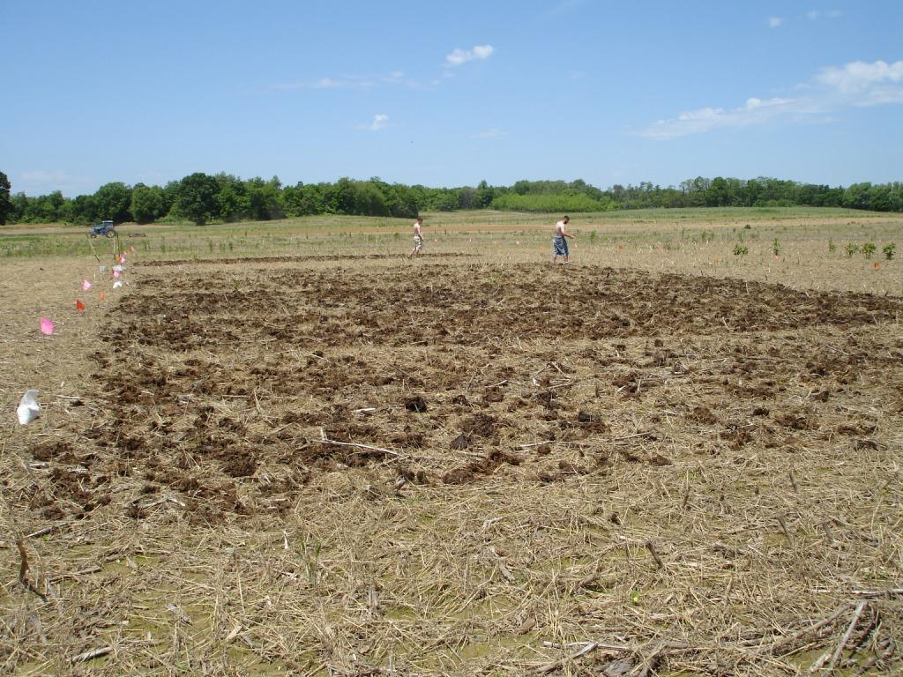
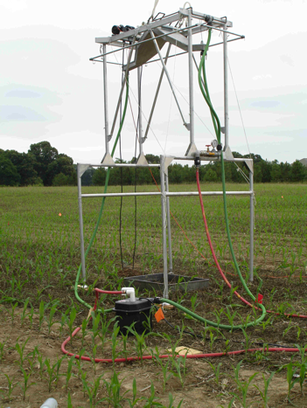

Nutrient management planning effects on runoff losses of phosphorus
Christopher Brosch, Robert Hill, Joshua McGrath, Patricia Steinhilber, Adel Shirmohammadi
Department of Environmental Science and Technology, University of Maryland, College Park, Maryland 20742
Introduction
Agriculture is a large contributor of non-point source pollution to surface water. Field surface application of manure as a soil amendment applies more phosphorus (P) than Zea maize uses when manure is applied at a rate satisfying the recommended amount of nitrogen (N) for crop production.
Managing manure application with Best Management Practices (BMPs) reduces the amount of nutrients entering surface water (Meyers et al., 1985).
Results
Runoff volume and plot size were used to determine total losses in terms of kg ha⁻¹. Bars in charts labeled with different letters indicate significant differences at the 5% level. When necessary, P losses were log transformed to remove patterns in the residuals and back-transformed for data presentation.
Poultry litter
Incorporating manure removed all nutrient management plan treatment effects on Soluble P losses. When manure was not incorporated, Soluble P loss increased with higher manure application rates.
SAP loss was two times higher at the Kville site than the Wye site. The largest SAP losses occurred for the high manure application rate as compared to soil that received no manure.
The Kville site had larger Total P losses than the Wye site. Incorporation also consistently removed NMP treatment differences in Total P losses. When manure was not incorporated, the largest Total P losses occurred for the high manure application rate as compared to soil that received no manure.
Dairy manure
Similar to the poultry litter results, Soluble P loss from both sites show that incorporation removed any differences between NMP treatments and when manure was not incorporated, N-rate manure exhibited more Soluble P loss than plots that received no manure.
The only significant differences in SAP losses occurred between the two sites. The Kville soils were clay loam soils in comparison to the sandy loam soils at the Wye site. The clay loam soils likely had higher concentrations of iron and aluminum oxides that would readily sorb P.
Significant differences in Total P losses only occurred for the Wye site. Kville samples exhibited similar NMP treatment means suggesting the same pattern of Total P loss, but increased variability at the Kville site eliminated significant differences.
Conclusions
Soluble P losses were a larger component of Total P losses for poultry litter in comparison to dairy manure Total P losses.
Incorporation resulted in non-significant NMP treatment differences in Soluble P and Total P for both types of manure at both sites.
N-based manure application rates where nutrients were not incorporated exhibited more Soluble P and Total P losses than plots that received no manure.
SAP was a significantly larger component of Total P losses when poultry litter was applied in comparison to dairy manure Total P losses.
Higher concentrations of oxides present in the Kville site soil likely increased SAP losses in comparison to SAP losses at the Wye site.
Materials and methods
Experimental design
Composted poultry litter was applied in 2007 and fresh dairy manure was applied in 2008 to separate plots at a Coastal Plain sandy loam (“Wye”) and an Appalachian clay loam (“Kville”) site. The experimental design each year at each site utilized 3 blocks in a random factorial arrangement with three nutrient management plans and two tillage treatments.
Treatments
Tillage treatments were incorporation and no incorporation of manure and fertilizer. Nutrient management plans (NMPs) were:
The simulated storm is equivalent to a 2 year recurrence interval storm in Maryland.
Sample analysis
Runoff samples were measured for volume, sediment, water soluble P (Soluble P), nitrate, ammonium, Total N and P. Sediment associated P (SAP) was determined by difference. Only P losses will be discussed.
Works cited
Meyers, C.E., J. Meek, S. Tuller, & A. Weinberg. 1985. Non-point Sources of Water Pollution. Journal of Soil and Water Conservation 40, 14-18.
Dairy NMPs “No P added fertilizer,” “P-removal rate manure” and “N-rate manure” from foreground to background
N Rate Manure
  A Nitrogen use based manure plan
  P-removal rate Manure
  A Phosphorus removal plan utilizing manure and nitrogen fertilizer
No P added Fertilizer
  No Phosphorus added plan using commercial fertilizer nitrogen
Rainfall simulation
Runoff samples were generated using a variable rate rainfall simulator applied at 76-mm hr⁻¹ for 30 minutes.
Rainfall simulator
Further information
Financial support from U.S.E.P.A. and the
Chesapeake Bay Nutrient Management Board.
Please contact cbrosch@gmail.com.
More information on this and related projects
can be obtained at www.enst.umd.edu.
Notes:
This poster template is from http://www.swarthmore.edu/NatSci/cpurrin1/posteradvice.htm. It is free, free, free for non-commercial use. But if you really like it, I’m always thrilled to get postcards from wherever you happen to be presenting your poster. Or, send me cookies! My kids made me put that last sentence in. Have fun. Sincerely, Colin Purrington, Department of Biology, Swarthmore College, Swarthmore, PA 19081, USA. Email: cpurrin1@swarthmore.edu

