Slide 1

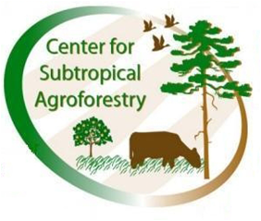

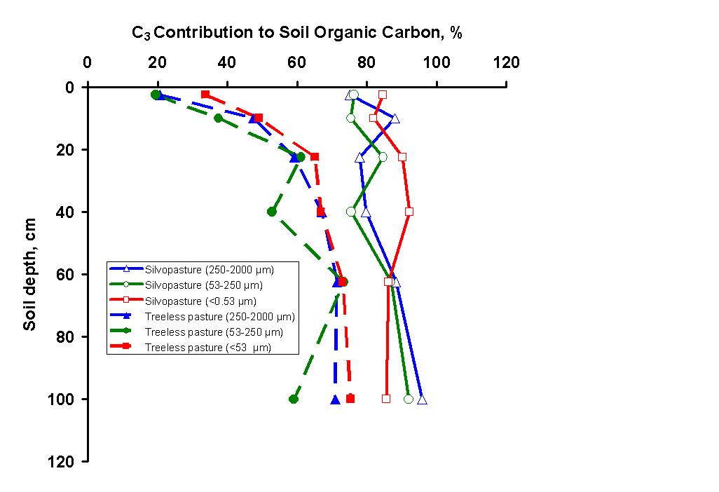
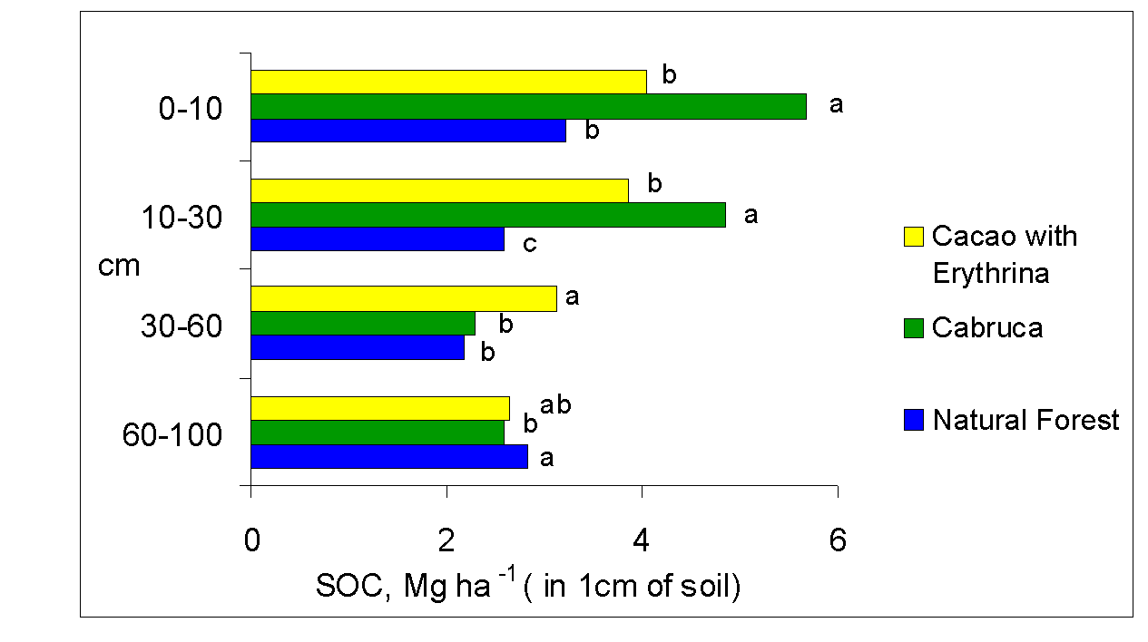
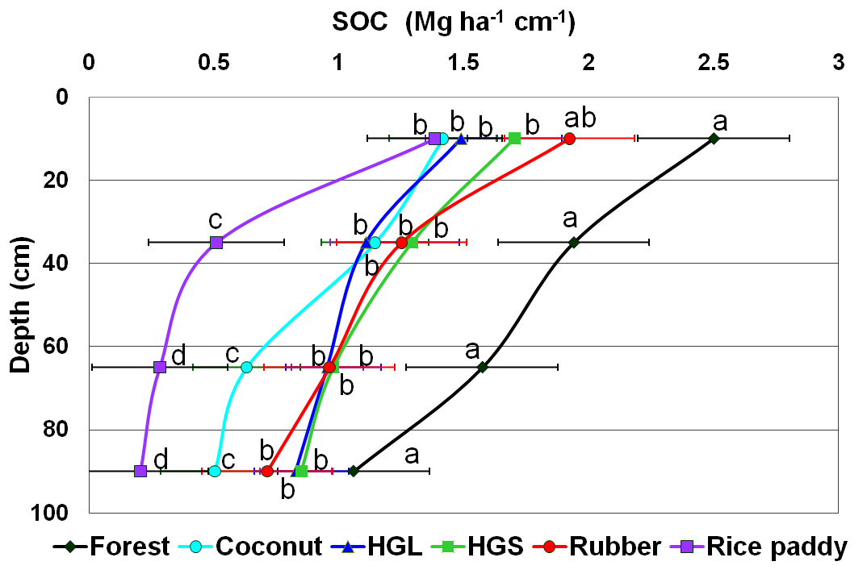
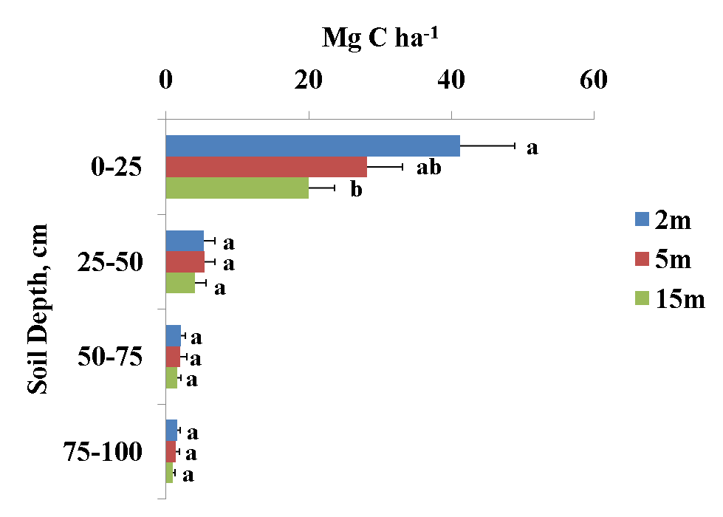
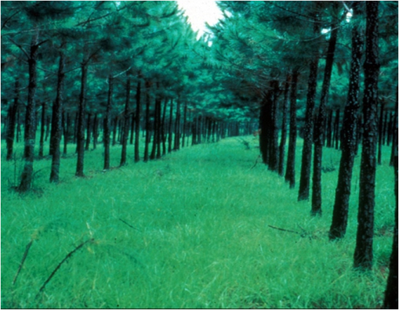
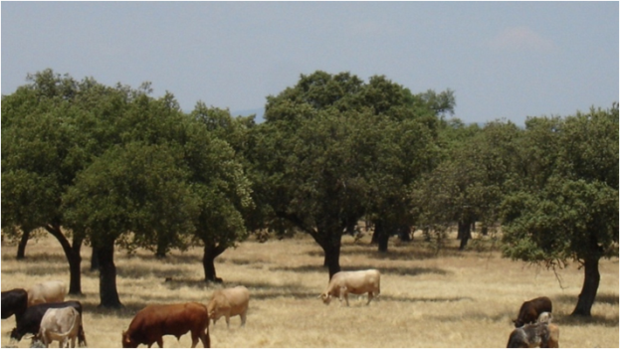
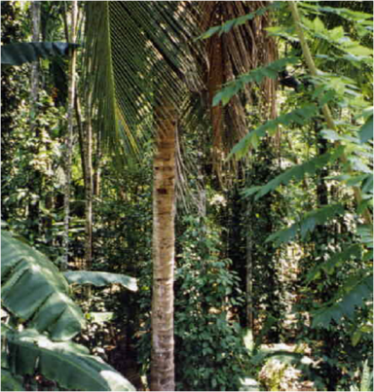
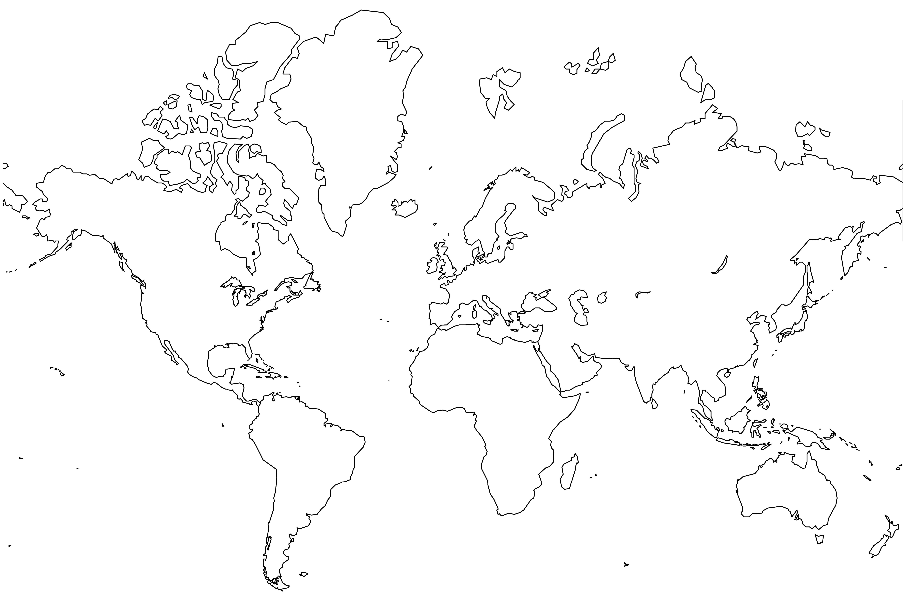

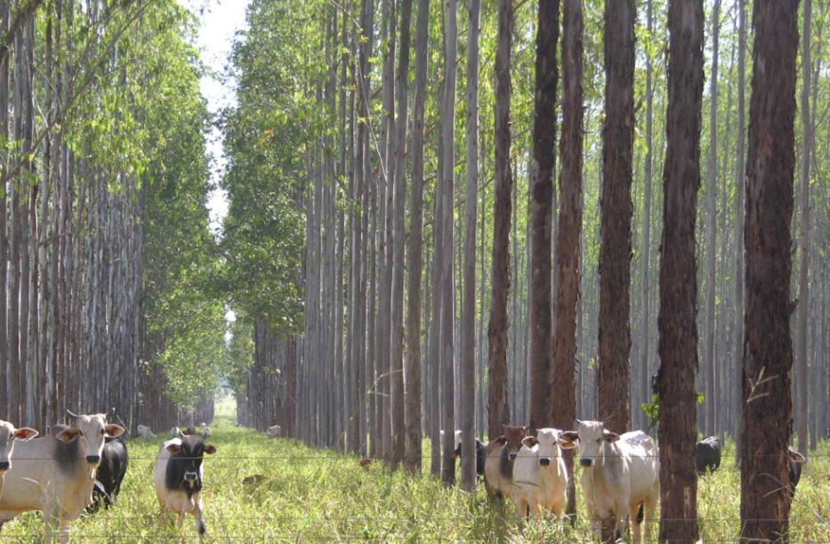
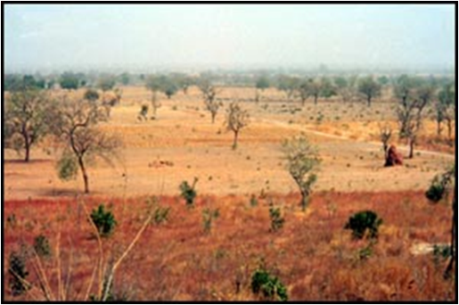
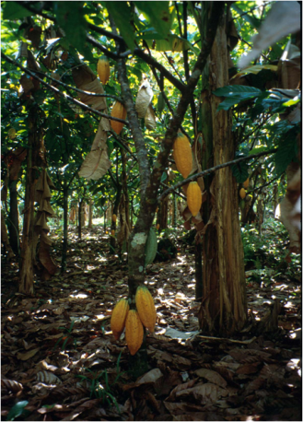
Soil Carbon Sequestration in Agroforestry Systems
Center for Subtropical Agroforestry (CSTAF),SFRC/IFAS, University of Florida, Gainesville, FL, USA
Primary Contact: P. K. Nair pknair@ufl.edu
Carbon Sequestration
Major Objectives
Results and Discussion
Definition: The process of removing C from the atmosphere and depositing it in a reservoir (UNFCCC = United Nations Framework Convention on Climate Change).
Carbon Sequestration in Soils as a Climate-Change-Mitigation Strategy :
… based on the assumption that the movement (flux) of C from air to soil can be increased while the release of C from the soil back to the atmosphere is decreased.
Global Estimates of Soil Carbon Stock:
The soil C pool, to 1 m depth, consists of:
Soil organic C (SOC) estimated at 1550 Pg (1 petagram = 10¹⁵ g = 1 billion ton)
Soil inorganic C about 750 Pg
  The total soil C pool (2300 Pg) is 3 X the atmospheric pool (770 Pg) and 3.8 X the vegetation pool of 610 Pg
  A reduction in soil C pool by 1 Pg is ~ an atmospheric CO₂ enrichment of 0.47 ppmv .
Quantify SOC storage, an indicator of sequestration, in different agroforestry systems.
Determine C storage in different soil fractions up to at least 1 m depth.
Quantify, wherever possible, C contribution by C₃ and C₄ plants (~ trees and herbaceous plants) using natural C isotopic differences between the two groups.
Florida, USA: Plant source of SOC at different soil depths
Bahia, Brazil: Shaded cacao
systems
Kerala, India: Homegardens & other land-uses
Extremadura, Spain:
Dehesa Silvopasture
1
2
3
Agroforestry and Carbon Sequestration
Silvopasture
Florida, USA
Dehesa,
Northern Spain
Homegardens
Kerala, India
HGL = Large Homegarden (> 0.4 ha);
HGS = Small Homegarden (< 0.4 ha)
The UNFCCC allows the use of C sequestration through afforestation and reforestation (A & R) as GHG offset activities.
Agroforestry (AF) is recognized as an A & R activity.
The Clean Development Mechanism (CDM) under the Kyoto Protocol allows industrialized countries to invest in mitigation projects in developing countries.
AF could be an attractive opportunity for subsistence farmers in developing countries – the major practitioners of agroforestry – to benefit economically by “selling” C.
Thus, AF is a win-win strategy for both developing and industrialized nations.
Figure 2. Tree-derived SOC in soil fractions of a 40 year-old silvopasture on an Ultisol in Florida, USA (Haile et al., 2009).
Figure 3. Soil C storage in cacao systems and a natural forest, Bahia, Brazil (Gama-Rodrigues et al., 2008).
Figure 4. SOC stock in land-use systems of Kerala, India (Saha et al., 2009).
Figure 5: Soil C storage to 1 m depth and at distances from Q. suber tree in the dehesa silvopastoral system, Spain. (Howlett, 2009).
2
1
4
Changes in soil C stock under different AF vs. non-AF systems
6
3
4
Table 3. Soil organic matter (SOC) stock in different soil fractions up to 1 m depth
under various agroforestry systems.
6
5
Location, Soil | SOC to 1 m depth (Mg ha⁻¹) | Distribution of soil fractions and their SOC content to 1 m depth
 |  | < 53 µm |  | 53 – 250 µm |  | 250 – 2000 µm
 |  | % weight of total soil | % of total SOC | % weight of total soil | % of total SOC | % weight of total soil | % of total SOC
1. Florida, USA: Spodosols Ultisols | 182 to 266 | 2 .0 | 8.5 | 61 | 38.9 | 34 | 52.6
 | 76 to 108 | 3.0 | 18.2 | 49 | 28.2 | 44 | 53.6
2. N. Central Spain: Inceptisols (1) Alfisols (2) | 80 to 177 | 4.9 | 12.1 | 24.3 | 32.4 | 42.1 | 55.4
 | 27 to 50 | 26.7 | 20.4 | 31.0 | 29.5 | 66.6 | 50.0
3. Kerala, India: Inceptisols | 108 to 119 | 30.0 | 32.6 | 34.0 | 35.6 | 31.0 | 31.8
4. Ségou, Mali: Alfisols | 28 to 33 | 44.5 | 40.9 | 26.7 | 24.6 | 37.5 | 34.5
5. Bahia, Brazil: Oxisols | 300 to 320 | 7.0 | 8.0 | 19.0 | 20.0 | 73.0 | 72.0
6. Minas Gerais, Brazil: Oxisols | 385 to 460 | 21.0 | 22.0 | 24.0 | 27.0 | 51.0 | 47.0
Table 1. Indicative values of soil carbon sequestration potential (SCSP)
under major agroforestry systems in the tropics.
Silvopasture
MG, Brazil
Shaded cacao
Bahia, Brazil
Parklands
Ségou, Mali
Agroforestry Systems | System Characteristics | SCSP (Mg C ha⁻¹) to 1 m soil depth | Time Frame (yr)
Shaded perennial systems | New/ young, <5 yr-old | 100 – 200 | 10
Alley cropping | New/ young, <5 yr-old | 30 – 120 | > 10
Homegardens | > 750 trees ha⁻¹ | 100 – 180 | > 20
Tree intercropping | ~ 50 trees ha⁻¹ | 70 – 120 | > 20
Silvopasture (semiarid grazing systems) | < 10 yr-old; ~ 50 trees/ha | 30 – 50 | >25
Figure 1: Univ. Florida, Center for Subtropical Agroforestry: Carbon Sequestration Studies, 2005 – –
Table 2. CSTAF “Soil Carbon Sequestration under Agroforestry Systems” Project; University of Florida: Site- and system characteristics of different agroforestry systems.
# | Systems; age (# years since AF system installation) | Location | Soil Order
1 | Pine + pasture vs. treeless pasture; 30 yr | Florida, USA | Ultisols
2 | Pasture under birch trees vs. treeless pasture; | Northern Spain | Inceptisols
3 | Home garden vs. rice paddy; >50 y | Kerala, India | Inceptisols
4 | Under tree vs. away from trees ( Dehesa); 80 y | Northern Spain | Alfisols
5 | Under trees vs. away from trees; Parkland system; >50 y | Ségou, Mali | Alfisols
6 | Homegardesn vs. forest: >50 y | Kerala, India | Inceptisols
7 | Cacao under shade vs. forest; > 30 y | Bahia, Brazil | Oxisols
8 | Brachiaria + Eucalyptus vs. Treeless forage stand; 30 y | Minas Gerais, Brazil | Oxisols
Sites |  |  | Agroforestry System | Reference
Location; Coordinates | Climate (m.a.p; Mean temp. range) | Soil Order
Florida, USA; 28° to 29° N; 81° to 83° W | Humid subtropical; 1330 mm; -3 to 28º C | Spodosols, Ultisols | Silvopasture: slash pine (Pinus elliottii) + bahiagrass (Paspalum notatum) | Haile et al., 2008; 2009.
Northern/ Cent. Spain 40° to 43º N; 6° to 7º W | Humid Atlantic / subhumid Mediterranean; 1200/ 600 mm; 6-18°C/ 8-26°C | Inceptisols, Alfisols | Simulated silvopasture: pine (Pinus radiata) and European Birch (Betula alba), Dehesa oak silvopasture (Quercus suber) | Howlett, 2009.
Kerala, India; 10º32’ N; 76º14’E | Humid tropical; 2700 mm; 27 to 32ºC | Inceptisols | Homegardens: Intensive multispecies mixtures of trees, shrubs, and herbs in small (< 0.5 ha) holdings around homes. | Saha et al., 2009.
Ségou, Mali; 13º 20’ N; 6º 10’ W | Semiarid tropical; 500 to 700 mm; 29 to 36ºC | Haplustalfs | Intercropping under scattered trees, > 30 yr old; and < 10-yr-old plantings of live fences and fodder banks. | Takimoto et al., 2008 a; b.
Bahia, Brazil; 14º 0’ S; 39º 2’ W | Humid tropical; 1500 mm; 25 to 32ºC | Reddish-yellow Oxisols | Cacao (Theobroma cacao) under thinned natural forest (cabruca) or planted shade trees; 30-yr old. | Gama-Rodrigues et al., 2008.
Minas Gerais, Brazil 17º 36’ S; 46º 42’ W | Cerrado: Subhumid tropical; 1350 mm; 22ºC | Oxisols | Silvopasture: Eucalyptus spp. with understory of Panicum spp (fodder grass) or rice (Oryza sativa). | Tonucci, 2010.
Soil Sampling & Analysis
At all sites, soils were sampled up to at least 1 m depth in multiple depth classes and fractionated into three classes (250 – 2000, 53 – 250 and <53 µm), and the C contents in each determined. Stable isotope ratio was used to determine, wherever applicable, the relative contribution of trees and grasses to soil C.
Figure 5. Changes in SOC stock in upper and lower soil layers under AFS vs. non-AFS.
Source: Nair et al. (2009).
Conclusions
  Research Collaborators:
  R. Garcia, Animal Sci Dept., Federal Univ of Viçosa, MG, Brazil
  E.F. Gama-Rodrigues, CCTA, Campos dos Goytacazes, RJ, 28013-602 Brazil
  S.G. Haile, Soil & Water Sci. Dept., UF, Gainesville, FL 32611-0510, USA
  D.S. Howlett, CSTAF/SFRC, IFAS, UF, Gainesville, FL 32611-0410, USA
  B.M. Kumar, College of Forestry, Kerala Agri Univ., Thrissur 680656, India
  M.R. Mosquera-Losada, Univ Santiago de Compostela, Lugo, Spain
  P.K.R. Nair, CSTAF/SFRC, IFAS, UF, Gainesville, FL 32611-0410, USA
  V.D. Nair, Soil & Water Sci. Dept, IFAS, UF, Gainesville, FL 32611-0510, USA
  S.K. Saha, CSTAF/SFRC, IFAS, UF, Gainesville, FL 32611-0510, USA
  A.N.G. Takimoto, UNDP, New York
  R. G. Tonucci, Federal Univ of Viçosa , Brazil and CSTAF/SFRC, IFAS, UF, FL, USA
Some Recent Publications
Haile, S.G., Nair, P.K.R., Nair, V.D. 2008. C storage of soil-size fractions in Fl. silvopastoral syst. J. Environ. Qual. 37: 1789 – 1797.
Haile, S.G., Nair, V.D., Nair, P.K.R. Contribution of trees to soil carbon sequestration in silvopasture. Global Change Biology (in press).
Howlett, D.S. 2009. Environ amelior potential of silvopast AFS in Spain: Soil C sequestr and phosphorus retention. Ph D Diss., U Fla.
Nair, P.K.R., Kumar, B.M., Nair, V.D. 2009. Agroforestry as a strategy for carbon sequestration. J. Soil Sci. Pl Nutrition 172: 10–23
Nair, P.K.R., Nair, V.D., Kumar, B.M., Haile, S.G. Soil C seq in trop. AFS A feasibility appraisal. Environ Science and Policy (in press).
Saha, S.K., Nair, P.K.R., Nair, V.D., Kumar, B.M. 2009. Soil C storage & pl diversity of homegardens Kerala, India Agrofor Syst 76: 53– 65.
Saha, S.K., Nair, P.K. R., Nair, V.D., Kumar, B.M. Carbon storage in soil size-fractions … tree-based systems. Plant and Soil (in press).
Takimoto, A., Nair, P.K.R., Nair, V.D. 2008. Carbon stock and seq potential AF systems in W Afr Sahel. Agri. Ecosys. Env. 125: 159 – 166.
Takimoto, A., Nair, P.K.R., Alavalapati, J.R.R. 2008. Socioecon of C seq W. Afr Sahel. Mitig Adapt of Strateg Global Change 13: 745–761.
Takimoto, A., Nair, V.D., Nair, P.K.R. 2008. Soil C seq potential of AF practices in the West African Sahel. Agrofor Syst 76: 11–25.
The amount of C stored in soils depends on soil qualities, esp. silt + clay content.
Tree-based agricultural systems, compared to treeless systems, store more C in deeper soil layers under comparable conditions.
Long-term AF systems (e.g. shaded perennials and homegardens) store similar or more amounts of SOC in upper soil layers compared with adjacent natural forests.
Higher SOC content is associated with higher species richness and tree density.
Soil near the tree, compared to away from the tree, stores more C.
C3 plants (trees) contribute to more C in the silt- + clay-sized (<53 µm) fractions than C4 plants in deeper soil profiles.

