Slide 1
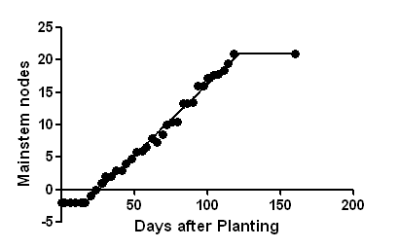
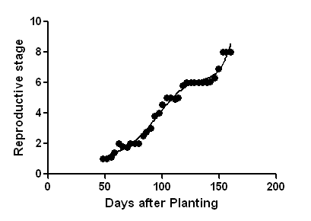
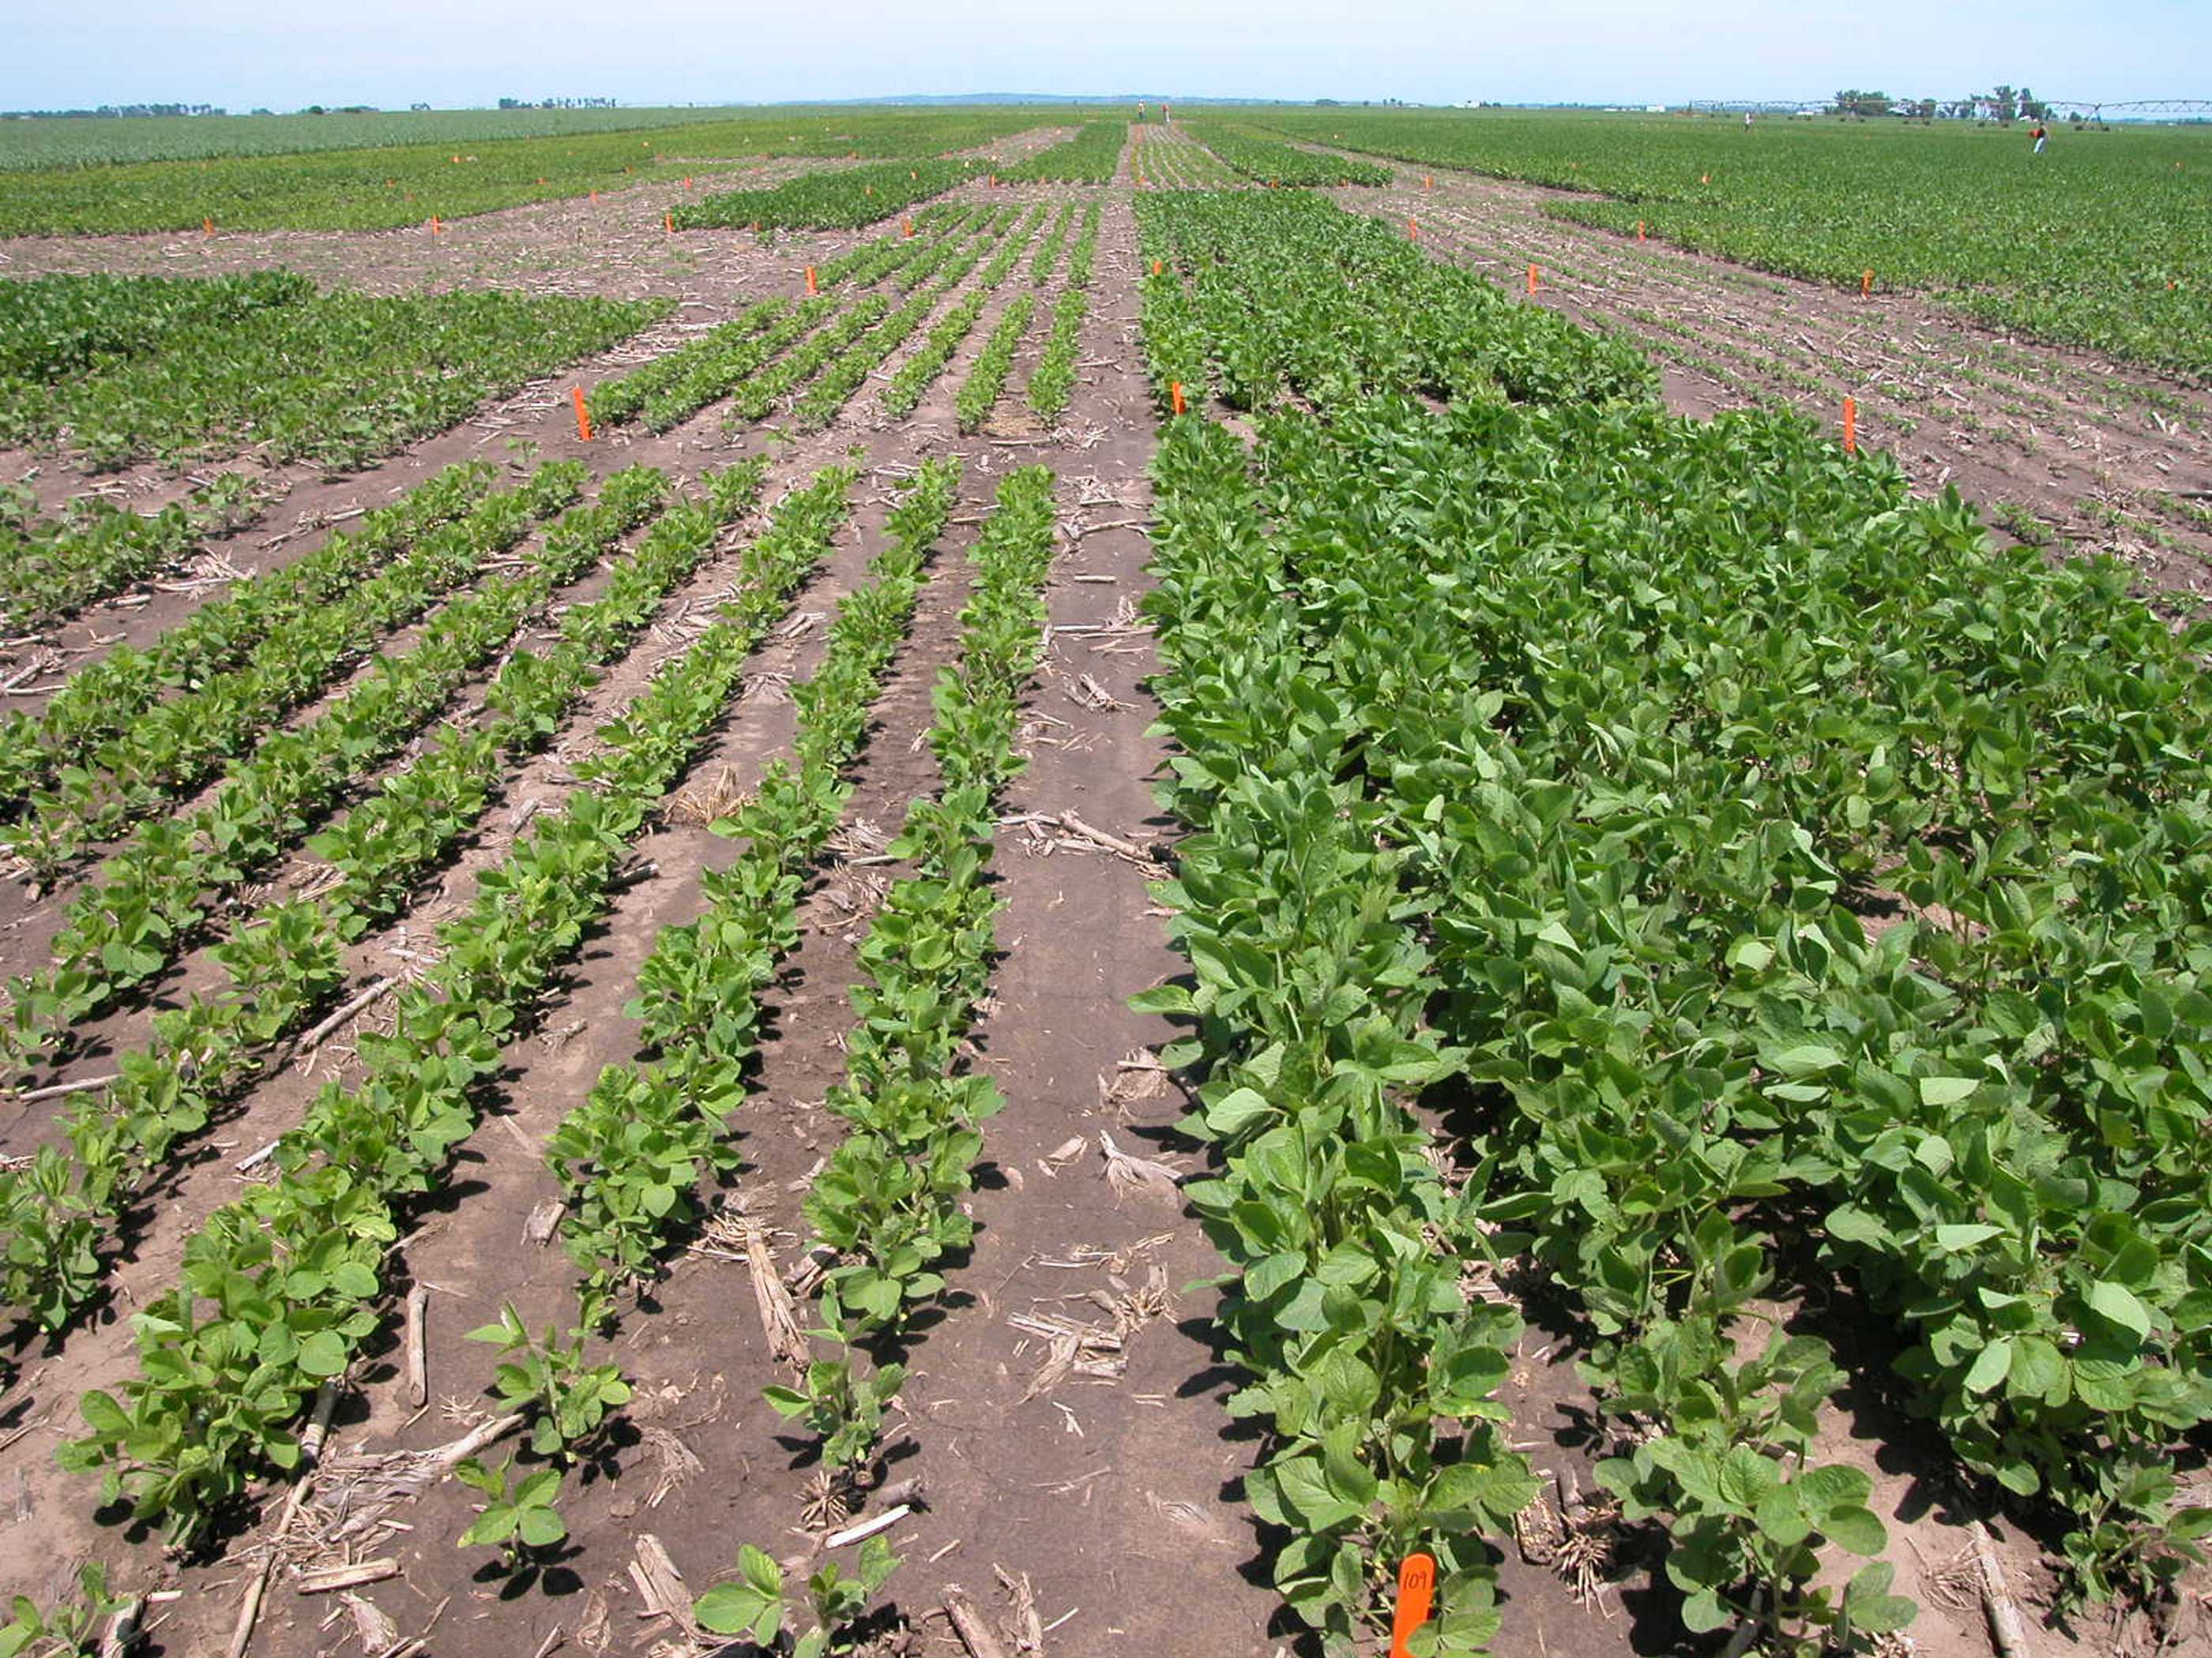
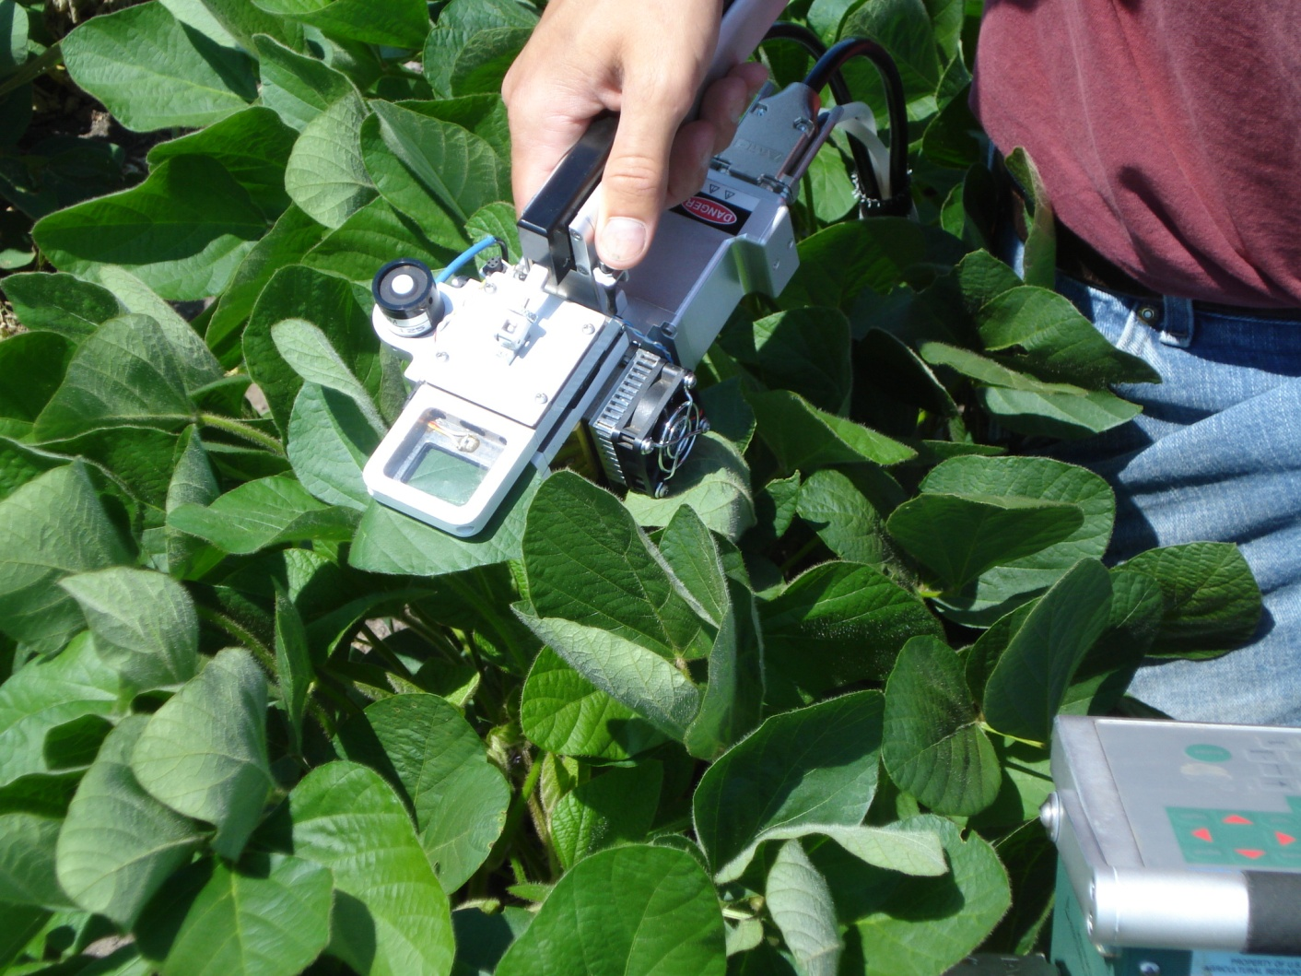
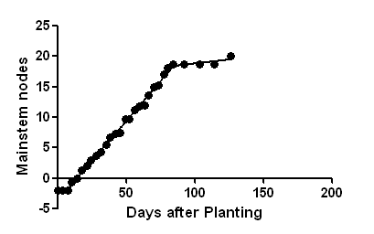
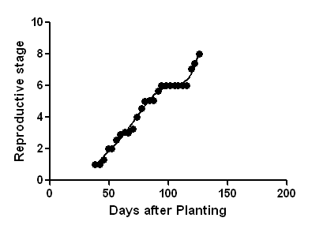
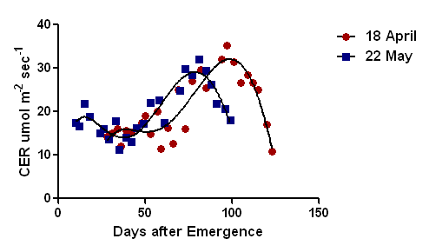
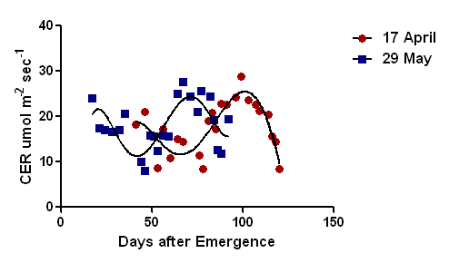
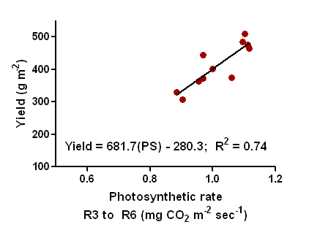

Photosynthetic Rate of Soybean at Various Planting Dates
Jason L. De Bruin¹, Jeremy W. Singer², and Palle Pedersen¹
¹Department of Agronomy, Iowa State University (jsndbrn@iastate.edu); ²The National Laboratory for Agriculture and the Environment, USDA-ARS
Introduction:
Early planting (Fig. 1a) is a current recommendation for increasing soybean [Glycine max (L.) Merr.] yield in the upper Midwest, USA. Average yield loss in Iowa for delayed planting is 70 kg ha⁻¹ wk⁻¹ between late April and early May (De Bruin and Pedersen, 2008) with the rate of yield decline increasing to 130 and 404 kg ha⁻¹ wk⁻¹ for the time period early May to late May and late May to early June, respectively. Others in the upper Midwest have reported 200 kg ha⁻¹ (Lueschen et al., 1992) and 300 kg ha⁻¹ (Grau et al., 1994) yield losses due to delays in planting from early May to mid-May. Explanations such as earlier flowering (Kantolic and Slafer, 2001), greater dry matter production (Anderson and Vasilas, 1985), and increased main-stem node accumulation (Bastidias et al., 2008) have been reported as partial explanations for greater yield at earlier planting dates. We hypothesize the rate of carbon fixation and radiation use efficiency during the critical yield period (R3 to R6; Fehr and Caviness, 1977) would provide an explanation for increased dry matter and yield caused by early planting.
a
b
a
b
R3 to R6
Duration = 35 days
-2 = planting
-1 = emergence (VE)
Figure 1. Plant size differences due to different planting dates (a) and measuring carbon exchange rate on individual soybean leaflets in the field (b).
c
d
a
35 d
35 d
R3 to R6 Duration = 35 days
-2 = planting
-1 = emergence (VE)
Materials and Methods:
Studies were conducted during 2007 and 2009 at Ames, Iowa. Experimental design was a randomized complete block design with three replications. Five and six planting dates were established at approximately one week intervals between the middle of April and the end of May during 2007 and 2009, respectively. Following planting the emergence date (50% through the soil) was determined (-1; Fig. 2a and c). Throughout the season vegetative and reproductive growth stages were recorded twice each week. Carbon dioxide exchange rate (CER) data were collected using a LI-6400 (LI-COR Biosciences; Lincoln, NE) as soon as leaflet size was adequate to fill the 6 cm² chamber (Fig. 1b). During the season three leaflets, of adequate size, were randomly selected from trifoliolates one node below the most recently unrolled (i.e leaf margins not touching) trifoliolate. Carbon dioxide exchange was measured twice weekly beginning at approximately V4 (five nodes) and continuing until leaf senescence (R7). Leaf area index (LAI) was measured non-destructively using a LI-COR LAI-2000 following the attainment of sufficient canopy for measurements. Light interception (LI) was measured each week using a Li-Cor line quantum sensor beginning at the same time as LAI measurements. Dry matter samples were collected from 1.52 m² areas at growth stages R1, R3, R5.5, and R8. Models published by Sinclair and Horie (1989) that incorporate LI, shade and sun LAI, light saturated CER for individual leaves, incoming solar radiation, and the daily angle of the sun were used to estimate grams of carbon fixation, dry matter accumulation, radiation use efficiency (RUE) for the canopy between R3 and 5.5, a period critical for seed number determination.
Figure 2. Vegetative and reproductive stages of soybean following 18 April (a & b) and 22 May (c & d) planting during 2007, Ames Iowa.
b
28 d
31 d
Table 1. Yield, predicted and measured dry matter accumulation, and carbon fixation for five planting dates in 2007 and six planting dates in 2009, Ames, IA.
Year | Planting date | Yield | RUE (R3 to R6) | Photosynthetic rate (R3 to R6) | Carbon fixation (R3 to R6) | Predicted crop growth rate (R3 to R6) | Predicted dry mater (R3 to R5.5) | Measured dry matter (R3 to R5.5)
 |  | g m⁻² | g MJ⁻¹ | mg CO₂ m⁻² sec⁻¹ | g C0₂ m⁻² | g m⁻² day⁻¹ | g m⁻²
2007 | 18 April | 509 | 1.64a | 1.10a | 1641.7a | 15.5 | 445.0a | 466.3a
2007 | 2 May | 485 | 1.63a | 1.09a | 1307.2c | 15.3 | 332.4b | 303.6b
2007 | 11 May | 476 | 1.63a | 1.11a | 1441.7b | 15.3 | 304.5c | 263.0b
2007 | 16 May | 464 | 1.62b | 1.12a | 1623.7a | 15.4 | 214.5e | 270.9b
2007 | 22 May | 445 | 1.59c | 0.97b | 1591.2a | 15.1 | 251.2d | 264.2b
P-value |  | 0.49 | 0.01 | 0.02 | <0.01 | 0.45 | <0.01 | 0.01
2009 | 17 April | 329bc | 1.63c | 0.88 | 1374.3a | 14.7a | 265.7b | 179.4**
2009 | 24 April | 308c | 1.65bc | 0.90 | 1378.3a | 14.7a | 264.7b | 212.2
2009 | 4 May | 363abc | 1.66bc | 0.96 | 1383.7a | 14.7a | 263.4b | 282.1
2009 | 11 May | 401a | 1.68ab | 1.00 | 1193.9b | 14.0b | 305.1a | 258.1
2009 | 19 May | 375ab | 1.69a | 1.06 | 1081.3c | 14.2b | 265.8b | 238.4
2009 | 29 May | 373ab | 1.69a | 0.97 | 1080.1c | 12.7c | 247.6c | 227.5
P-value |  | 0.05 | 0.02 | 0.17 | <0.01 | <0.01 | <0.01 | 0.11
Figure 3. Seasonal CER for 18 April and 22 May planting during 2007 (a) and 17 April and 29 May planting during 2009 (b), Ames Iowa. Horizontal bars indicate duration of R3 to R6.
** indicates difference between predicted and measured dry matter was different from zero at P = 0.01
Figure 4. Relationship between carbon dioxide exchange rate and radiation use efficiency (a) and yield (b) for multiple planting dates during 2007 and 2009.
Results and Discussion:
Early planting lengthened the time from planting to emergence, increased the number of mainstem nodes (Fig. 2a and c), did not influence the R3 to R6 period duration (35 days) during 2007, but lengthened it by 3 days during 2009 (Fig. 3a and b).
Carbon dioxide exchange data were fit generally well by 5th order polynomial models (Fig. 3) (R² values between 0.58 and 0.89) with a declining period prior to R1, a linear increasing period between R1 and R6, followed by a declining CER rate until leaf senescence.
During both years early planting did not result in consistent yield increases. In 2007 the effect was non-significant and in 2009 planting 11 May produced greater yield than 17 April even though early planting had greater carbon fixation between R3 and R6 (Table 1).
During 2007, early plantings were more efficient at producing dry matter (RUE = 1.64 vs. 1.59 g MJ⁻¹) but during 2009 RUE increased as planting was delayed (RUE = 1.63 vs. 1.69 g MJ⁻¹) (Table 1).
Total carbon fixation between R3 and R6 was always greater for early planting dates compared with the latest planting date leading to increased predicted dry matter by R5.5 and R6 for dates in 2007 but not in 2009 (Table 1).
Using LAI, LI, CER, and solar radiation provided a fairly accurate prediction of dry matter accumulated between R3 and R5.5. Entry of sudden death syndrome into the 17 April planting date was likely the cause of the poor agreement (Table 1).
As CER increased, RUE (Fig. 4a) and yield (Fig. 4b) increased linearly. These data indicate soybean becomes more efficient at producing dry matter as CER increases, yield is strongly related to CER rate between R3 and R6, and both RUE and CER were factors that were increased by early planting in 2007 but not in 2009. Historically cool temperatures during July and August , 2009 may explain this inconsistent response between years.
Acknowledgments:
The authors thank Jose Rotundo for assistance in taking CER measurements and data analysis, Brent Pacha, Catherine Swoboda, Alecia Kiszonas, Tim Berkland, and James Lee for assistance, and the Iowa Soybean Association for funding.
References:
Anderson, L.R., and B.L. Vasilas. 1985. Effects of planting date on two soybean cultivars: seasonal dry matter accumulation and seed yield. Crop Sci. 25:999-1004.
Bastidas, A.M., T.D. Setiyono, A. Dobermann, K.G. Cassman, R.W. Elmore, G.L. Graef, and J.E. Specht. 2008. Soybean sowing date: the vegetative, reproductive, and agronomic impacts. Crop Sci. 48:727-740.
De Bruin, J.L., and P. Pedersen. 2008. Soybean seed yield response to planting date and seeding rate in the upper midwest. Agron. J. 100:696-703.
Fehr, W.R., and C.E. Caviness. 1977. Stages of soybean development. Special Report 80. Iowa Agric. Home Econ. Exp. Stn., Iowa State Univ., Ames.
Grau, C.R., E.S. Oplinger, E.A. Adee, E.A. Hinkens, and M.J. Martinka. 1994. Planting date and row width effect on severity of brown stem rot and soybean productivity. J. Prod. Agric. 7:347-351.
Kantolic, A.G., and G.A. Slafer. 2001. Photoperiod sensitivity after flowering and seed number determination in determinate soybean cultivars. Field Crops Res. 72:109-118.
Lueschen, W.E., J.H. Ford, S.D. Evana, B.K. Kanne, T.R. Hoverstad, G.W. Randall, J.H. Orf, D.R. Hicks. 1992. Tillage, row spacing, and planting date effects on soybean following corn and wheat. J. Prod. Agric. 5:254-260.
Sinclair, T.R., and T. Horie. 1989. Leaf nitrogen, photosynthesis, and crop radiation use efficiency: a review. Crop Sci. 29:90-98.

